Slide 1
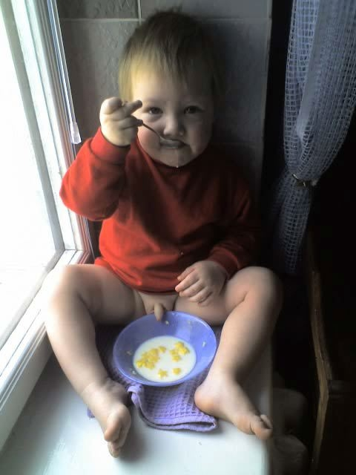
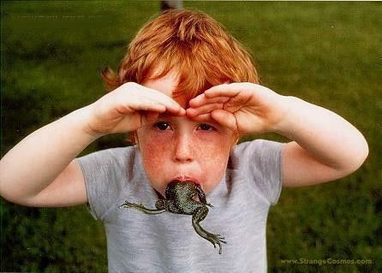
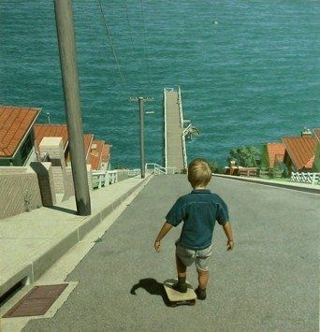

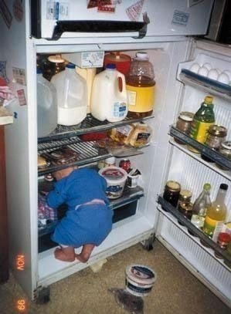
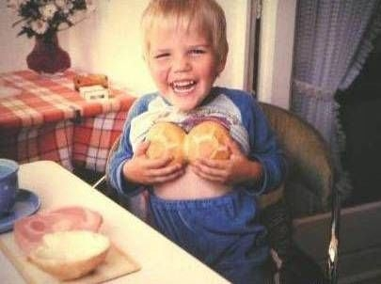
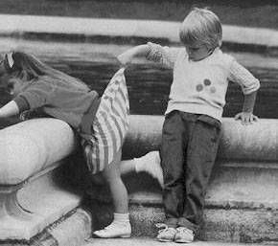
Boys will be boys?

Slide 2
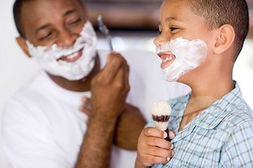
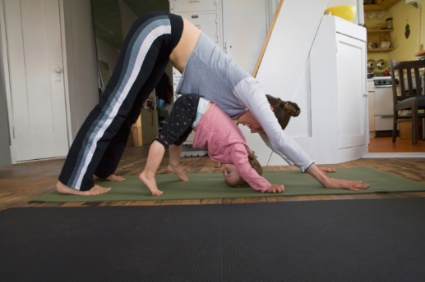
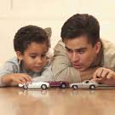
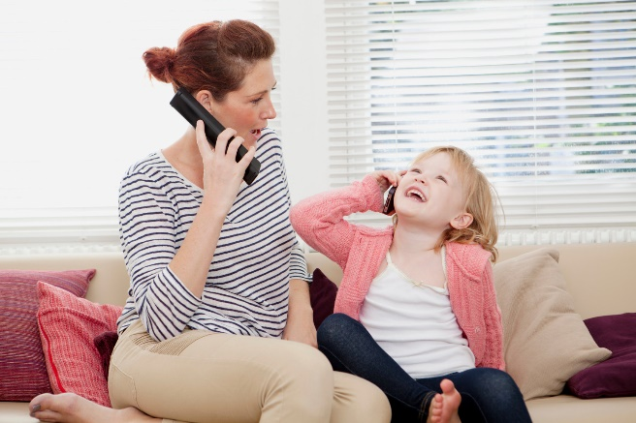
Social Learning Explanation for Gender Development
Specification Details:
Social Learning theory as applied to gender development

Slide 3
Learning outcomes:
Recap SLT
Identify the differences between direct and vicarious reinforcement/punishment
Watch and answer questions on Smith and Lloyd’s research into SLT of GD

Slide 4
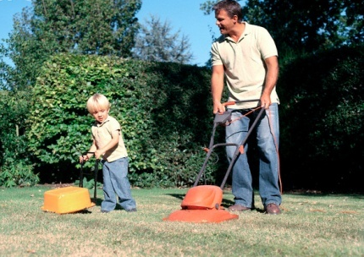
What do we already know about the Social learning theory?
On your write down the key terms you need to know for SLT
What are the mediational processes?
Discuss with a partner how these concepts can be applied to understanding gender development.
Notes:
Go through it as a class

Slide 5
Social Learning Theory
SLT is one of the two learning approaches covered last year, the other being Behaviourism.
SLT is a way of explaining behaviour that includes both direct and indirect reinforcement. It combines learning theory with the role of cognitive factors
SLT acknowledges the social context in which learning takes place

Slide 6

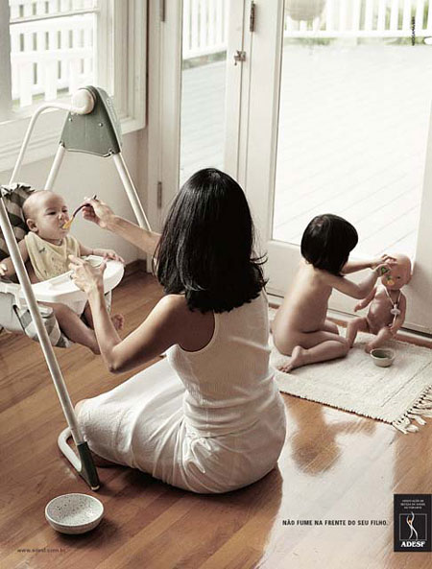

Significant others
Children see, children do
The environment is important in shaping gender development – this includes significant others that the child comes into contact with (including parents, peers and teachers, etc.)

Slide 7
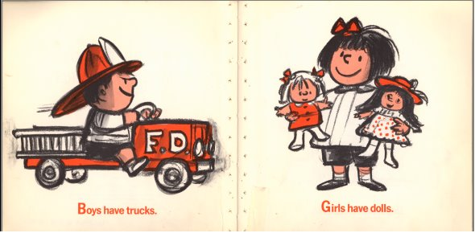
The main principles of SLT
Social learning theory proposes that we learn through observation that is watching and internalizing the consequences of other people’s actions. (vicarious learning)
Children look to ‘models’ for guidance as to how they should act and then imitate the behaviour observed.
It also suggests that gender related behaviour is learnt when children receive both direct and indirect reinforcement for the behaviour

Slide 8

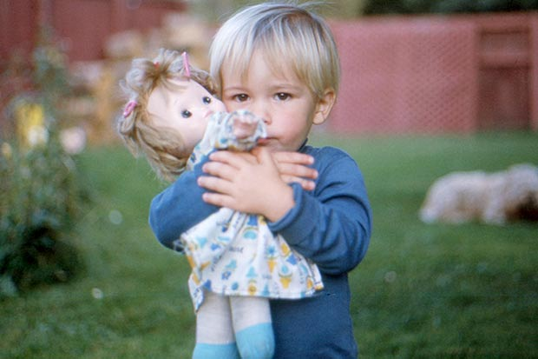

Reinforcement: positive + negative
What is positive reinforcement?
Anything that strengthens behaviour because it is rewarding to the learner, e.g. a girl receiving praise/affirmation when she is dressed as a princess
What is negative reinforcement?
Anything that strengthens behaviour because it stops an unpleasant experience, e.g. boy repeatedly teased for long hair, so he cuts it short and the teasing stops, so he keeps his hair short.
Differential reinforcement describes the way boys and girls are reinforced for showing gender appropriate behaviours

Slide 9
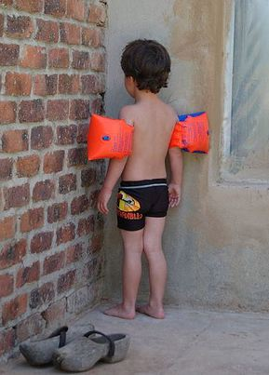
Reinforcement: direct and vicarious
Children are more likely to be praised for gender appropriate behaviours (differential reinforcement)
They are unlikely to continue to reproduce a behaviour that has been punished (direct)
They are also unlikely to reproduce a behaviour where the role-model has a negative experience (vicarious);
Identification is important too. Children select role models who they identify with and want to be like.
Notes:
Examples from p65 of the textbook.

Slide 10
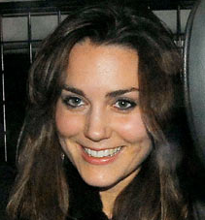
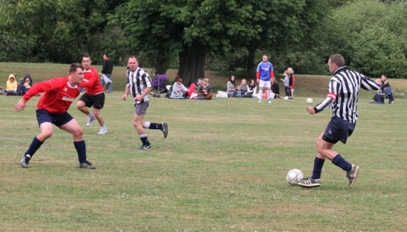

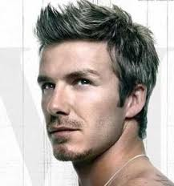
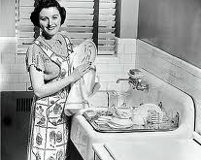
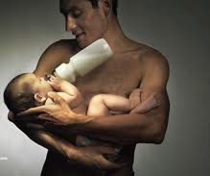
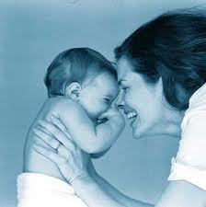
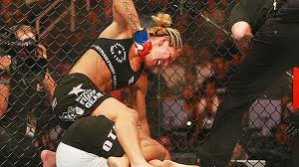
Gender is developed by….
…identifying with people who model gender behaviour. Identification refers to the process whereby a child attaches himself or herself to a person who is seen to be ‘like me’ or because a person is like someone ‘I want to be’.
Not all behaviour is imitated. There needs to be some quality or characteristic in the role model that a person wants to imitate. Individuals tend to identify with same-sex role models (Bussey & Bandura, 1984).
Notes:
Anyone can model behaviour. It can be family members, peers, sports personalities characters from TV. At the same time not everyone is a role model, there needs to be something about the role model that the person imitating the behaviour identifies

Slide 11

Mediational processes
Attention - the behaviour has to be noticed
Retention – The behaviour has to be remembered
Motivation – the behaviour will be copied if the child is motivated to do so – i.e the behaviour is perceived to be cool/rewarding in some way
Motor Reproduction – br physicalaly cable of copting th te behaviour
Self-Efficacy - the belief that you are able to copy the behaviour yourself

Slide 12
According to the SLT explanation of gender, the following factors influence gender development
Any feature in society e.g. the media, peers, parents
Reinforcement of gender appropriate behaviour
Identification

Slide 13
The SLT definition of identification is the process by which a child attaches themselves to a person who is seen to possess qualities the child regards as rewarding
True
False

Slide 14
The SLT definition of identification is the process by which a child attaches themselves to a person who is seen to possess qualities the child regards as rewarding
True
False

Slide 15
Indirect reinforcement is copying someone else’s behaviour after seeing them rewarded for their behavior.
This is also described as
___________________

Slide 16
Smith and Lloyd (1980) study
Watch the video and consider these questions:
What do the adults blame their actions on?
Is it only men or only women who choose gender specific toys?
Were they surprised at what they did?
How can this relate to SLT?
You can use this study as supporting evidence for SLT of GD
Notes:
https://www.youtube.com/watch?v=nWu44AqF0iI

Slide 17
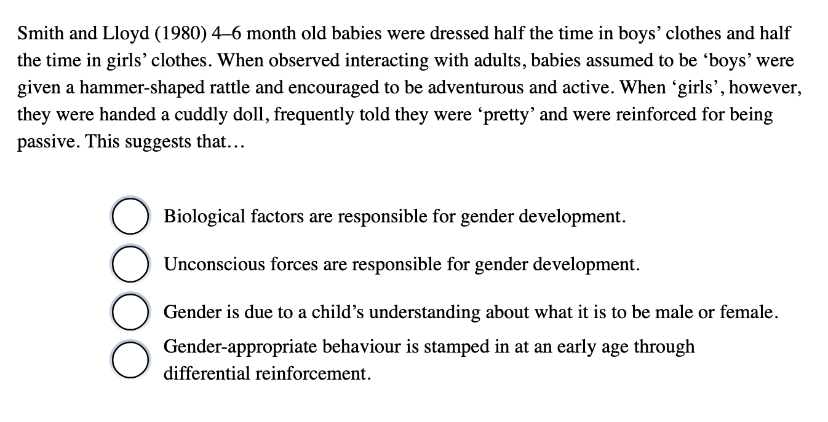

Slide 19
Other supporting studies
Siegal (1987) – found boys adopted gender ‘appropriate’ behaviour faster than girls as they were more likely to be directly reinforced for this by their fathers.
Fagot (1985) found children as young as 21 months made fun of other children for playing with the “wrong” gender specific toys!
Sroufe (1993) Found children who fail to play in gender sterotyped ways were least popular with their peers

Slide 20
However!!
Maccoby and Jacklin (1974) found no evidence that children were rewarded for competitive and aggressive behaviour. In fact this behaviour was usually discouraged.
These findings suggest that ‘testosterone’ may override what boys are taught at home!

Slide 21
Other evaluation issues
Western Society is becoming more androgynous – this can be better explained through SLT than through changing biology. ☺
However,
A weakness of the SLT explanation is that it does not take into account that children gradually become more interested in copying gender appropriate behaviour as they mature. The influence of age and maturation on the learning of gender concepts are not explicitly accounted for in the SLT explanation of gender development. ☹

Slide 22
Comparison with the biological approach
The SLT (nurture) explanation does not take into account the affect of genes and hormones on gender development.
David Reimer’s story demonstrates that nurture alone cannot account for gender identification. It was not possible to raise a biological boy as a girl and override chromosomal influences.
Therefore a bio-social (interactionist) explanation is better.

Slide 23
Bio –social explanation of gender
Modern researchers now accept that there are innate biological differences between boys and girls that are then reinforced through social interaction and cultural expectations.

Slide 24
Comparison with the Psychodynamic approach
Freud would agree with SLT about the importance of same sex role models. However Freud focusses on the parents whilst SLT sees the importance of a wide range of role models.
Whereas SLT describe the conscious mediational processes in gender development, for Freud these processes are largely unconscious.

Slide 25
Exam question
Steve and Sue are non identical twins. Steve’s bedroom is painted blue, he likes playing football and his favourite television programme is Formula 1 racing. Sue’s bedroom is painted pink, she likes dancing and her favourite film is Sleeping Beauty.
Use explanations of gender behaviour from the Learning and Psychodynamic Approach to explain why Steve and Sue behave differently.
[4 marks ]

Slide 26

Activity
Describe the research of Perry and Bussey (1979) . you can use your textbook.
What could you use their findings to support?
Then complete exercise 6.15 and 6.16 in the PHG gender pack

Slide 27
Homework
Plan an answer to this question
Discuss social learning explanations of gender development, as part of your evaluation make some reference to the biological and psychodynamic explanations of gender development (16 marks)

