Slide 1
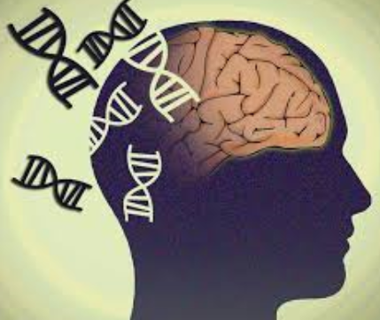
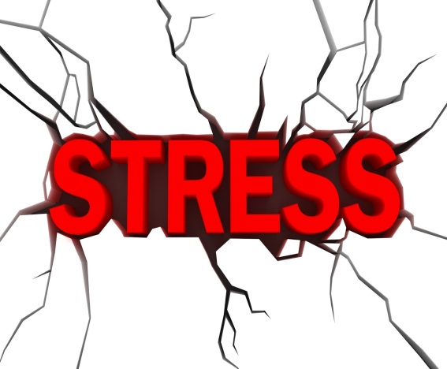
An Interactionist Approach
Specification details:
The importance of an interactionist approach in explaining and treating schizophrenia: The diathesis-stress model

Slide 2
What the spec says…
Classification of schizophrenia. Positive symptoms of schizophrenia, including hallucinations and delusions. Negative symptoms of schizophrenia, including speech poverty and avolition. Reliability and validity in diagnosis and classification of schizophrenia, including reference to co-morbidity, culture and gender bias and symptom overlap.
Biological explanations for schizophrenia: genetics, the dopamine hypothesis and neural correlates.
Psychological explanations for schizophrenia: family dysfunction and cognitive explanations, including dysfunctional thought processing.
Drug therapy: typical and atypical antipsychotics.
Cognitive behaviour therapy and family therapy as used in the treatment of schizophrenia. Token economies as used in the management of schizophrenia.
The importance of an interactionist approach in explaining and treating schizophrenia; the diathesis-stressmodel.
Pages 212-213 PHG

Slide 3


The Interactionist Approach
  Acknowledges there are biological, psychological and societal factors in the development and maintenance of Sz.
  Biological = genetic vulnerability and
  neurochemical and neurological abnormality
  Psychological = stress resulting from life events including poor quality interactions in the family

Slide 4
The Diathesis-Stress Model
A vulnerability to Sz and a stress-trigger are necessary to develop Sz
One or more underlying factors make a person vulnerable but the onset of the condition is triggered by

Slide 5
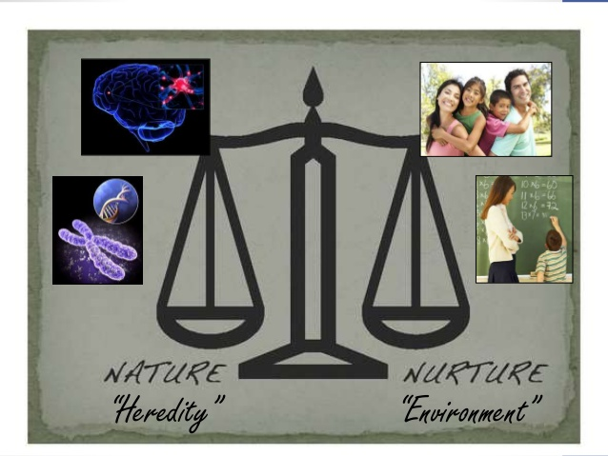
The Diathesis-Stress Model
Symptoms of SZ are triggered or made worse when significant stressors in a persons life when combined with ‘bio’ vulnerability.
SZ is result of combination of psychological and environmental and Bio/genetic influences
Stress
Diathesis
Explains why not all people who have a genetic predisposition go on to develop the disorder

Slide 6
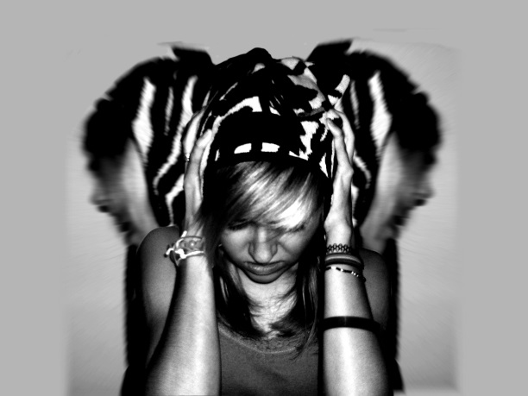
Meehl’s Model
Believed diathesis was entirely genetic, the result of a single ‘schizogene’
This led to the development of a biologically based schizotypic personality, one characteristic is sensitivity to stress
According to Meehl, if a person doesn’t have the schizogene then no amount of stress would lead to Sz.
However, in carriers of the gene, chronic stress through childhood and adolescence, particularly a schizophrenic mother could result in Sz

Slide 7
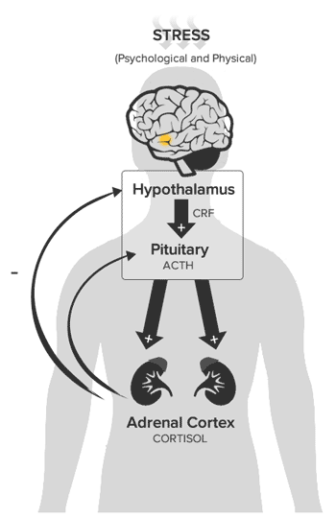
Modern Understanding of Diathesis
Now clear that many genes increase genetic vulnerability. There is no single ‘schizogene’
Modern views of diathesis also include a range of factors beyond the genetic, including psychological trauma – trauma becomes the diathesis rather than the stressor
Read (2001) proposed a neurodevelopmental model in early development in which early trauma alters the developing brain. E.g. The hypothalamic-pituatry-adrenal system (HPA) becomes over-active and the person is more vulnerable to later stress

Slide 8
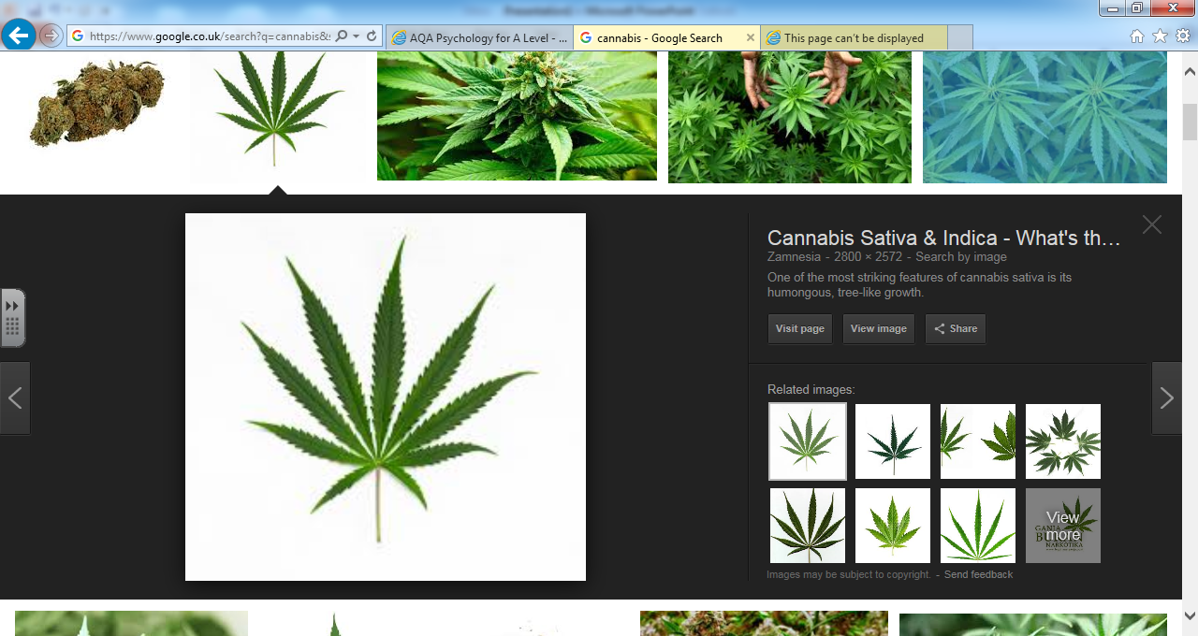
Modern Understanding of Stress
Originally stress was seen as psychological in nature, in particular related to parenting
Psychological stress is still seen as important, a modern definition of stress includes anything that risks triggering Sz e.g. cannabis
Cannabis is a stressor because it increases the risk of Sz (x7) as it interferes with the dopamine system
However most people don’t develop Sz after smoking cannabis so there must be other vulnerability factors
Interesting article: https://www.ncbi.nlm.nih.gov/pmc/articles/PMC2632429/
Remember, you can read the abstract to get a good idea as to what the research did and found. Please at least read the abstract.

Slide 9
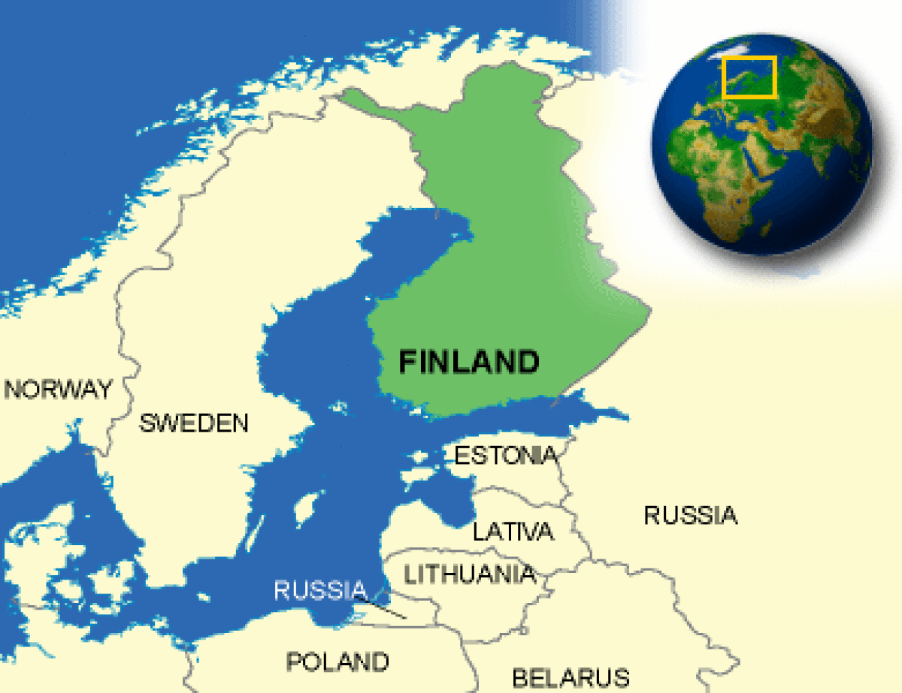
A03 – Evidence for the role of vulnerability and triggers
Tienari (2004) investigated the combination of genetic vulnerability and parenting style (the trigger).
Sample: Children adopted from 19,000 Finnish mothers who had Sz between 1960-1979 and a control group of adopted children.
A child-rearing style of high levels of criticism and conflict and low levels of empathy was implicated in the development of sz but only for the children with high genetic risk but not in the control group.
This suggests that both genetic vulnerability and family stress are important in development of Sz – genetically vulnerable children are more sensitive to parenting behaviour

Slide 10
A03 - We don’t know exactly how diathesis and stress work
Strong evidence to suggest some sort of underlying vulnerability coupled with stress can lead to sz
Also have well informed suggestions for how vulnerabilities and stress might lead to symptoms
However, we do not yet fully understand the mechanisms by which the symptoms of sz appear and how both vulnerability and stress produce them

Slide 11


Treatment
The interactionist approach also acknowledges both biological and psychological factors is compatible with both types of treatment
Model combines antipsychotics with psychological therapies such as CBT
Standard practice in UK is to combine the two and is unusual to treat using psychological therapies alone

Slide 12


A03 – Support for combinations of treatments
Tarrier (2004) 315 patients were randomly allocated to a medication + CBT group, medication + supportive counselling or a control group
Patients in the two combination groups showed lower symptom levels than control, although there were no difference in rates of hospital readmission
This and other studies show there is clear advantage to adopting an interactionist approach

Slide 13

Outline the diathesis-stress model of schizophrenia.
(6 marks)
Checkpoint….
Work with a partner to complete the question to check you are ok with the content you have just covered

Slide 14
Develop an evaluation for this approach (explanation and treatments) using as many resources as possible
Consider:
- evidence for the role of vulnerability and triggers
- is the model over simplified? Any evidence?
- does it fully explain everything or are there limitations?
- is a combination of therapy the most effective? Any research to support this idea?

Slide 15
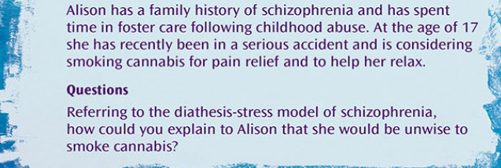
Apply it: Alison

Slide 16
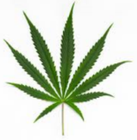
Possible answer
1 diathesis factor
Another diathesis factor
Psychological stress
Cannabis use can lead to Sz (bio)
Alison has at least two diathesis factors; her family history of Sz and her own history of child abuse. She has also suffered psychological stress in the form of an accident. Cannabis is believed to be a biological stress factor increasing the likelihood of developing Sz. If the person has a genetic vulnerability it can increase their chances of developing Sz by 7 times. Alison would be very unwise to introduce another stressor as this could increase her chances of developing Sz.

Slide 17
Apply it: The interactionist approach
In the article by Houston et al (2008) regarding cannabis and Sz, the participants responded to a survey; 543 reported a childhood sexual trauma and 643 reported using cannabis before the age of 16.
1. is the data above quantitative or qualitative? Explain your answer (2 marks)
2. Surveys can involve questionnaire or interview. Outline one advantage of using a questionnaire to gather this data (2 marks)
3. what is a closed question? (1 mark)
4. why might a closed question be used here? (2 marks)
5. explain one ethical issue with the study (2 marks)

Slide 18
Suggested answers to Houston et al (2008) questions
A survey of diathesis
is the data above quantitative or qualitative? Explain your answer (2 marks)
  This data is quantitative. Quantitative data is in the form of numbers, which is clearly the case here.
Surveys can involve questionnaire or interview. Outline one advantage of using a questionnaire to gather this data (2 marks)
  Questionnaires are more anonymous than interviews. When gathering information on sensitive topics like experiences of child abuse or drug taking, participants are more likely to give honest answers if they feel they have anonymity
what is a closed question? (1 mark)
  A closed question is one requiring a short answer, for example yes or no.
why might a closed question be used here? (2 marks)
  Closed questions have the advantage in this study that it is easy to produce headline figures such as a percentage of participants who have smoked cannabis.
explain one ethical issue with the study (2 marks)
  This study deals with very sensitive data. Participants must therefore be assured of confidentiality. This right is covered by data protection law.

Slide 19

Essay question
Describe and evaluate the interactionist approach to both explaining and treating schizophrenia.
(16 marks)

Slide 20
Extension Material

Slide 21
Interesting websites
http://www.schizophrenic.com/articles/schizophrenia/diathesis-stress-theory
http://flowpsychology.com/diathesis-stress-model-of-schizophrenia/ - this has a good video as well. Looks at anxiety

Slide 22

Diathesis-stress & anxiety
http://flowpsychology.com/diathesis-stress-model-of-schizophrenia/
Nice article and mini film

