Slide 1
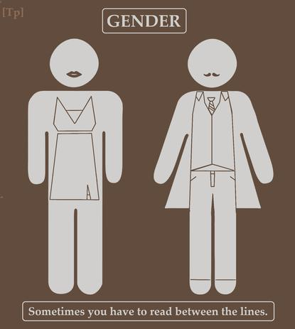

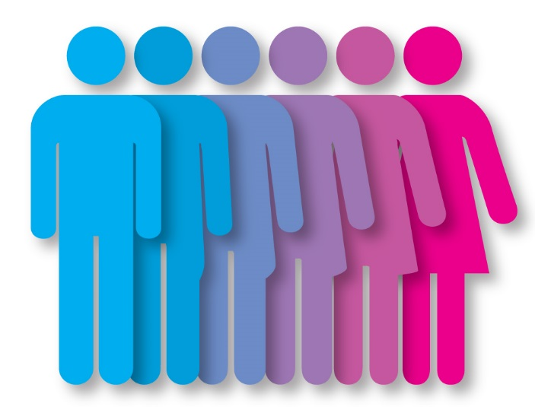
GENDER
Paper 3: Options

Slide 2
What do we need to cover: spec check
Sex and gender. Sex-role stereotypes. Androgyny and measuring androgyny including the Bem Sex Role Inventory.
The role of chromosomes and hormones (testosterone, oestrogen and oxytocin) in sex and gender. Atypical sex chromosome patterns: Klinefelter’s syndrome and Turner’s syndrome.
Cognitive explanations of gender development, Kohlberg’s theory, gender identity, gender stability and gender constancy; gender schema theory.
Psychodynamic explanation of gender development, Freud’s psychoanalytic theory, Oedipus complex; Electra complex; identification and internalisation.
Social learning theory as applied to gender development. The influence of culture and media on gender roles.
Atypical gender development: gender identity disorder; biological and social explanations for gender identity disorder.

Slide 3
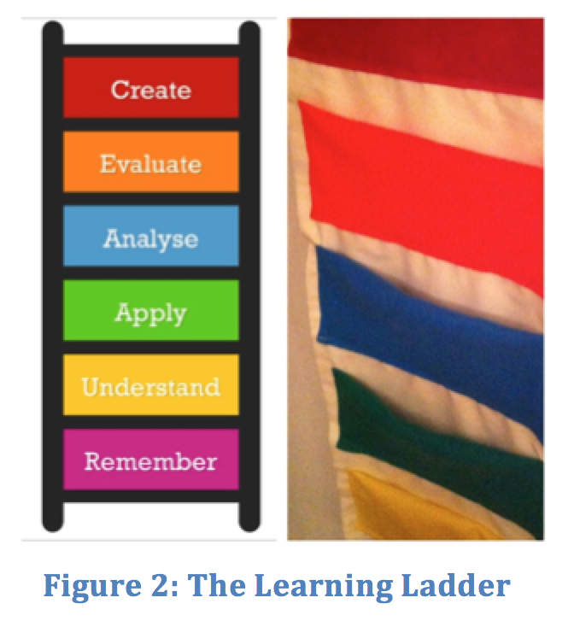
Lesson Objectives:
Define key terms using own knowledge
Consider and develop ideas as to what femininity and masculinity means
Using real life examples, apply ideas to the real world

Slide 4
Key question … linking to a debate
Are we born knowing we are male or female?
Or
Is our sense of maleness and femaleness the product of our upbringing?
Is gender the product of Nurture?
Is gender the product of Nature?

Slide 5

Starter
In pairs, can you try to define the following:
Sex
Gender
Masculinity
Femininity
Androgynous
Gender Identity Disorder
Swap your ideas with another pair …. Is there anything you can add to their ideas? anything you disagree with?

Slide 6

Sex: biologically male or female
Gender: psychological characteristics that relate to male and female
Masculinity: characteristics typically associated with males
Femininity: characteristics typically associated with females
Androgynous: male and female characteristics are BALANCED in one individual – “genderless”
GID- when a person’s biological sex and gender identity don’t match

Slide 7
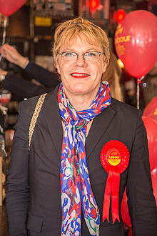

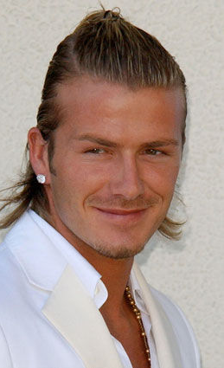
This Photo by Unknown Author is licensed under CC BY-SA
This Photo by Unknown Author is licensed under CC BY-SA
This Photo by Unknown Author is licensed under CC BY-SA

Slide 8
Task 1: exploring stereotypes – masculinity and femininity
Read the PHG hand out front page with 3 stories
What do they teach children about gender roles?
What do the teach us about stereotypes?

Slide 9
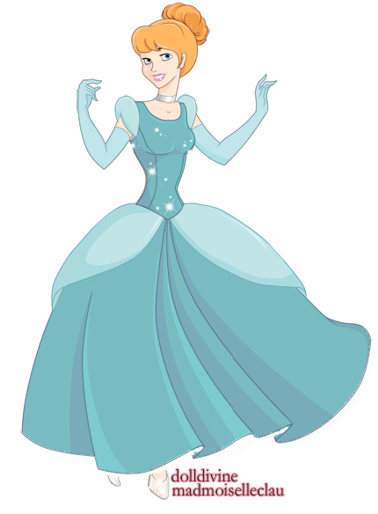
Cinderella…some thoughts!
Cinderella is seen as a fragile and powerless girl because she is very obedient to her stepsisters and does not stand up to the way that she is mistreated by them despite her father owning the house they live in.
She cooks and cleans and does what they ask of her and acts like their servant.
When she goes to the ball she has to wear a beautiful dress to attract the prince as this is seen as the only way to attract a man. Beautiful women are seen as weak and complying in the story whereas men are powerful and superior to women.
Powerful women are ugly like the stepmother.
The men are the ones with the money and women are seen as all wanting to marry the prince because he is wealthy so they all want to try on the slipper so that if they do marry the prince they will have security because women are seen as being incapable of being independent.

Slide 10
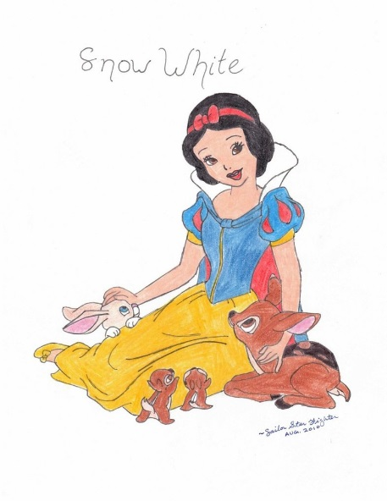
Snow White….
Snow White is seen as a beautiful and kind but very naïve woman.
Beauty is seen as very important unlike other characteristics a woman could possess such as intelligence. Snow White takes the role of cooking and cleaning for the dwarves to keep her safe because of the security they will provide for her.
Therefore, a woman is domesticated and cooks and cleans whilst the dwarves’ (who are all men) role is to guard her from harm.
When Snow White fails to obey the dwarf’s instructions about not letting in strangers Snow White gets harmed by the queen.
Females are seen as weak and are expected to obey the rules of men or they will come to harm.
Women need to be rescued by a man and get married to be happy.

Slide 11
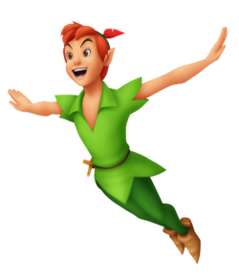
Peter Pan
Mr Darling is a businessman and provides all the money in the household and is seen as superior to his wife.
He demands respect and obedience.
When his wife comes to him worried about Peter Pan, he dismisses her worries. Mrs Darling is very compliant to her husband. Peter is a strong male figure who protects the lost boys.
Wendy is asked to be mother to the boys in Neverland showing females are ideal for caring activities like putting the boys to bed.

Slide 12
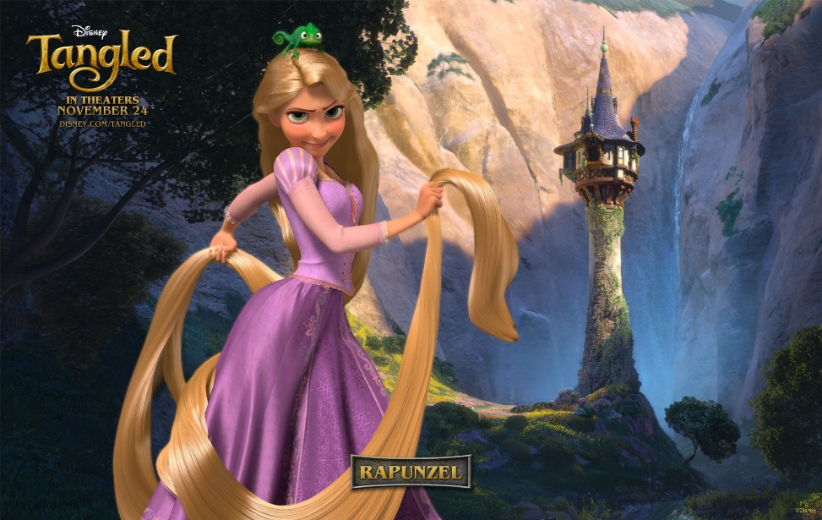
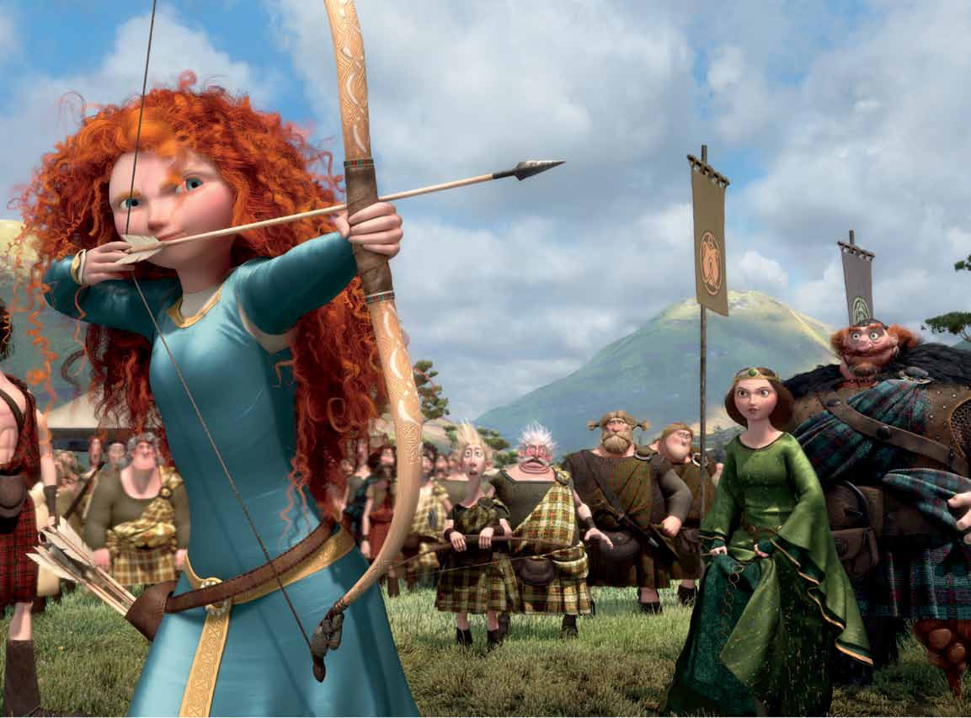
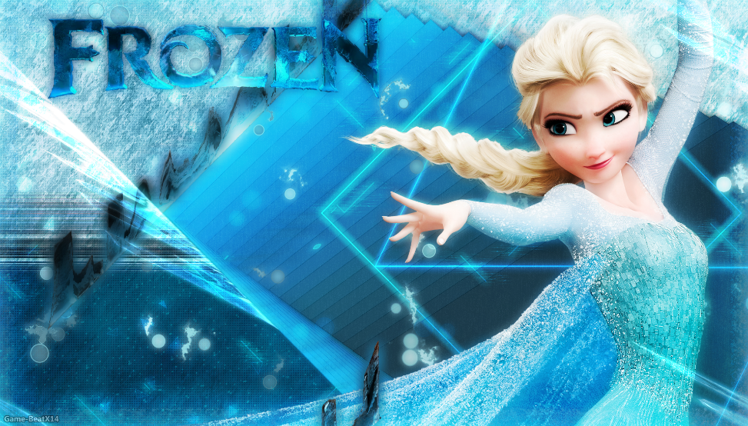
Think of more recent Disney films / stories
Are children still taught these values?
Brave
Tangled
Frozen

Slide 13
Stereotypes
Sex role stereotypes are social/cultural expectations of how males and females should behaved.
Some have a basis in reality, BUT some make incorrect assumptions and can lead to sexist and damaging attitudes.
Research confirms sex-role stereo typing in the media
Furnham and Farragher (2000) looked at adverts and found that females are often shown in family situations, whereas males are shown in more professional contexts

Slide 14

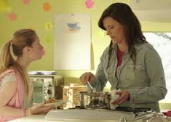

Slide 15
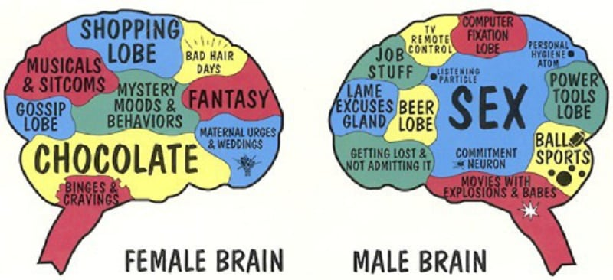

Slide 16
Are there gender stereotypical job roles?
In pairs come up with at least 6 different jobs that are stereotypically either male or female
Female
Nursing
Teaching
Psychologist
Childcare
Male
Surgeon
Dustman
Engineers Management
Accounting
Lawyers
Soldier
999 Services
Football players
Anything else that we gender stereotype?
Colours? Clothes? Toys? Play – role-play ?
A-Level subjects? Drinks? Food?

Slide 17
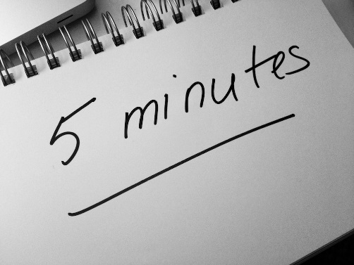
What about adverts?
In pairs you have a copy of an advert from the 50s
You need to analyse in terms of sex role stereotyping
2 minute talk to the group on your advert and your analysis of it.
Do we think advertising in 2019 is much different – are sex-role stereotypes still prevalent?
H/W: bring an advert to the next lesson which demonstrates a reinforcement of, or challenge to sex-role stereotypes

Slide 18
Androgyny
In pairs have a go at exercise 6.2 PHG pack
50 males and 50 females (all from USA) judged 200 traits in terms of gender desirability. The top 20 in each case were used for BSRI.
A pilot study of 1000 students confirmed the BSRI reflected their gender identity. (=valid)
On retest later ppts scored similarly (= good test-retest reliability)

Slide 19

Task 2: Androgyny
Some one who is androgynous has a BALANCE of male and female characteristics.
Bem saw this as a positive attribute.
Take the Bem Sex Role Inventory (BSRI) – you do not need to share your results unless you want to!
BSRI has 60 questions and is measured on a 7 point scale
20 masculine 20 feminine 20 neutral characteristics

Slide 20
Categorisation
Masculine = high score on masculine and low score on feminine
Feminine = high score on feminine and low score on masculine
Androgynous = high score on both masculine and feminine
Undifferentiated = low score on both masculine and feminine

Slide 21
Evaluation
BSRI is both valid and reliable according to BEM’s own findings.
BUT questionnaires ever be free of demand characteristics and people giving socially desirable answers?
Can gender identity really be measured as a single score? Maybe it is more complex, the person will be affected by their own interests and abilities and can be affected by cultural values.
BSRI was developed in USA
BSRI was developed 40 years ago

Slide 22
Task
Read pages 148-149 PHG digital text book
Read about the Batista Boys !! Then…..
1. Describe one study that illustrates the difference between sex and Gender (4 marks)
2. Patrick works as a head baker in a bakery. As part of a work appraisal he has just completed the Bem Sex Role Inventory. His score shows that he is highly androgynous.
Explain how Patrick’s high level of androgyny might be demonstrated in his behaviour at work. [4 marks]

Slide 23
In 1993, a book about gender was published in New Haven. The book was written by Sandra L Bem from Cornell University. The title was ‘The lenses of gender: transforming the debate on sexual inequality’. The book was published by Yale University Press.
A researcher needs to modify the above information to include Bem’s book in the references section of a scientific report.
Write the full reference for this book as it should appear in the reference section of the researcher’s report.
[2 marks]

Slide 24
Explain what is meant by ‘androgyny’. [1 mark]
Read the item and then answer the questions that follow.
In a study of androgyny, a group of 100 18-year-old students completed a self-report sex-role inventory. The inventory gave two sets of scores: a femininity score and a masculinity score. Each set of scores was on a scale of 0–20, with 0 representing no masculinity or no femininity and 20 representing extreme masculinity or extreme femininity.
The researchers calculated measures of central tendency for the masculinity scores. They found that the mean masculinity score was 10.3, the median masculinity score was 9.5 and the mode masculinity score was 7.
Sketch a graph to show the most likely distribution curve for the masculinity scores in this study. Label the axes of your graph and mark on it the positions of the mean, median and mode. [3 marks]
What sort of distribution does your graph show? [1 mark]
Explain one limitation of a self-report technique. [2 marks]

Slide 25
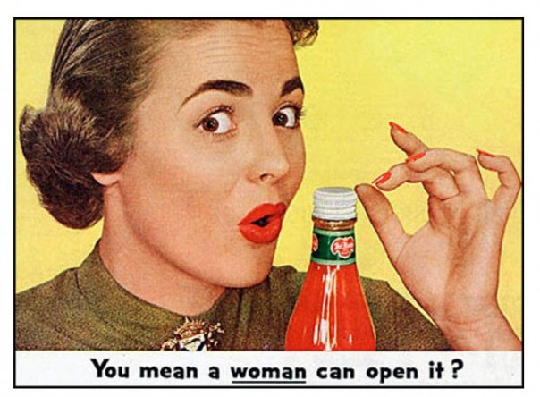

Slide 26
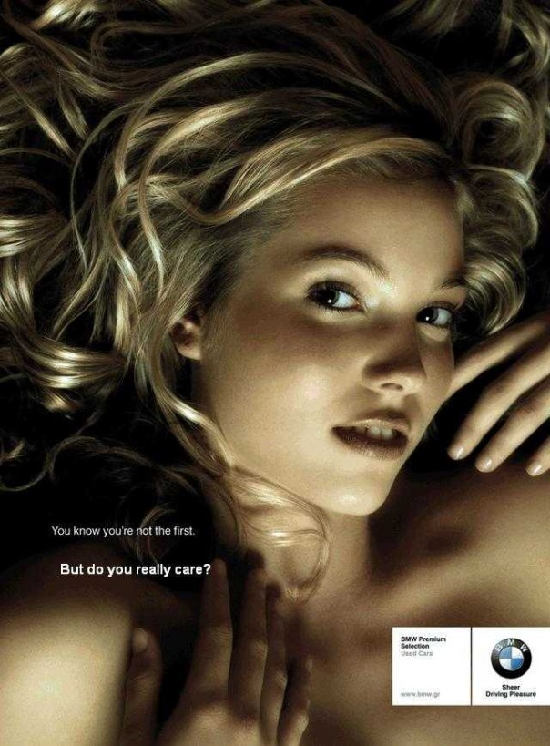
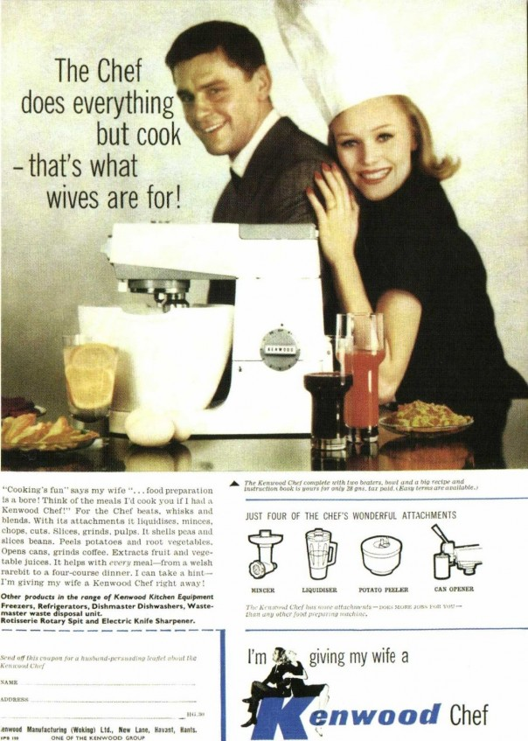

Slide 27
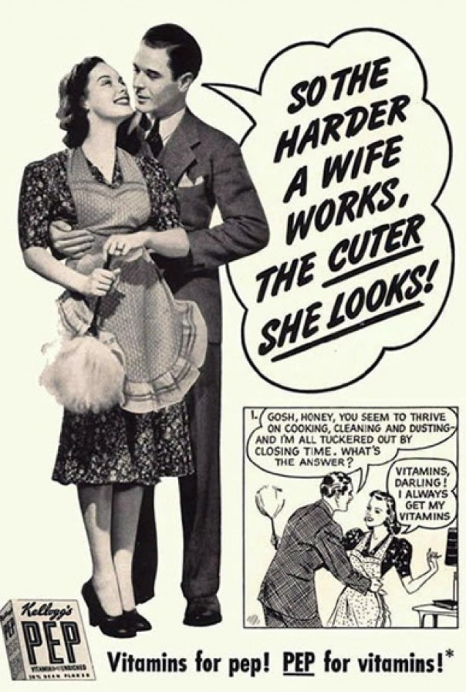
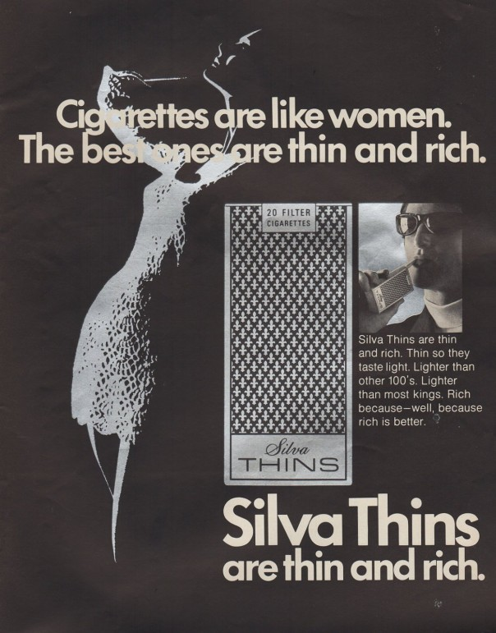

Slide 28
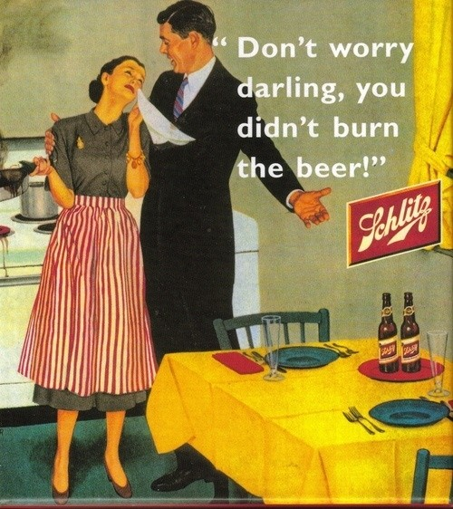
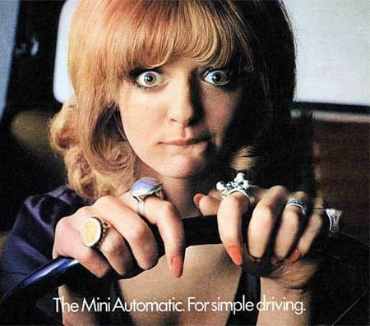

Slide 29
