Slide 1
Psychological explanations…
Learning approach
STARTER:
How might the learning approach explain criminality?

Slide 2
Differential association theory
Definition: An explanation for offending which proposes that individuals learn criminal behaviour through interaction with others.
They learn the values, attitudes, techniques and motives for criminal behaviours.
WHO might they learn this from?
Family
Friends
Media

Slide 3
Edwin Sutherland
1924 – attempt to set scientific principals to offending
“the conditions that are said to cause crime should be present when crime is present, and absent when crime is absent”
His aim was to discriminate absolutely between criminals and non criminals regardless of race, class or economic background.
WHY might such a theory be useful to society?

Slide 4
Sutherland’s differential association theory
Crime is a learned behaviour
This occurs most often with interactions with significant others (family, close friends.
There’s 2 parts to his theory:
Learned attitudes towards crime
Social transmission of values, motivations & rationalisations for committing a crime.
Learning of specific criminal acts
Such learning involves the development of both the techniques required to commit the crime, such as the delicate touch of a pickpocket.

Slide 5
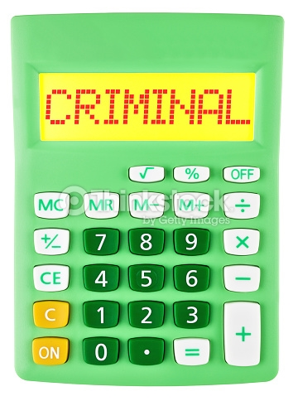
Learned attitude towards crime
Pro-criminal attitude = criminality
Sutherland argues if the number of pro-criminal attitudes a person acquires outweighs the number of anti-criminal attitudes, then they will go on to offend.
DA suggests that we should be able to carry out a simple calculation to predict the likelihood of someone committing a crime, all we need to know is:
The frequency, intensity & duration of their exposure to criminal & non-criminal norms and values.
Would this be simple?? How could we find this out??
But what would a positive of this approach be?
Numeric, objective, strong application to preventing crime.

Slide 6
Learning of specific criminal acts
In addition to learning about WHY they might want to commit a crime, criminals may also learn HOW to carry out crimes.
E.g.
how to break into someone's house through a locked window,
how to spot the signs of an empty house, or
the delicate touch of a pickpocket.
This can help explain re-offending when people are released from prison as they learn specific techniques from inmates.
Learning can happen through observation & imitation, or direct tuition.

Slide 7
Evaluation
SUMMARISE THE FOLLOWING
Farrington et al. (2006)
Explanatory power
Difficulty of testing
Alternative explanations (mendick)
Individual differences.

Slide 8
Plenary
What explanations have we looked at so far?
Predict what the psychodynamic explanation might say.

