Slide 1
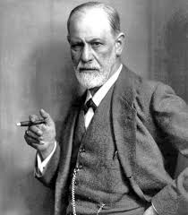
Psychological explanations- psychodynamic Explanation
What would Freud say ?

Slide 2
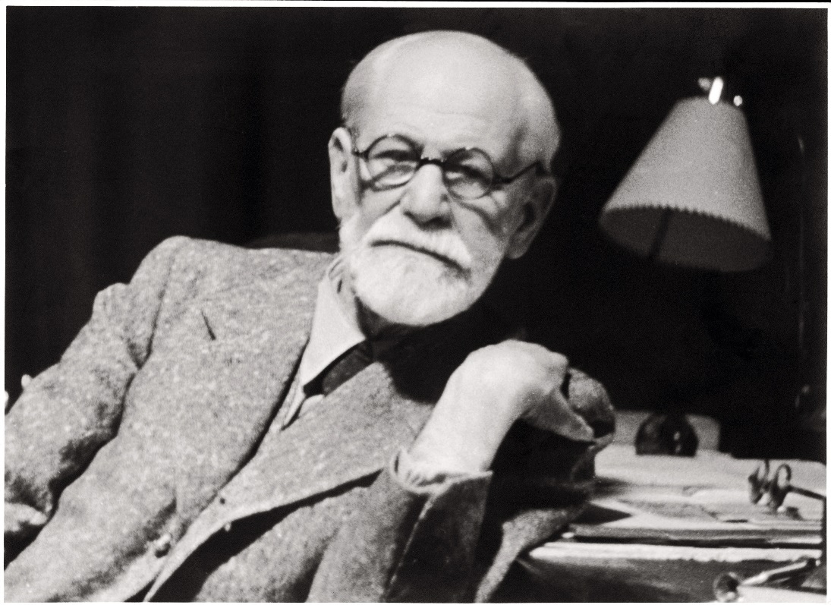
3 aspects to the personality
Freud suggested that there are 3 aspects to the personality
The id
The ego
The superego

Slide 3
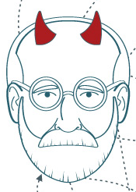
The id
You are born with this part of the personality and it therefore develops first
It is the instructive part of our personality – it can be very demanding!
It is often referred to as the “I want”
An infant will demand for its needs to be satisfied
It is important to know that the id works on the pleasure principle
Notes:
I want it now... not worries about the consequence
Food
Nappy change
etc

Slide 4

The ego
The ego develops next
It is the rational part of the personality because it works on reality principles
The ego tries to satisfy the needs of the id (I want) with realistic ways to achieve these desires
Notes:
The ego is YOU.. tries to meet the needs of the id, by getting the food etc

Slide 5
The superego
The superego develops last, around 4 years old
It works on the morality principle
It’s the “you can’t have that” part of the personality
The superego is your conscience given to you by parents, rules, society etc.
Notes:
Example:
Eating healthy in a supermarket
Spontaneous decisions…you weigh up the cost. What spontaneous decisions have you made recently?

Slide 6
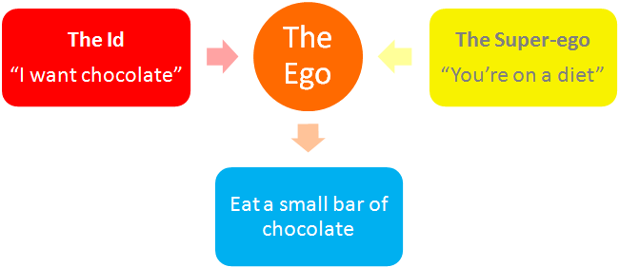
It is the job of the ego to find a balance between the id and the superego

Slide 7
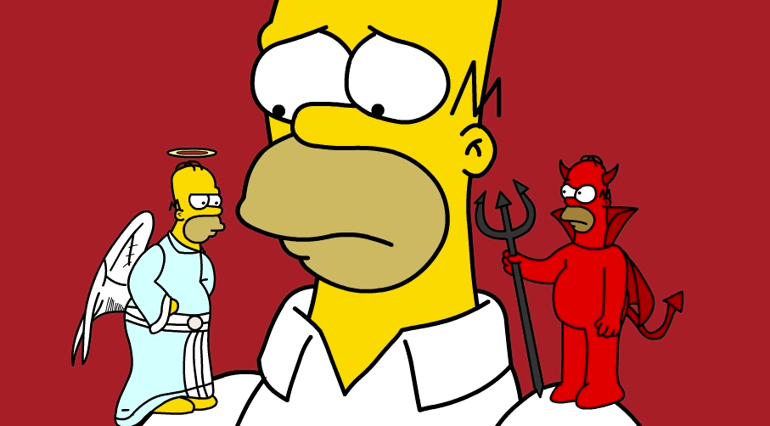
Explaining criminality
“Inadequate” Superego says Blackburn (1933)
The superego punishes the ego with feelings of guilt for wrong-doing, and rewards it with feelings of pride and satisfaction ☺ for ‘good’ behaviours.
Blackburn suggests that in criminals the Superego is weak or deficient.
The superego can be inadequate in 3 ways:

Slide 8
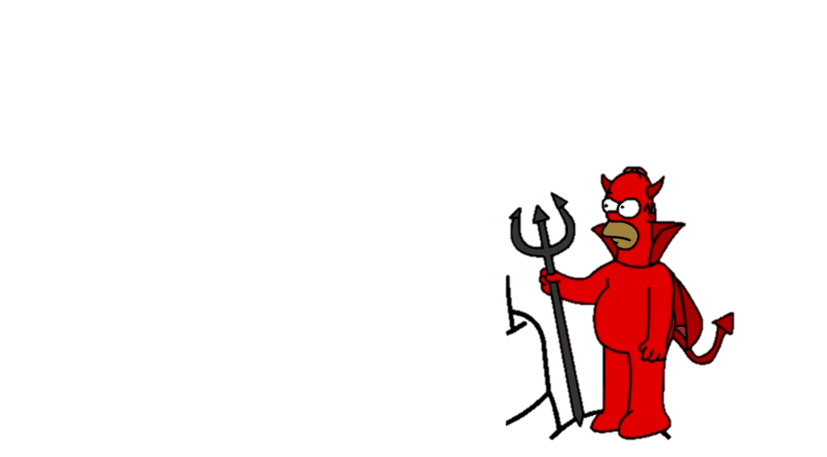
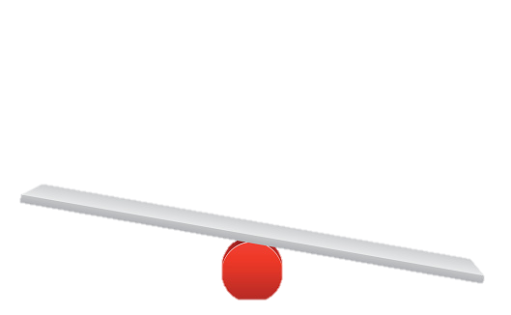
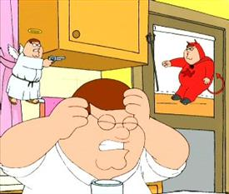
Inadequate Superego
The Weak Superego which is developed during the phallic stage. This is possibly caused by an absent same sex-parent in the phallic stage.
The Deviant Superego (possibly caused by the internalisation of an immoral superego from deviant parents)

Slide 9
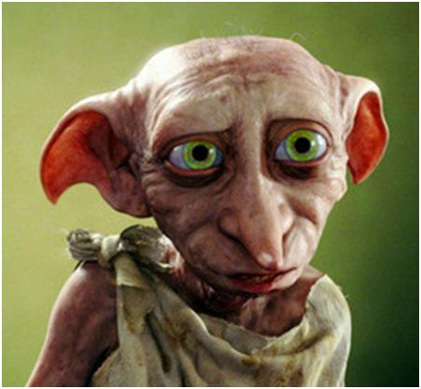

Inadequate Superego
The Strong / Over-harsh Superego - either causing the person to become anxious and guilty by nature, causing them to unconsciously seek punishment and maybe to do so by committing criminal acts. (Dobby the house elf)
OR by preventing the release of anxiety (due to guilt) through defence mechanisms which lead to unresolved conflicts. These then overwhelm the ego, and may be expressed in extreme criminal behaviour.

Slide 10
Theory number 2 –loss of attachment
A second theory focuses on the lack of a ‘mother-figure’ to attach to during infancy leading to criminal behaviour, specifically ‘affectionless psychopathy.’ (lack of empathy or guilt) and increased likelihood of delinquency.
Thinking back to attachment, which theory is this?
Who’s theory was it?
What research was done into it?

Slide 11

Maternal Deprivation
Bowlby proposed that the ability to form meaningful social relationships in adulthood was dependent on a close, warm and continuous relationship with the mother in the ‘critical period’ of the first few years. (6 months -2 ½)
Since this ‘monotropic’ relationship acts as the prototype (Internal working models/template) for all future relationships, its disruption would impair the person’s ability to relate to others.
This could result in a condition Bowlby called ‘affectionless psychopathy’.

Slide 12
Maternal Deprivation support
Bowlby (1944) ‘44 juvenile thieves study’
Reported that 39% of a group of juvenile delinquents had experienced significant disruption to their attachments, compared to only 5% of a non-delinquent group. Bowlby concluded that the effects of maternal deprivation had caused affectionless psychopathy and delinquency
Use this as an a opportunity to revise MD theory.
Note down any evaluation points. Supporting evidence etc.

Slide 13
Evaluation ☹
Because girls do not experience the castration anxiety psychodynamic theory suggests they will develop a weaker super ego.
This means they should be more likely to engage in criminal behaviour – but this is not supported by the evidence = a serious flaw in the psychodynamic explanation for offending behaviour.
Little evidence that children raised in a single parent family are less law abiding- if they are it is more likely to be explained by socialisation or genetics.
Doesn’t make sense that criminals want to be punished as they go to extreme lengths to conceal their crimes.
Freudian ideas are difficult to test empirically – these ideas can only be judged on their face value rather than their scientific worth. For this reason psychodynamic explanations are regarded as pseudo (fake) science that contribute little to our understanding of crime.

Slide 14
Evaluation ☹
Bowlby has been criticised for researcher bias in the 44 thieves study as his expectations may have influenced the interviewees.
Koluchova (1976), Hodges and Tizzard and other researchers found the effects of deprivation are not always irreversible.
Lewis (1954) analysed interviews with 500 young people and found that maternal deprivation was not correlated with offending behaviour.
Even if a correlation had been found you cannot use correlational data to demonstrate a causal relationship.

Slide 15
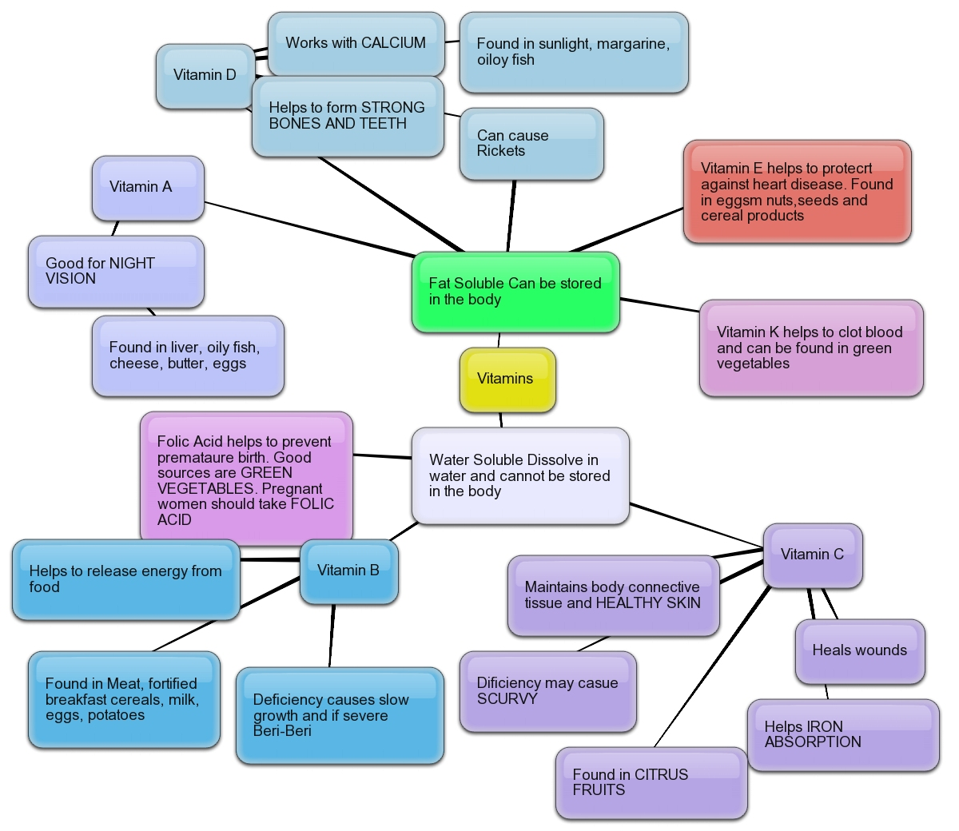
Plenary
Make a revision document (poster, mind-map, cards etc.) on the EXPLANATIONS FOR OFFENDING BEHAVIOUR

