Slide 1
We have examined some Biological explanations for criminal behaviour.
Now we are going to find out about some Psychological explanations.
Today we are learning about Eysenck's theory. He believed that personality can be measured.

Slide 2
 | Explanation | Strengths / Support | Limitations
Brain Structure | PFC
 | Amygdala
Mirror Neurons
Neurotransmitters | Dopamine Serotonin
Genetics | Twin studies
 | Adoption Studies
 | MAOA gene

Slide 3
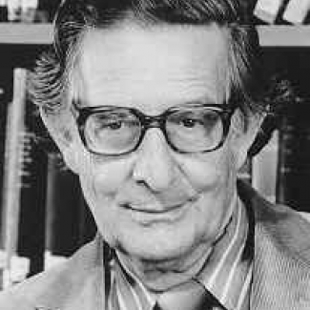
Hans Eysenck (1947): Eysenck Personality Inventory.
Eysenck developed the Eysenck Personality Inventory, a psychological test which locates respondents along the Extroversion and Neuroticism dimensions to determine their personality type. He believed that personality has an underlying biological basis . Extraverts, for example, have an underactive nervous system which means that they constantly seek stimulation through risk-taking behaviours.

Slide 4
Basic tenets of the theory
Personality/temperament is inborn/genetic.
Criminals have particular personality types.
Therefore criminality has a biological basis.
Eysenck tries to combine biological, social and environmental factors to explain criminality.

Slide 5

Psychological explanations.
Is there a Criminal Personality type?
Aim: to critically explore Eysenck’s theory of the criminal personality
Take both Eysenck personality tests in front of you of to determine your levels of extraversion and neuroticism

Slide 6
Scoring for PHG EPI (12.6)
Introvert = Q 8, 10, 13, 16,18
Extravert = Q 3, 5, 6, 14, 19
Neurotic = Q 2, 4, 7, 12, 17
Stable = Q 1, 9, 11, 15, 20

Slide 7
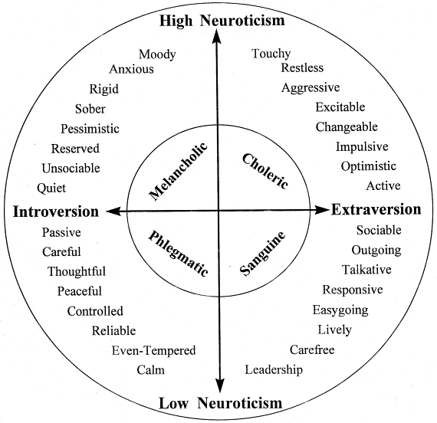
How did you score?

Slide 8
What do we mean by concurrent validity?
Assessing concurrent validity involves comparing a new test with an existing test (of the same nature) to see if they produce similar results. If both tests produce similar results, then the new test is said to have concurrent validity.

Slide 9
Concurrent validity
Concurrent validity is a concept commonly used in psychology, education, and social science. It refers to the extent to which the results of a particular test, or measurement, correspond to those of a previously established measurement for the same construct.
click
You could find out if there is a correlation between the scores you obtained on each of the tests
The correlation coefficient would need to be 0.8 or higher
What is the weakness of using a questionnaire like this to measure personality ?

Slide 10
Dimensions of personality
Extraversion/Introversion
Neuroticism/Stable
later Psychoticism was added
These dimensions of personality are measured by the EPI (Eysenck’s Personality Inventory/Questionnaire)

Slide 11
Neurotic
Extraverted
Introverted
Ambiverts
Stable

Slide 12
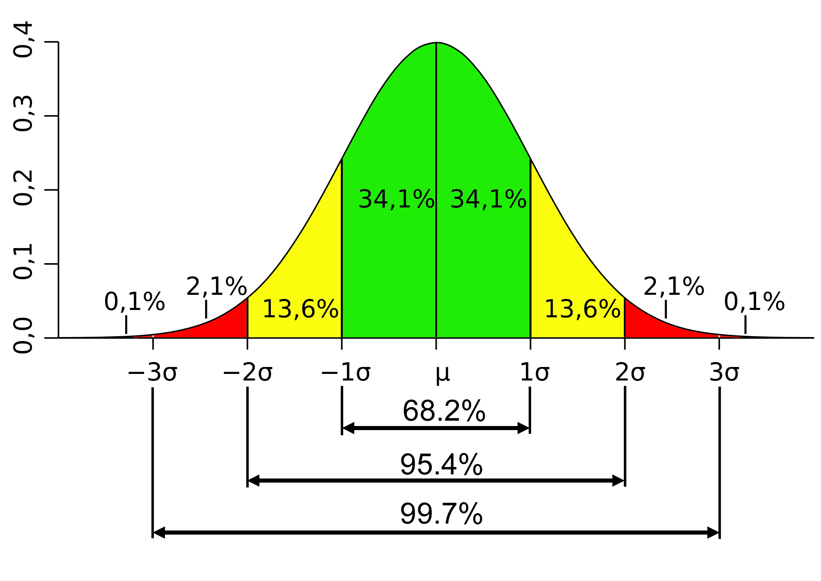
Extraversion - Introversion
Normally distributed in the population
68% of the population are ‘ambiverts’. 16% in each extreme
The extraversion trait reflects a need for stimulation, extraverts like excitement and become bored easily.

Slide 13
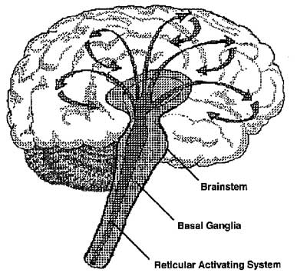
Biological basis for E-I
CNS and RAS (reticular activating system)
Extravert - RAS dampens stimulation leaving them under aroused
Introvert - RAS amplifies stimulation leaving them over aroused
They resort to different behaviours/activities to reach the same ‘optimum level of arousal’.

Slide 14

Extroversion and criminal behaviour
Criminals are more likely to be:
Thrill-seeking
Impulsive
Take chances
Less able to be conditioned to internalise society’s rules

Slide 15
Neuroticism - Stable
Normal distribution in the population
Most in average range, 16% in each extreme.
Reflects a biological predisposition to respond physiologically to a stressful situation/events.
To respond emotionally.

Slide 16
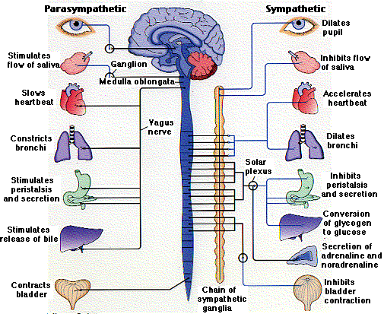
Biological basis for N-S
The ANS (sympathetic and parasympathetic) are under the control of the limbic system, most importantly, a structure of the limbic system called the hypothalamus.

Slide 17
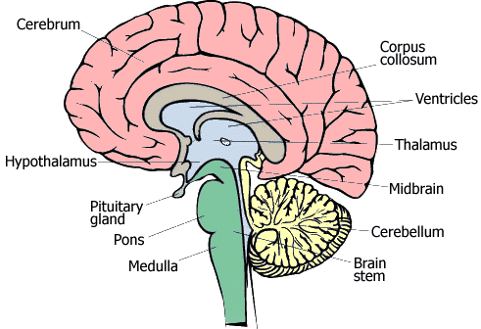
Stable individuals have a sympathetic nervous system that is slower to activate, and a parasympathetic system that responds more quickly
Neurotic individuals have sympathetic nervous systems that activate quickly, while their parasympathetic is slower to respond
Criminals more likely to be neurotic as they respond emotionally and remain ‘switched on’. They act on impulse.

Slide 18
Biological basis
So according to Eysenck, personality traits come about through our nervous system.
Extraverts
- Underactive nervous system; constantly seek excitement. Likely to engage in risk-taking behaviours.
Neurotic individuals
- Overactive nervous system; anxious, touchy, largely unstable personality. Instability means their behaviour is difficult to predict.

Slide 19

Psychoticism
There is as yet no agreed underlying biological mechanism, but it is assumed to be affected by levels of testosterone and serotonin.
Characterised by ‘cold cruelty’, social insensitivity, disliking of others and attraction to the ‘unusual’.
This Photo by Unknown Author is licensed under CC BY-SA

Slide 20
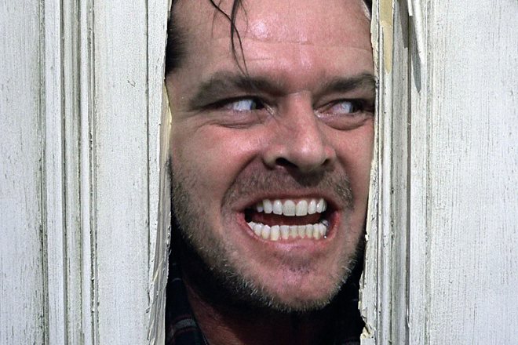
The Recipe for the
Criminal Personality
Psychoticism
Extraversion + Neuroticism +
= PEN
= The Criminal Personality
Neurotics are unstable and prone to over react
Extroverts seek more arousal and thus engage in risk taking activities
Psychotics are aggressive and lack empathy

Slide 21
Characteristics of a PEN personality
Psychoticism | Extraversion | Neuroticism
Aggressive | Sociable | Anxious
Assertive | Irresponsible | Depressed
Egocentric | Dominant | Guity feelings
Unsympathetic | No reflection | Low self esteem
Manipulative | Sensation seeker | Tense
Achievement orientated | Impulsive | Moody
Dogmatic | Risk taking | Hypochondriac
Masculine | Expressive | Low autonomy
Tough minded | Active | Obsessive

Slide 22
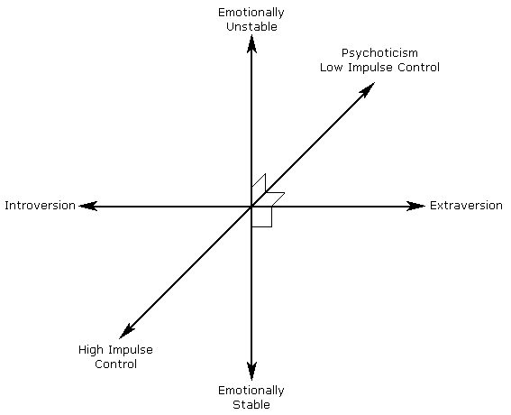

Slide 23

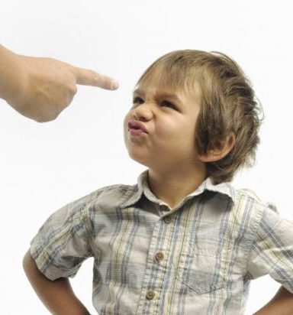
Back to the role of the environment…
Having established a biological basis for the criminal personality, Eysenck also recognised the importance of learnt behaviour which comes from the environment… it’s all in the conditioning…
This Photo by Unknown Author is licensed under CC BY-SA

Slide 24
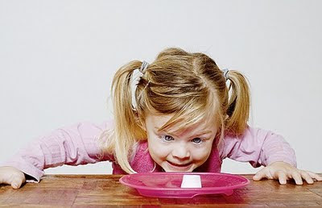
The environmental bit…
A child is conditioned (socialised)
Child learns sense of right and wrong
Child avoids behaviour which leads to punishment
Child controls own impulses
Some children are biologically more predisposed to the conditioning process.
Click pic

Slide 25
Conditioning
Behaviourists would say that our conscience (right and wrong) is a conditioned/learnt response.
Wrongful behaviour is associated with punishment, and the thought of doing wrong/being punished evokes fear.
This prevents us from doing wrong and causes guilt if we do wrong.
Criminal personalities (high PEN) are less likely to be conditioned in the ‘normal’ way as they are less likely to feel guilty.

Slide 26
Socialisation
By the process of socialisation children are typically taught delayed gratification.
Criminals may not have been taught this – because E & N are difficult to condition.
Eysenck said criminal behaviour is developmentally immature, selfish & concerned with immediate gratification.
Criminals are impatient and cannot wait for things so they are more likely to act antisocially.

Slide 27
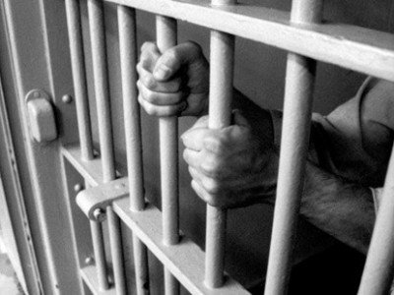
Evaluation: Supporting evidence ? (1977)
Eysenck and his wife Sybil assessed 2070 male prisoners who were compared to a control group of 2422 males.
On measures of E, N and P, prisoners recorded higher scores than the control group which supports the theory.

Slide 28
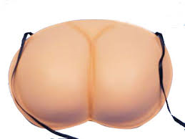
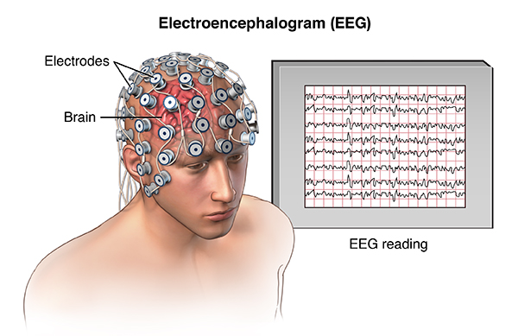
Evaluation: Conflicting evidence
Farrington et al (1982) found that offenders tend to score highly on P measures, but not on E and N.
There are also NO consistent differences between the EEG measures (used to measure cortical arousal) between extraverts and introverts, which cast doubt on the biological basis of Eysenck’s theory.

Slide 29

See page 213 in the PHG revision guide for further evaluation points
There may be more than one type of criminal personality
Eysenck’s research may be culturally biased, so not generalisable
Maybe we cannot measure personality at all. Maybe it is not something that is fixed. Personality can change in different contexts
Because of the biological basis you could say this theory is both determinist and reductionist

Slide 30
Complete page 17-18 of your fill in pack
You should be able to identify the key terms
Ensure you have identified some evaluation issues
Remember you can use general arguments for and against this theory
You can use evidence to support or refute this theory
You have a variety of sources for evaluation PHG, T2U pack, text books in class room, online material.

Slide 31
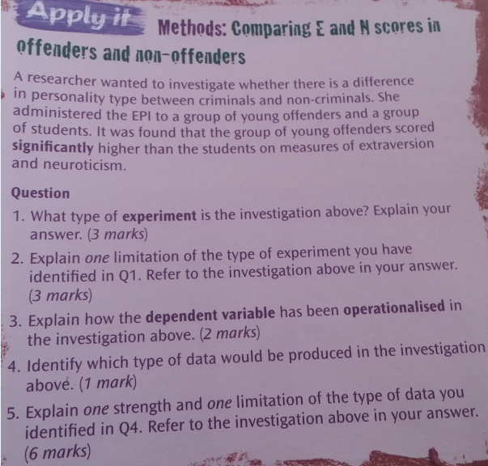
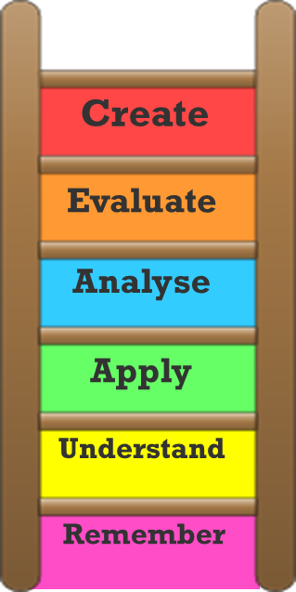
RM Activity

Slide 32
Exam practice: Open book 30 mins
Discuss Eysenck’s theory of the criminal personality, referring to evidence within your answer (16marks)

