Slide 1
Dealing with offending behaviour
Custodial Sentencing

Slide 2
How should WE deal with offending behaviour?
We need to consider the purpose of punishment

Slide 3
When someone is found guilty in court, their punishment for committing the crime may be to spend time in prison, or a young offenders institution.
When this occurs it is called custodial sentencing

Slide 4
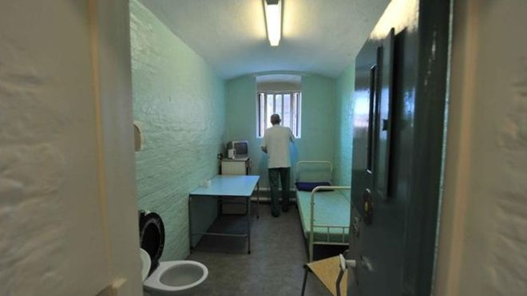
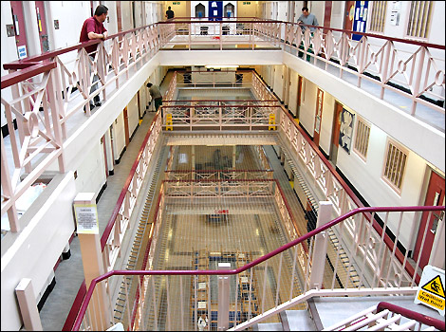
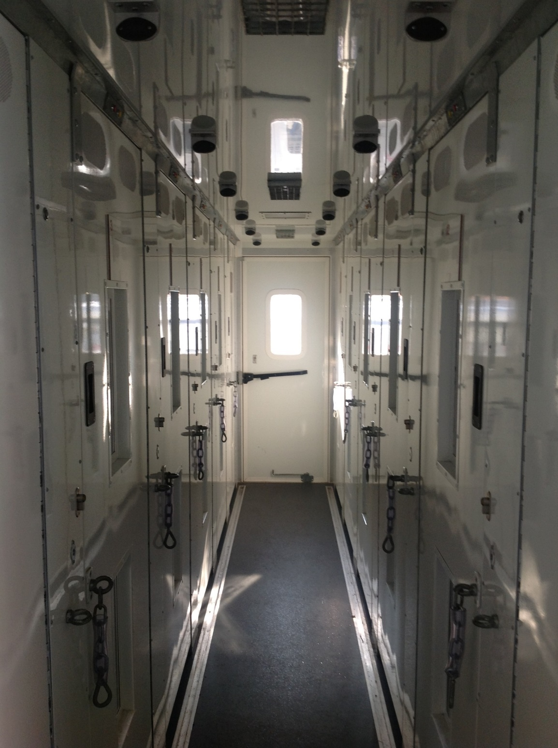
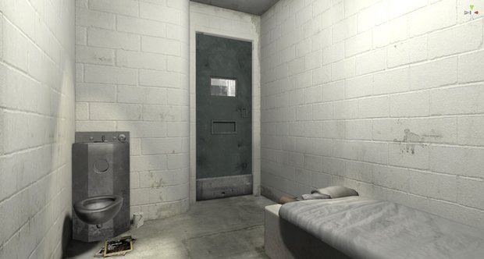
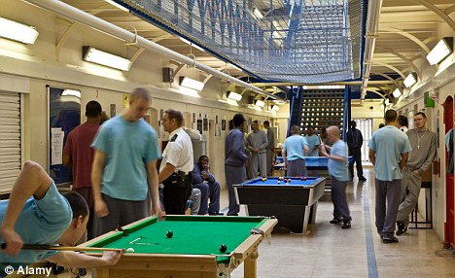

Slide 5
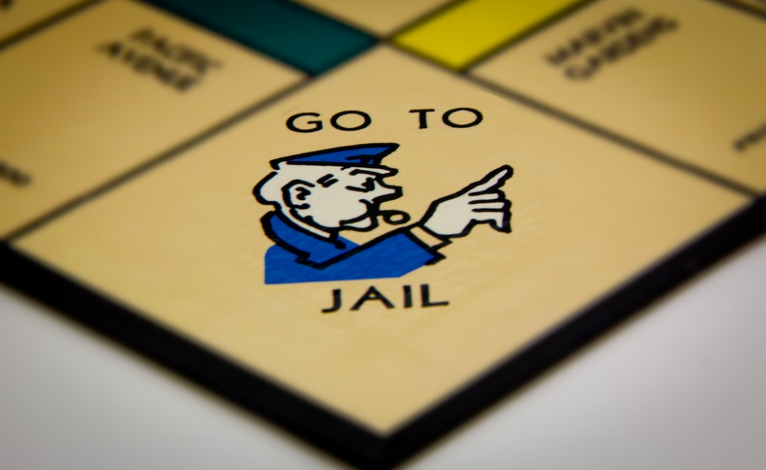

Imagine you are convicted of a crime
You have been sentenced to 15 years in prison
How do you think you will feel on your way to prison?
Think individual differences – not everyone responds in the same way

Slide 6
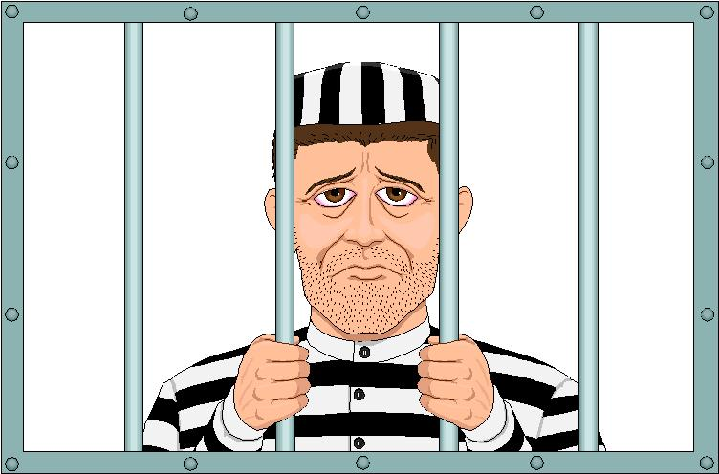

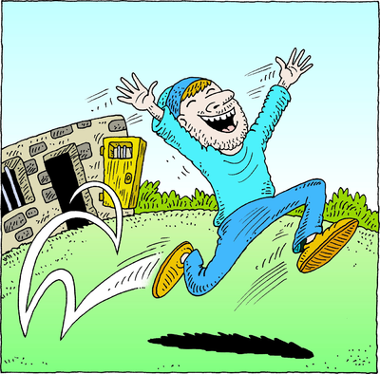
How do you think you will feel during your imprisonment?
How will you feel after you have been released?
Are you the same person walking out of prison who walked in? How may you have changed?

Slide 7
Custodial sentences
Are a form of punishment designed, like operant conditioning, to have an effect
However, there are other potential psychological effects an individual may experience – you need to know what they are.
Stress/depression…self harm, suicide
Institutionalisation
Prisonation

Slide 8
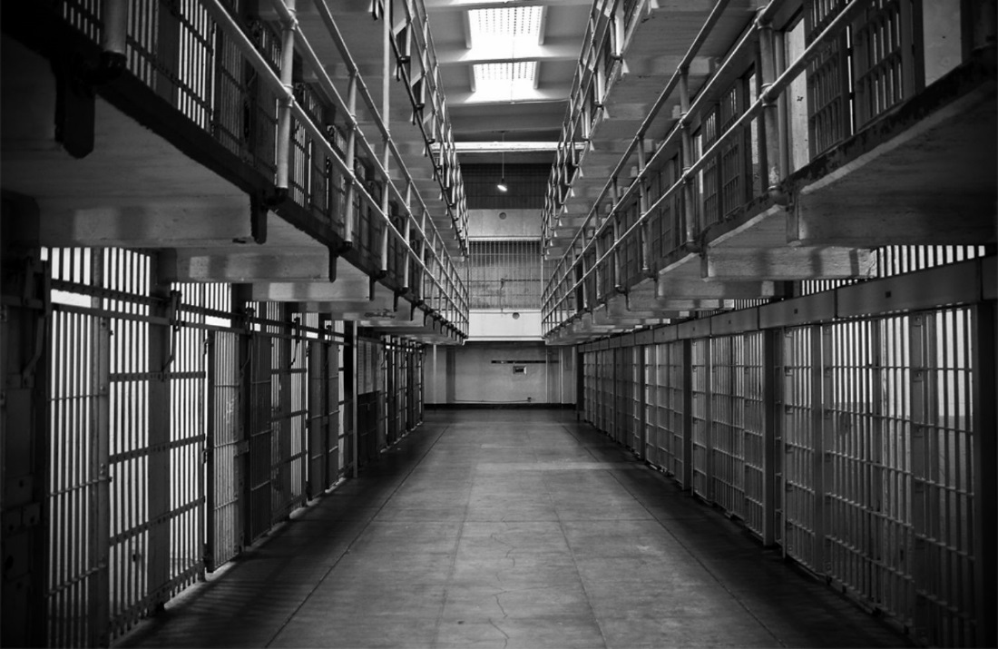

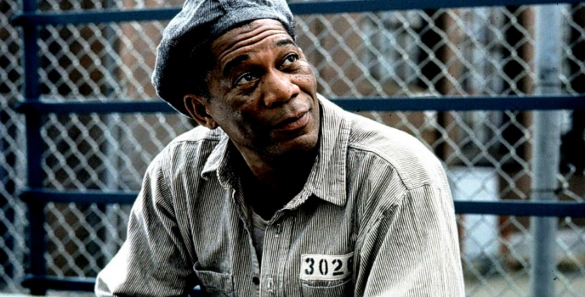
Institution = a place devoted to a particular cause which people are a part of
Institutionalisation = when the norms of the institution become your norms. Often you may fail to know how to exist outside the institution

Slide 9


Effects of custodial sentences
Individuals who are imprisoned can become institutionalised
This has a huge influence on their behaviour
Think of Zimbardo’s (1971) prison experiment
  Individuals in the study were influenced by their setting

Slide 10
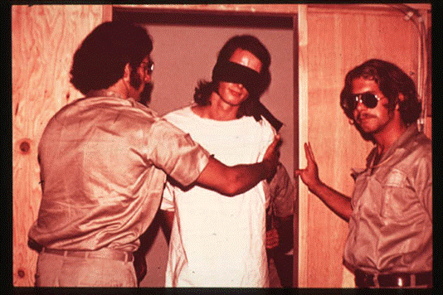
Negative effects on mental health
Zimbardo’s 1971 study showed the negative effects of being incarcerated on individuals well-being
Prisoners were dehumanised
As guards became more aggressive and assertive, the prisoners became more submissive

Slide 11
Negative effects on mental health
One prisoner was released after 36 hours because of uncontrollable bursts of screaming, crying and anger – he displayed the early stages of depression, something of which had lasting consequences

Slide 12
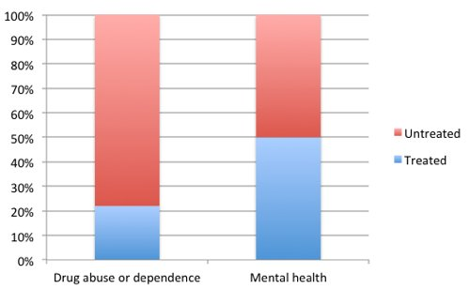
Mental health in prison
Self-harm amongst prisoners is high
In many prisons, offenders are assumed to be suicidal upon entry

Slide 13
Suicide levels are higher inside of prison than in the wider community (Crighton, 2006) 15 times higher!
The number of suicides amongst prisoners has increased in recent years – young men during the first 24 hours of custody are most at risk
15% of men entering prison show symptoms of psychosis ( Prison Reform Trust 2014)

Slide 14
Why?? There are lots of possible reasons
Over crowding
Lack of staff-to-offender ratio
Lack of access to medical services
Lack of physical exercise
Risk of physical assault
Guilt? Shame?

Slide 15
Can institutionalisation be a good thing?

Slide 16

Institutionalisation
Individuals may want to become institutionalised because of their life outside of prison
If an individual is homeless or has a poor standard of living, they may like being in prison with a bed, a roof over their head, and food available to them

Slide 17
Institutionalisation
Some people enjoy the routine of prison
If this is the case, they are likely to re-offend
Re-offending is known as ‘recidivism’

Slide 18
What is the point in custodial sentencing?
To punish the offender?
To help the offender?
For the victim’s payback?
For society?
These functions fall into four categories;
Deterrence
Incapacitation
Retribution
Rehabilitation

Slide 19
Outline what each of the following mean
Deterrence
Retribution
the victim(s) family, friends and society will see justice is served
Prisoners will learn not to do behaviour again
Rehabilitation
Confinement
(incapacitation)
strategies are implemented to reduce re-offending
Society is kept safe

Slide 20
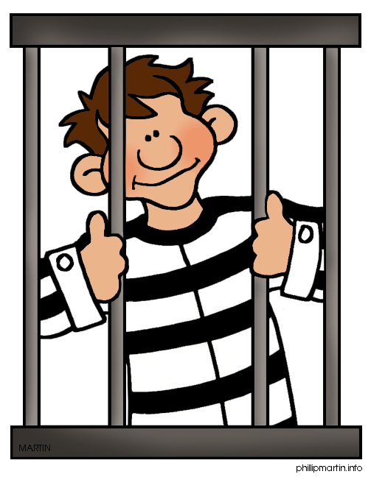
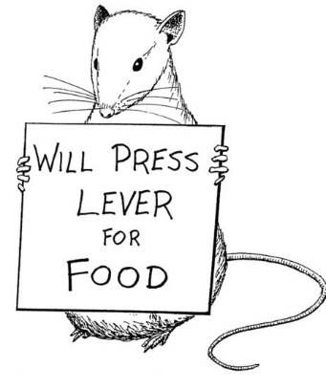
Deterrence
Individuals are sent to prison to prevent criminals from reoffending
Based on what we already know, how can you change someone's behaviour?
the behaviourist principle is that prisoners will learn that crime is punished and therefore not want to commit a crime again

Slide 21
Recidivism
the term given for re-offending
Recidivism rates can be measured to see whether prison can be used successfully as a deterrent
Do you think prison works? Does it stop recidivism?

Slide 22
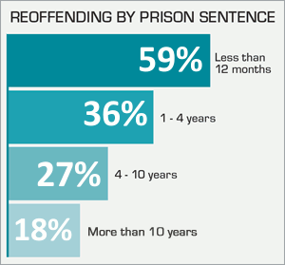
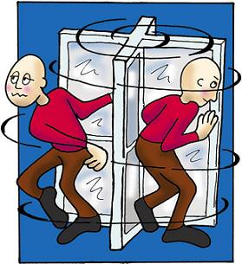
In the UK, more than 2 in 4 criminals reoffend within a year (Ministry of Justice, 2013)

Slide 23
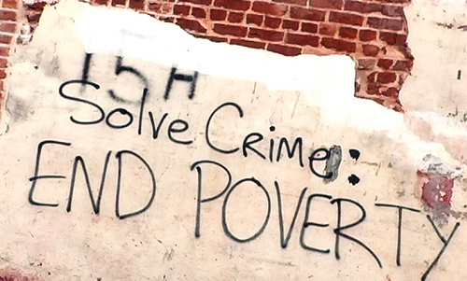
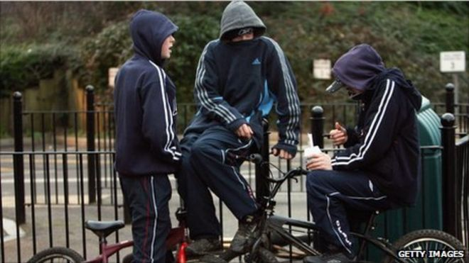
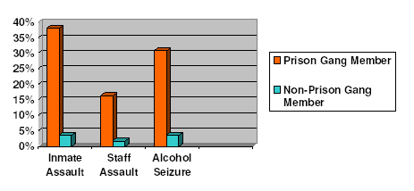
Why do they reoffend?
Poor education
Troubled backgrounds – poor socio-economic status
Peer pressure
Gang involvement

Slide 24
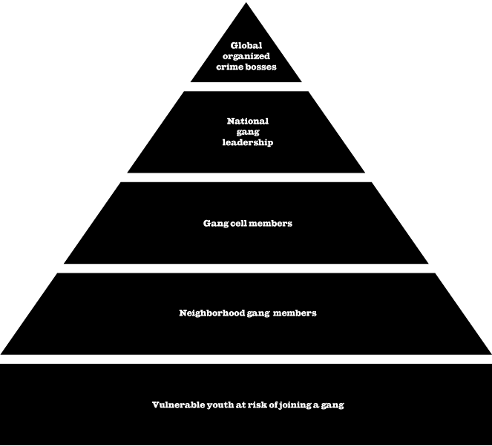
Why reoffend?
No purpose
They haven’t learned that the behaviour is wrong
Use it as an excuse to escape ‘normal’ life
In prison they are someone, outside they are no one

Slide 25


Retribution
How much time is ‘enough’?
Individuals may be sent to prison based on the feelings of the victim(s) and their close family, friends and society
It is based on the idea the offender has ‘hurt’ someone else and should pay for their actions
By sending them to prison, the offender loses their freedom and this is seen as a necessary consequence for their actions
Should life mean life?

Slide 26
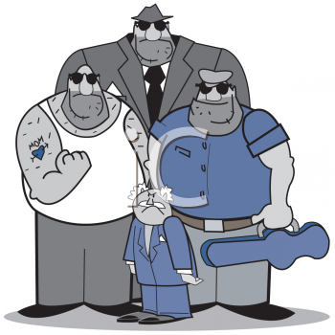

Confinement
Some offenders (violent offenders or sexual offenders) are seen to pose a threat to society – these individuals need to be incapacitated
While in prison or a young offenders institute, the offender is not free to commit other crimes
By putting them in prison for a period of time they are no longer a threat to society

Slide 27
If offenders are in prison, is society safe?
Despite government statistics which suggest crime levels are falling, imprisonment rates are increasing
What does this mean?
Does prison become a ‘-school for crime’?....think of Sutherland’s differential association theory

Slide 28
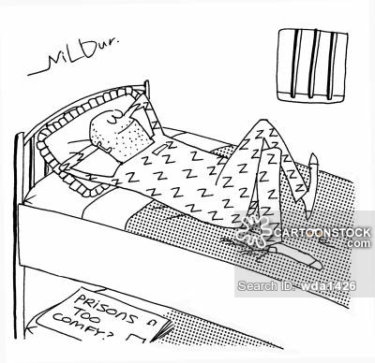
Not only this
To some, prison is not a deterrent – some may want to go or even return
Recent news story saw partying, drugs and mobile phones being used

Slide 29
‘Prisonation’
Some behaviours considered unacceptable in the outside world are encouraged via socialisation into an inmate code

Slide 30

Rehabilitation
As we know, behaviours can be changed
It is argued that a prison sentence allows for rehabilitation of the offender, so that they will not re-offend
This is different to deterrence
Counselling and offender programmes are offered within the prison

Slide 31
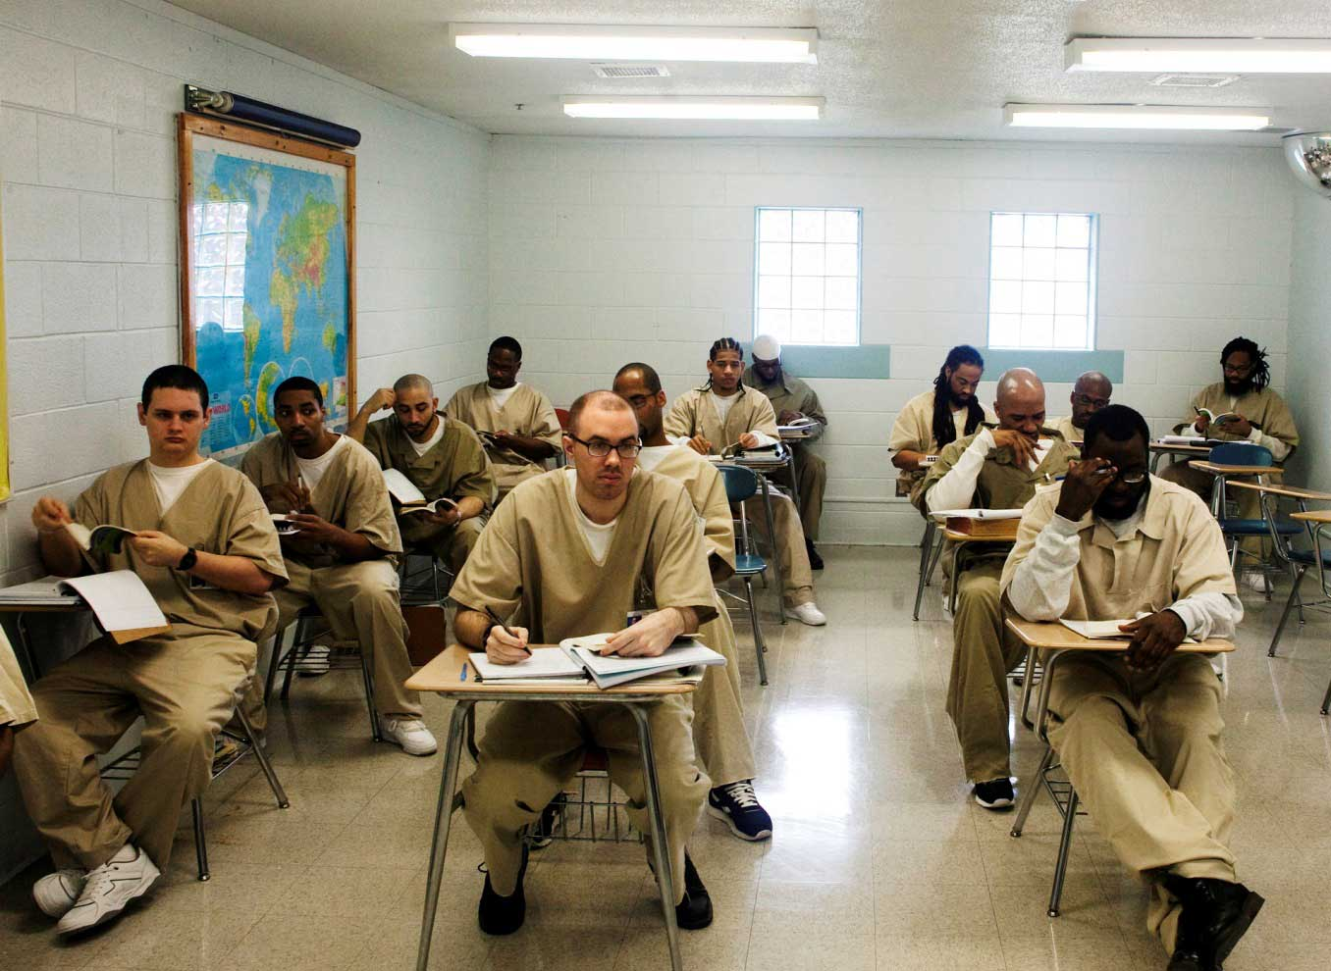
Rehabilitation
Offenders can be provided with an education, useful life skills, trades
These help prepare offenders for their lives outside of prison to help them live as normal lives as possible

Slide 32
However;
The waiting list is very high (often some finish their sentence before making it to the top of the list)
Budget cuts
To change, an individual must want to

Slide 33
Do you think incarceration in prison is effective for reducing reoffending?
If not, what else could be done?

Slide 34
TASK Choice: Either make an advertisement promoting the use of prisons as a means of dealing with offending behaviour
You should identify the psychological effects of custodial sentencing
  Positive and negative
You should identify prisons four functions
You should also comment on how effective you think these are

Slide 35
Or …. exam question
Discuss whether custodial sentencing is an effective way of dealing with offenders (16 marks)

Slide 36
OVERVIEW OF KEY CONCEPTS
The psychological effects of custodial sentencing concern the mental consequences of imprisonment:
Institutionalisation – individuals deliberately re-offend, as they cannot live independently outside of prison.
Negative mental health – imprisonment incurs high levels of self-harm, suicide, depression, etc.
Recidivism – imprisonment incurs high
re-offending levels through institutionalisation, the learning of criminal skills in prison, and
ex-prisoners finding employment hard to come by.
Custodial sentencing involves imprisonment for offending behaviour and serves several functions:
Deterrence – imprisonment is so unpleasant that criminals will not re-offend.
Retribution – imprisonment punishes offenders for their criminal actions.
Confinement – imprisonment protects society through offenders not being free to re-offend.
Rehabilitation – imprisonment allows for counselling and other programmes to help teach criminals not to re-offend.

