Slide 1

Psychological explanations for Offender Behaviour: Cognitive Explanations.
Aim: to explain and evaluate the cognitive explanations for offender behaviour
Moral Reasoning: Process of assessing whether something is right or wrong based on your own value system.

Slide 2
We need to know 2 cognitive explanations
1. Criminals may work at a different level of moral reasoning
2. Criminals may be prone to cognitive distortions

Slide 3
Kohlberg used a number of ethical dilemmas to understand the moral reasoning of children.
He was interested in the way children think about right and wrong.
From analysing thousands of responses he came up with a theory of moral development

Slide 4

Kohlberg's most famous dilemma
A woman was near death from a unique kind of cancer. There is a drug that might save her. The drug costs $4,000 per dosage. The sick woman's husband, Heinz, went to everyone he knew to borrow the money and tried every legal means, but he could only get together about $2,000. He asked the doctor scientist who discovered the drug for a discount or let him pay later. But the doctor scientist refused.
Heinz broke into the laboratory and stole the drug. The next day, the newspapers reported the break-in and theft. Brown, a police officer and a friend of Heinz remembered seeing Heinz last evening, behaving suspiciously near the laboratory. Later that night, he saw Heinz running away from the laboratory.
Officer Brown reported what he saw. Heinz was arrested and brought to court. If convicted, he faces up to two years’ jail. Heinz was found guilty.

Slide 5


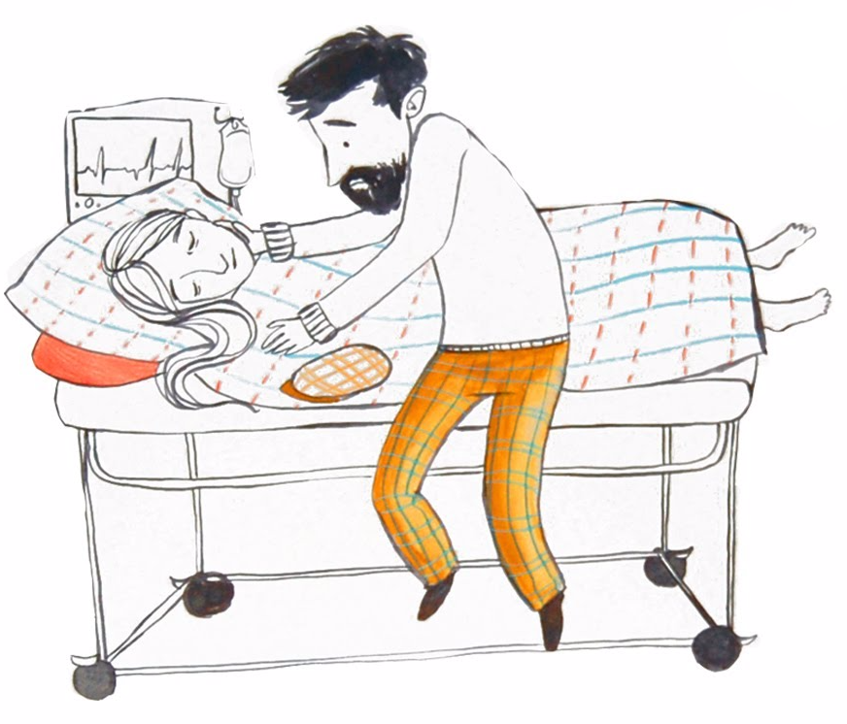
Watch the Heinz Ethical Dilemma video (also on p333 phg)
https://www.youtube.com/watch?v=5czp9S4u26M

Slide 6
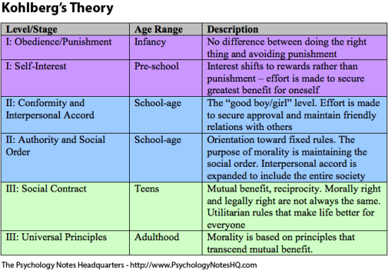
See t2U pack
Pre-conventional morality
Conventional morality
Post-conventional morality

Slide 7
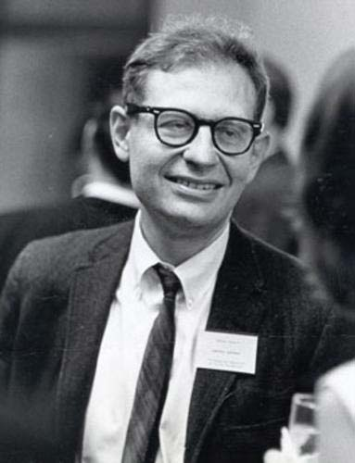
Kohlberg’s theory was later applied to explain criminal behaviour :
Criminals have a lower level of moral reasoning than others. Criminals do not progress from the pre-conventional level of moral reasoning – they seek to avoid punishment and gain rewards. They have child-like reasoning. Non-criminals tend to reason at higher levels and sympathise with the rights of others, exhibiting honesty, generosity and non-violence (post-conventional moral reasoning)
Research suggests criminals are more self-centred and are less able to see another persons point of view.
They show less sympathy for others

Slide 8
Offenders tend to be more egocentric and show less sympathy.
Chandler (1973) suggests that offenders are more self centred and display poorer social perspective taking skills
Individuals who operate with a higher level of moral reasoning tend to sympathise more and are less violent

Slide 9
Kohlberg used an all male sample of children. This is an example of Beta Bias.
Gilligan (1972) a feminist psychologist argued that female morality is fundamentally different to male morality. She said you cannot generalise Kohlberg’s findings
Male = law based and pragmatic
Female = compassionate
Furthermore Kohlberg used children as his sample – this may lack validity as they have no experience of being married etc. – therefore the scenarios aren’t relevant.
Negative evaluation

Slide 10
AO3
Palmer and Hollin (1998): compared moral reasoning between 210 female non-offenders 112 male non-offenders and 126 convicted offenders using the
Socio-Moral Reflection Measure (SRM). This contains moral-dilemma related questions such as not taking things and keeping a promise to a friend.
The offenders showed less mature moral reasoning than the non-delinquent groups.
Supporting evidence
Suggest a real world application of this study?

Slide 11
A03 - furthermore
Thornton and Reid (1982) suggest pre-conventional moral reasoning tends to be associated with crimes such as robbery, whereas impulsive crimes such as assault did not pertain to any specific type of moral reasoning.
Pre-conventional reasoning tended to be evident in crimes where the offender thought they might have had a good chance at evading punishment. Therefore, the level of moral reasoning may depend on the kind of offence committed.

Slide 12
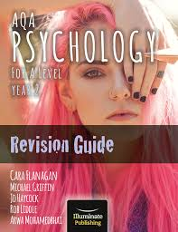
Find further evaluation points
Page 215

Slide 13
Psychological Explanation:
Cognitive Explanations
2
COGNITIVE DISTORTIONS
Faulty, irrational ways of thinking which can cause individuals to perceive themselves, others or the world inaccurately, and usually negatively.
E.G. “My partner hasn’t texted me in the last few hours, they must be angry with me, they’re about to break up with me.. Well I’ll get in there first”

Slide 14
Cognitive Distortions and Offending.
Hostile Attribution Bias
Other people’s expressions/behaviour is incorrectly perceived as being aggressive.
People may be perceived as being confrontational when they are not.
E.g. “he was giving me a funny look” as a reason for attacking someone, when no such look had been intended.
Minimalisation
Downplaying the seriousness of an offence.
‘Euphemistic labelling’, e.g. burglars are just “doing a job” or “supporting their family”.
Some will underplay their offence, e.g. paedophiles may claim they were “just being affectionate” or fraudsters may claim “it wasn’t that much money compared to the company’s worth”

Slide 15

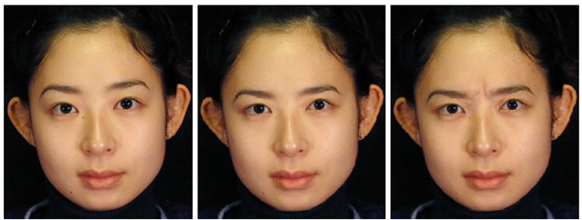
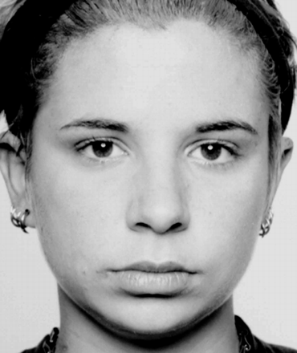
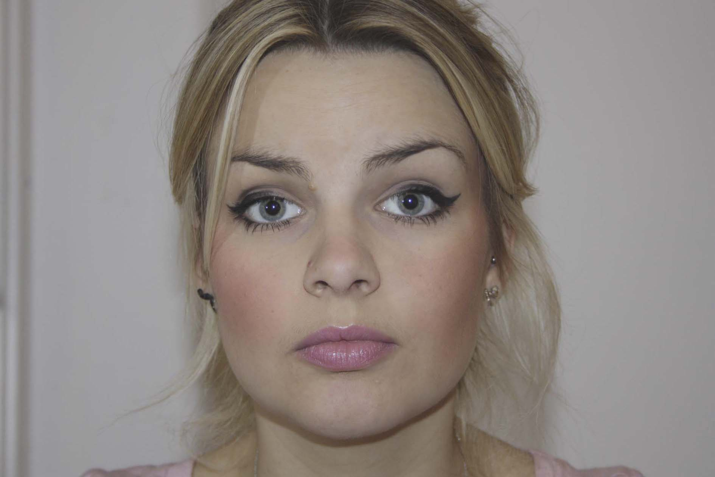

Which expression is the angry expression?

Slide 16
Hostile attribution bias –supporting evidence
Schonenberg and Justye (2014) 55 violent offenders were presented with images of emotionally ambiguous facial expressions. When compared with a control group, offenders were more likely than non-violent PPs to perceive the images as angry/hostile.
Dodge and Frame (1982): children were showed an “ambiguous provocation” where the intention was neither clearly hostile or accidental. Prior to the study, children who has been judged as aggressive were more likely to perceive the situation as hostile.
Domestic violence is also associated with hostile attribution bias

Slide 17
Minimalisation –supporting evidence
Kennedy & Grubin (1992) found the majority of sex offenders tended to blame the victim, ¼ of those interviewed thought the abuse was a positive thing for the victim!
Barbaree (1991) found that amongst 26 convicted rapists, 54% denied they had committed an offence at all at 40% minimised the harm that they had caused the victim.
Pollock and Hashmall (1991) report that 35% of a sample of child molesters said that the crime they committed was non-sexual. 36% said that the victims had consented.

Slide 18
Hostile Attribution Bias or Minimisation
It’s not like they would even care, they never used it anyway.
The way he spoke to me was very aggressive.
Please, it’s not even a crime, everyone pinches sweets from the corner shop.
With a car like that with all those mods, he was asking for it to get nicked.
Her attitude was appalling, did you hear that fake laugh? Rude cow.
She was rude, she needed taking down a peg or two.
I was just trying to be nice, it’s a complement.
They provoked me, sitting there acting the “big I am” with their new phones.
1-8
write it down
HAB or MINI

Slide 19
HAB or MINI
It’s not like they would even care, they never used it anyway. MINI
The way he spoke to me was very aggressive. HAB
Please, it’s not even a crime, everyone pinches sweets from the corner shop. MINI
With a car like that with all those mods, he was asking for it to get nicked. MINI
Her attitude was appalling, did you hear that fake laugh? Rude cow. HAB
She was rude, she needed taking down a peg or two. HAB
I was just trying to be nice, it’s a complement. MINI
They provoked me, sitting there acting the “big I am” with their new phones. HAB

Slide 20
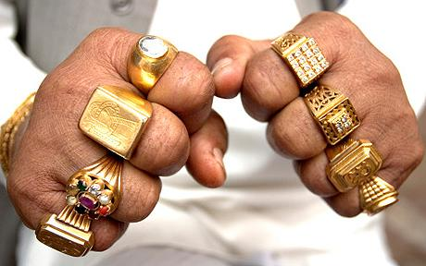
A02: apply it!
When questioned by police, Max claimed he punched the man in the bar because “he looked at me funny.” In court, defending his actions – Max told the judge that the man he punched “wasn’t even hurt that bad” and “what was I supposed to do? I was just taking care of business.”
With reference to the above, explain what is meant by cognitive distortions (4marks)

Slide 21

exam question:
Describe and discuss cognitive explanations for offending.
Refer to at least one other explanation of offending in your answer (16marks)

