Slide 1
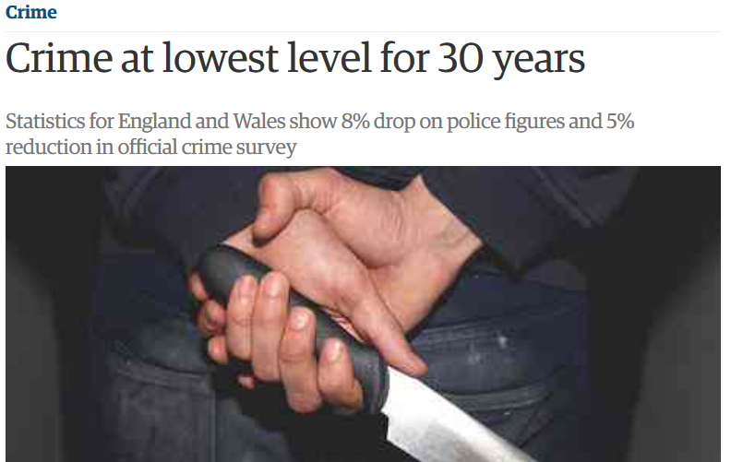
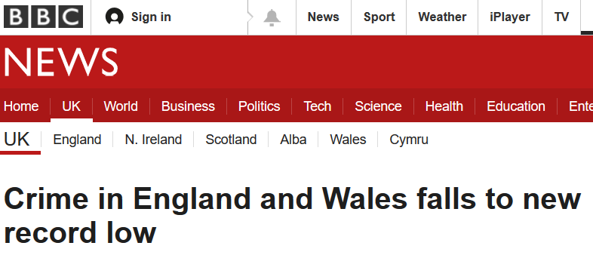
Think back to last lesson . . .
Check you have…
1. Read the Course Companion about OP
2. Read and click PHG.
3. Consider research into OP..does it work?
Can we trust headlines like these? Identify three reasons why these statistics may be unreliable and/or lacking validity

Slide 2


Forensic Psychology
Offender Profiling
Top-down approach
Organised and disorganised offender
Bottom-up approach
Investigative Psychology
Geographical Profiling

Slide 3
Learning Objectives
explain top down approaches to profiling
  Know the four stages of the top-down process
distinguish between organised and disorganised type of offender

Slide 4
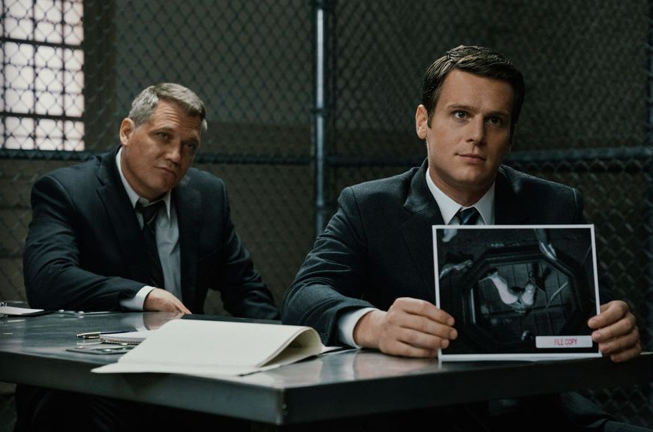

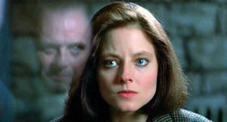
the Top Down Approach
.
Offender Profiling: a behavioural and analytic tool that is intended to help investigators accurately predict and profile the characteristics of unknown criminals.
A method of working out the characteristics of an offender by examining the characteristics of the crime and the crime scene.
Notes:
Mindhunters Netflix

Slide 5
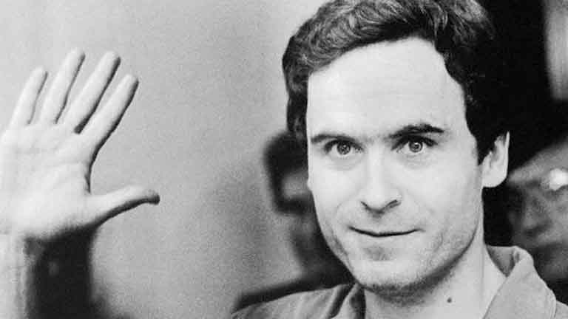
Ted Bundy, the “Organised Killer”
Theodore Robert Bundy (1946-1989) was an American serial killer, kidnapper, rapist, and necrophile who assaulted and murdered numerous young women and girls during the 1970s. Shortly before his execution, after more than a decade of denials, he confessed to 30 homicides committed in seven states between 1974 and 1978. The true victim count remains unknown, and could be much higher.
He was intelligent, charming and attractive. He excelled at law school and fell in love with a young woman at college. After the breakdown of this relationship, Bundy’s killing spree ensued – his victims resembling his college girlfriend with long hair parted down the middle. After escaping police custody twice, Bundy was executed by electric chair in 1989.

Slide 6
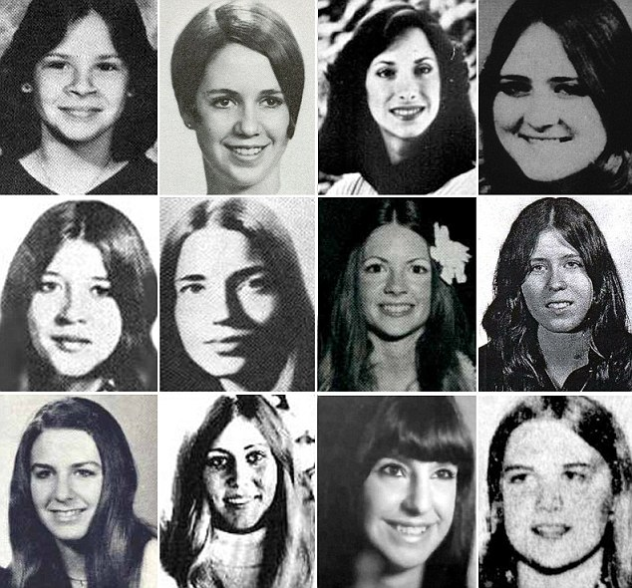
Some of Bundy’s confirmed victims . . .
WHAT DID THE FBI DO?
INTERVIEWED 36 SEXUALLY-MOTIVATED SERIAL KILLERS, INCLUDING BUNDY AND CHARLES MANSON.
WHY DID THEY DO THIS?

Slide 7
OVERVIEW OF KEY CONCEPTS
Offender profiling creates descriptions of criminals through the analysis of available information by investigative techniques.
The top-down approach uses the experience and intuition of a profiler to draw up an outline of a criminal from a crime scene in order to narrow down the number of potential suspects.
The top-down approach uses seven decision-making tools:
Murder type – the sort of killing committed.
Primary intent – whether a crime was premeditated or not.
Victim risk – a victim’s degree of vulnerability.
Offender risk – what level of risk was taken in committing a crime.
Escalation – the degree by which a crime has become more serious than previously.
Time factors – time of day a crime was committed.
Location factors – where a crime took place.

Slide 8
Organised offenders plan out their crimes in advance, leave little evidence and are skilled and intelligent.
Disorganised offenders commit unplanned crimes, leave evidence and have lower levels of skill and intelligence.
The bottom-up approach is an unintuitive approach that creates an outline of a criminal from data taken from previous, similar crimes.

Slide 9

The Top-Down Approach
Qualitative profile created from interviews and analysis of previous crime details/scenes
Top: motives and characteristics of offenders.
Lead to . . .
Down: creating more knowledge of the crime
Is described as a qualitative approach to offender profiling due to looking at the overall picture and using typologies. (types)
It's based on police experience and case studies rather than psychological theory.
It's suitable for the more extreme/unusual crimes, such as murder, rape and ritualistic crimes.
Classification system is used to predict and prevent crime

Slide 10
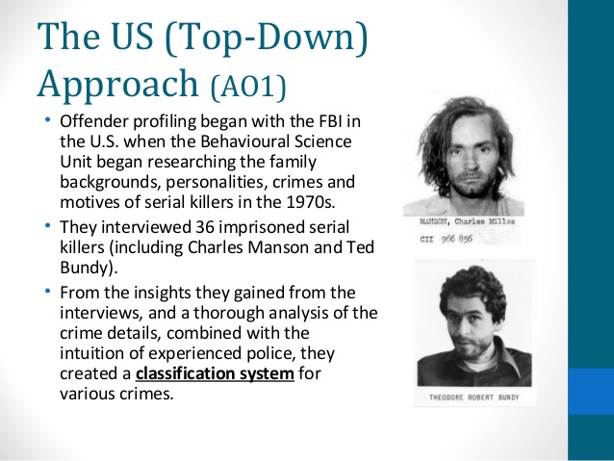
Qualitative profile created from interviews and analysis of crime details/scenes
Top: motives and characteristics of offenders.
Lead to . . .
Down: creating more knowledge of the crime
Classification system is used to predict and prevent crime

Slide 11
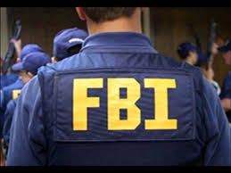

Top Down Approach to Profiling
Starts with a classification of the crime scene and then the profiler uses the information gained to make judgements about the likely offenders who would fit the circumstances.
Relies heavily on the prior knowledge and the intuition of the profiler.

Slide 12

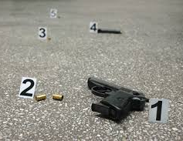
Stages of the Top Down process
Background information about the victim (work, relationships, habits, routine)
Description of crime scene (photographs, sketches)
Stage 1:
Data assimilation
Details of the crime itself (e.g. weapon used, cause of death, autopsy reports
Notes:
Originally there were 6 Stages of the Top Down process Ressler et al (1988)

Slide 13
Stage 2:
Crime Scene Classification
The data is organise into meaningful patterns.
Organised vs. Disorganised Offender

Slide 14
Stage 3:
Crime Reconstruction
A possible sequence of events is theorised
Stage 4:
A profile is generated including
possible behavioural traits, appearance etc.

Slide 15
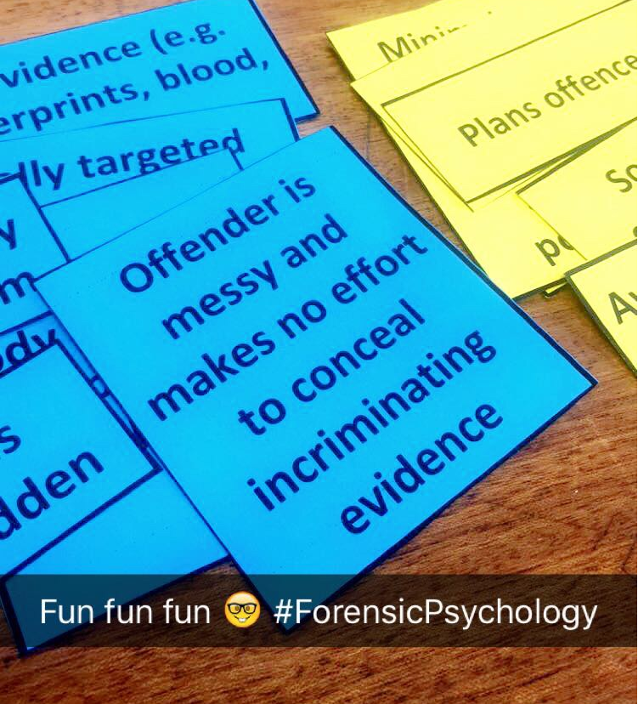
Organised vs. Disorganised Offender
TASK: You will be each receive characteristics of an organised OR disorganised offender.
Decide which type of offender is being described and come up to the front to stick it on the board with bluetac.
Notes:
Give students a characteristic of an organised or disorganised offender with some blutac and they are to come and attached it to the right place on the comparison table on the whiteboard.

Slide 16
Organised vs. Disorganised Offender
Organised
Disorganised
Average to high intelligence
Socially competent
Plans offences
Uses restraints on victims
Weapon is usually hidden
Body is usually transported from the scene
Victim is specifically targeted
Tries to conceal evidence (e.g. getting rid of fingerprints, blood, semen)
Below average intelligence
Socially incompetent
Unskilled or unemployed
Minimal use of restraints/ leaves body on display and performs sexual acts postmortem.
Victim is likely to be random
Offender is messy and makes no effort to conceal incriminating evidence
Notes:
Give students a characteristic of an organised or disorganised offender with some blutac and they are to come and attached it to the right place on the comparison table on the whiteboard.

Slide 17
Evaluating the Top Down Approach
Some Police who have used the FBI methods (top down approach) have found it useful.
Copson (1995) conducted a questionnaire on 184 US police officers.
  82% said that the technique was useful
  90% said that they would use it again.
HOWEVER The top down approach is based on extreme cases which are not representative of the general criminal population.
Can you think of any other evaluation issues ?

Slide 18

Evaluating the Top Down Approach
Top down approach is not scientific as it is based on the opinions and intuition of profilers. It can even be compared to horoscopes whereby the descriptions are made to fit any situation for most people (Barnum effect).
This is a problem especially if the profile is wrong. Profiling holds greater consequences than horoscopes. Wrong profiling could result in wrongful convictions and of course a criminal on the loose.

Slide 19
Evaluating the Top Down Approach
Distinguishing between organised and disorganised offenders
Tuvey (1999) suggests that these categories are not dichotomous, rather, they are on a continuum and can overlap.
Douglas et al (1992) suggested that there be a mixed offender category – however this would reduce the usefulness of the classification as this new category would be considered a ‘dust bin’ for offenders that do not fit the norm.

Slide 20
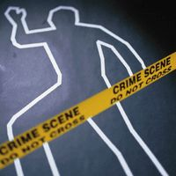
Further evaluation issues.
Only applies to particular crimes such as . . .
Canter (2004) claimed that evidence does not support the disorganised offender due to . . .
Classification is too simplistic
Original sample of 36 criminals is too small and unrepresentative because . . .
Use your tutor2u pack and your text book to find some more evaluation issues.

Slide 21


15 minute challenge! Answer all 3
Define what is meant by offender profiling (3marks)
Outline one investigation of the top-down approach to offender profiling. Include what a psychologist did and what was found (3marks)
Distinguish between organised and disorganised types of offender (4 marks)
See also 10.2 Offender profiling - white mask
Pages 351-354
Notes:
Page 354 white mask – the case of Arthur Shawcross

