Slide 1
Which ones are crimes? THINK PAIR SHARE
Collecting rainwater Blackmail
A pregnant woman urinating in a policeman’s helmet
Having a food hygiene rating of 1 Manslaughter
Being a female topless cashier in a tropical fish shop in Liverpool.
Emotional abuse of a person under 16 Concealment of birth
Notes:
Collecting rainwater, pregnant helmet urination, emotional abuse, tropical fish store law and food hygiene rating are not crimes.

Slide 2

The Dark Figure of Crime
I am the Dark Figure of Crime . . .
Under-reported by victims . . .
Under-recorded by police . . .
BUT WHY DO I EXIST????
Notes:
Get students in 3s to list all the different reasons why this figure still exists.

Slide 3

Forensic Psychology
Defining and Measuring Crime
Crime: an act committed in violation of the law where the consequence of conviction by court is punishment (especially a serious punishment such as imprisonment)

Slide 4
Two problems with defining crime:
Cultural: polygamy is illegal in the UK, although it is still legal to have multiple wives in other parts of the world.
Historical; homosexuality is still illegal in many part of the world and was only made legal in the UK in 1967.
THINK: what might be the crimes of the future? Create 3 potential examples.

Slide 5
3 ways of measuring crime:
Can you think of a problem for each of these methods of measurement?
Official statistics: the crimes reported to the police and recorded in the official figures that allow the government to formulate prevention strategies and police initiatives. These are published by the Home Office as a “snapshot” of the number of crimes committed across the country.
Victim Surveys: the public’s experience of crime over a particular period. 50,000 households are randomly chosen to report on the crimes that they have been a victim of in the past year and this is compiled in the Crime Survey for England and Wales.
Offender surveys: individuals self-report on the types of crimes that they have committed. These people are likely to be offenders based on certain risk factors such as previous convictions, age range and socio-economic background. The Offender Crime and Justice Survey was the first national self-report of this kind; it aimed to identify trends in offending and the relationship between perpetrators and victims.
Notes:
Print off for students or get HA to prepare before the lesson as an intro

Slide 6
Evaluation Time: A03 skills.
Farrington and Dowds (1985): police in Nottinghamshire were more likely than other areas to record thefts of under £10. This is a clear weakness of Official Statistics because . . .
“Telescoping” may happen when a person remembers an event as happening in the past year when it didn’t and this may distort the figures. However, the British Crime Survey reported a 3% increase in crimes as victims are more likely to report on crime unrecorded by police (the same year the official statistics reported a 2% decrease!)

Slide 7
Over to you . . . Evaluate Offender Surveys:
Offender surveys provide insight into how many people are involved in particular crimes. Confidentiality is assured when offenders self-report. However, reliability may not always be reached since . . .
Certain types of crime may be over-represented such as burglary or theft. Middle class crimes such as fraud and corporate crime are unlikely to be represented. This is because . . .

Slide 8
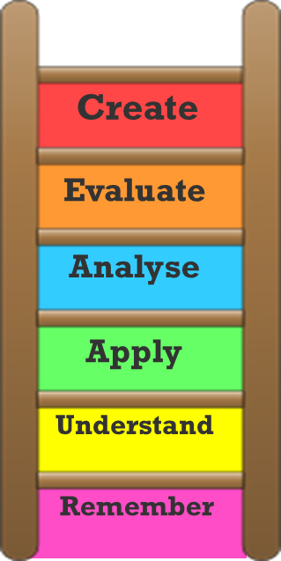
Exam Practice: pick one!
Explain two problems in defining crime (6marks)
(clue: focus on the cultural and historical issues, no need to evaluate if the question asks you to explain)
Outline and briefly evaluate one way of measuring crime (5 marks)
(focus on the one you feel you know the best and focus on a specific evaluation point – explain WHY this is a challenge)

Slide 9
Homework: use the mark scheme in your folders for guidance.
Describe and Evaluate three ways of measuring crime. Refer to evidence and/or published examples in your answer (16marks)

