Slide 1

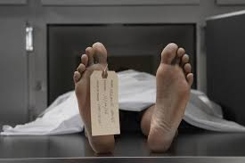

FORENSIC PSYCHOLOGY
A-level SPECIFICATION :
Problems in defining and measuring crime
Offender profiling - does it work?
Biological explanations of Crime
Psychological explanations of Crime
Dealing with offending behaviour –what works?

Slide 2

Learning Objectives
By the end of the next 2 lessons, you will be able to:
  Explain how crime is a dynamic construct
  Outline social, cultural, historical and political influences on the definition of crime
  Outline how the concept of ‘age’ and ‘intent’ can influence our definition of crime.
  Explain methods of measuring crime along with their strengths and limitations.

Slide 3



What is Forensic Psychology?
The intersection between psychology and the criminal justice system.

Slide 4


What is forensic psychology ?
As defined by the American Psychological Association, Forensic psychology is the application of clinical specialties to the legal arena.
This definition emphasizes the application of clinical psychology to the forensic setting.
The broad definition of forensic psychology emphasizes the application of research and experimentation in other areas of psychology (e.g., cognitive psychology, social psychology) to the legal arena.
Eyewitness testimony
Use of children in court

Slide 5

Defining and measuring crime
We need to be able to Define what crime is
We need to understand factors that influence the concept of crime
We need to be able to discuss the problems in defining crime
Are you a criminal? PHG worksheet

Slide 6
Defining crime
An act committed in violation of the law, where the consequence of conviction by a court is punishment.
How do we decide what is a crime and what isn’t?
What influences the concept of crime ?
Crime is socially constructed and is a reflection of the beliefs and attitudes of the society.

Slide 7
STRANGE LAWS
Have you seen the strange laws at the start of the forensic chapter in the PHG ?
TRUE OR FALSE

Slide 8
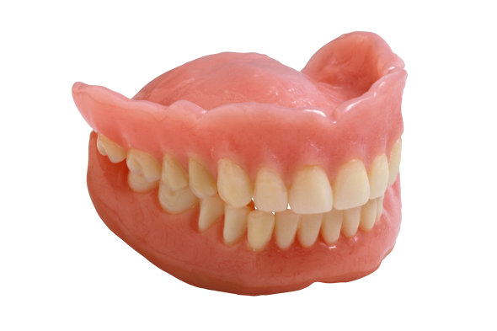
in Vermont, women must obtain written permission from their husbands to wear false teeth

Slide 9
TRUE

Slide 10
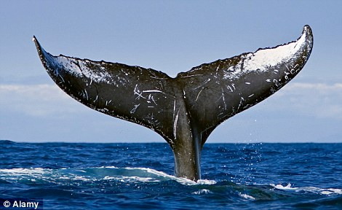
THE HEAD OF ANY DEAD WHALE FOUND ON THE BRITISH COAST AUTOMATICALLY BECOMES PROPERTY OF THE KING, AND THE TAIL OF THE QUEEN

Slide 11
TRUE

Slide 12
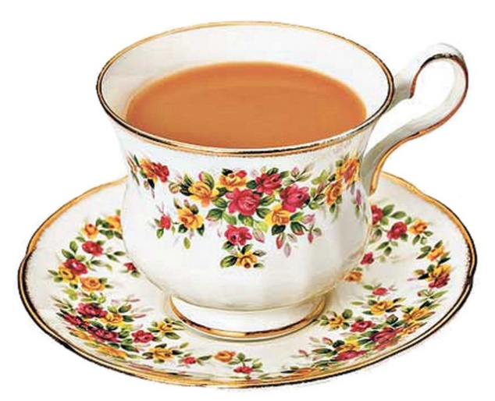
IN CORNWALL, IT IS ILLEGAL TO DRINK TEA CONTAINING MILK FROM A VILLAGE FURTHER THAN FIVE MILES AWAY FROM YOUR OWN

Slide 13
FALSE

Slide 14
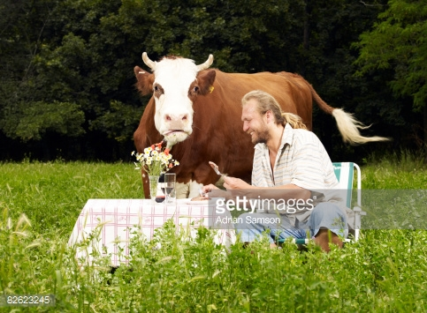
IT IS ILLEGAL TO BE DRUNK AND BE IN CHARGE OF A COW

Slide 15
TRUE

Slide 16
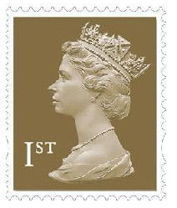
DEFACING AN ENGLISH STAMP IS CONSIDERED A TREASONOUS ACT

Slide 17
FALSE

Slide 18
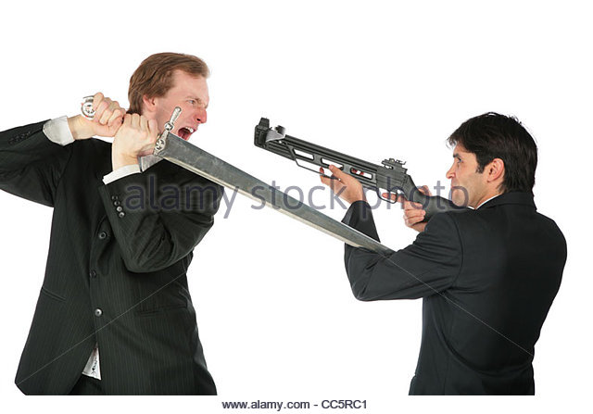
IT IS PERFECTLY LEGAL TO SHOOT AN ARMED SCOTSMAN IN YORK, AS LONG AS YOU USE A CROSSBOW

Slide 19
TRUE

Slide 20

IN ALABAMA, WEARING A FAKE MUSTACHE THAT COULD CAUSE LAUGHTER IN CHURCH IS PROHIBITED

Slide 21
TRUE

Slide 22

IT IS ILLEGAL TO BEAT A CARPET OR DOORMAT AFTER 8AM

Slide 23
TRUE

Slide 24
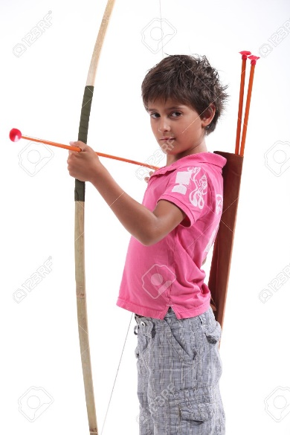
IN ENGLAND, ALL MEN OVER THE AGE OF 14 ARE REQUIRED TO PRACTICE THE LONGBOW FOR AT LEAST TWO HOURS EVERY DAY

Slide 25
TRUE

Slide 26
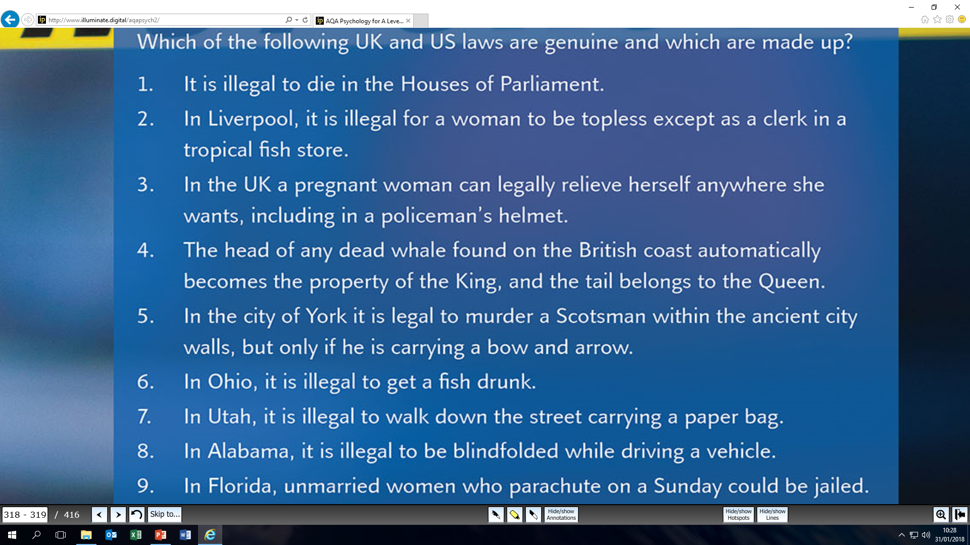

Slide 27

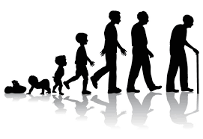
Problems in defining crime
AGE
SPECIFIC CIRCUMSTANCES
CULTURE
HISTORICAL
CONTEXT
Social Context

Slide 28

Consider this…
It is illegal to drive on the right-hand side of the road in the UK
In Germany, its is illegal to drive on the left-hand side of the road.
What does this suggest about how we define crime?
In the UK it is illegal for a man to have more than one wife, however, this is not the case in some other countries.
Cultural Factors

Slide 29
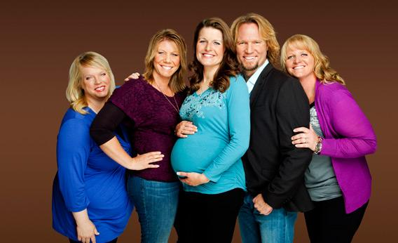
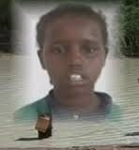
CULTURE
This adds on to the idea that crime is socially constructed and there is no true definition of crime.
Definitions of crime and what is socially acceptable vary cross-culturally.
Some countries accept that a man can marry several wives. In the UK this is a crime of bigamy.
Adultery is seen as a serious crime in many states in the USA. This is also the case in many countries globally.
It’s not a crime in the UK, but it is grounds for divorce.
Aisha Ibrahim,
In 2008, a 13-year-old rape victim was stoned to death by 50 men in Somalia under the Islamic government's laws.
Notes:
Oklahoma , MASSACHUSSET
This adds on to the idea that crime is socially constructed and there is no true definition of crime.

Slide 30

Read this article about Criminal Responsibility and Age
https://www.theguardian.com/science/2011/dec/13/age-criminal-responsibility-brain-scientists
Age Factors

Slide 31
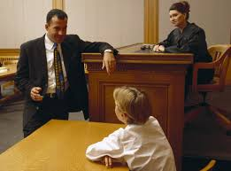
AGE
At what age children understand the difference between right and wrong is difficult to ascertain.
If someone commits a crime they should understand that it is wrong.
Age of criminal responsibility is 10 in the UK.
A 10 year old can be tried in a UK court.

Slide 32
Criminal Responsibility and Age
In England, Wales and Northern Ireland, a child is deemed fit to stand trial at the age of 10, but in recent years it has been shown that important changes in the brain's neural circuits go on well into a person's teens. In Scotland children cannot be convicted until they are 12.
"A number of psychologists have already shown that adolescents are not wholly responsible individuals and are inclined to take risks and behave in irresponsible ways,"
Nicholas Mackintosh, a professor in the department of experimental psychology at the University of Cambridge.

Slide 33
MITIGATING CIRCUMSTANCES
There are some circumstances in which the legal system can take the situation/context of the crime into account.
Actus reus = the person should be in control of what they are doing.
Mens rea = it is the intention to commit the act that constitutes a crime.
Can you think of a situation where circumstances would be considered therefore negating a criminal act?
Specific circumstances

Slide 34
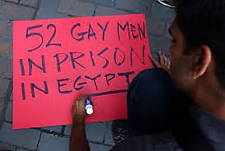
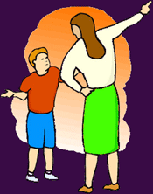
Consider this…
Before 1967, homosexual acts were illegal in the UK. Now homosexual acts are legal in the UK but considered to be illegal in more than 70 countries in the world.
The 2004 children’s act made it illegal for parent to to smack their children
HistoricalContext
Notes:
What does this suggest about crime?

Slide 35
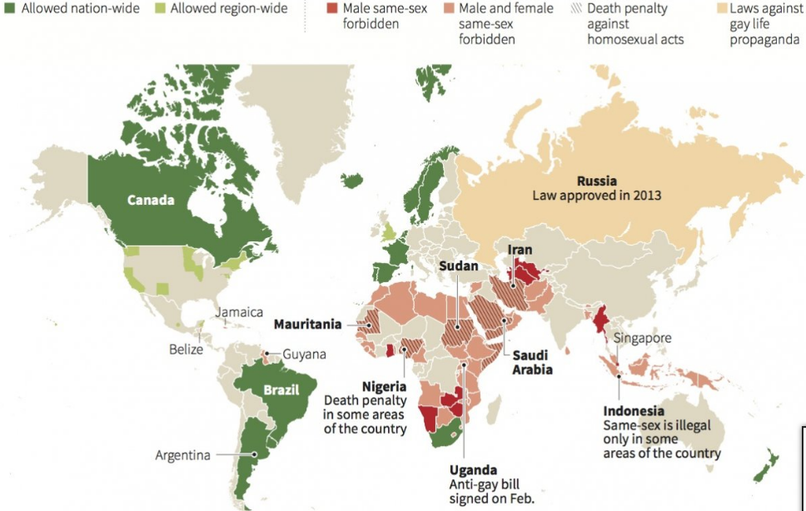

Slide 36
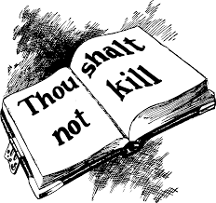
Defining ‘Crime’
Some behaviours are universally regarded as unacceptable and unlawful. E.g. Murder. However, some countries will give a lenient punishment for ‘crimes of passion’ or even ‘honour killings’.
Remember, a crime is only a crime if a law is broken.
Notes:
Charlotte’s group

Slide 37
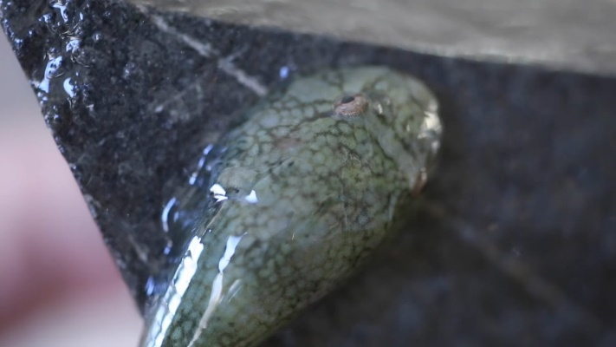
The problem of Defining ‘Crime’
Crime is any act (or lack of acting, e.g. Not paying TV licence, road tax, MOT) that violates the law and is punished by the state.
BUT…we should consider the H_________ C_______, S__________ context, age of offender as well as the specific C_____________ when defining crime.
Crime is a socially dynamic construct.
What is considered ‘criminal’ changes all the time
The definition of crime is time relative and
culturally relative

Slide 38
Typical EXAM QUESTION
Explain two problems in defining crime
One problem in defining crime is (state the problem) ….. This problem arises because …
Another issue with defining crime is (state the problem) this is a problem because …
Don’t answer this Q

Slide 39
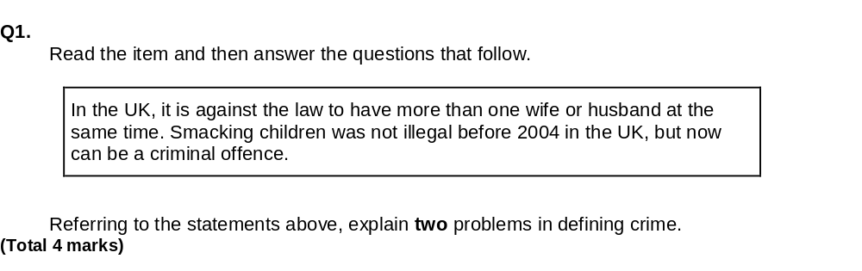
Exam Question –timed you have 5 minutes

Slide 40
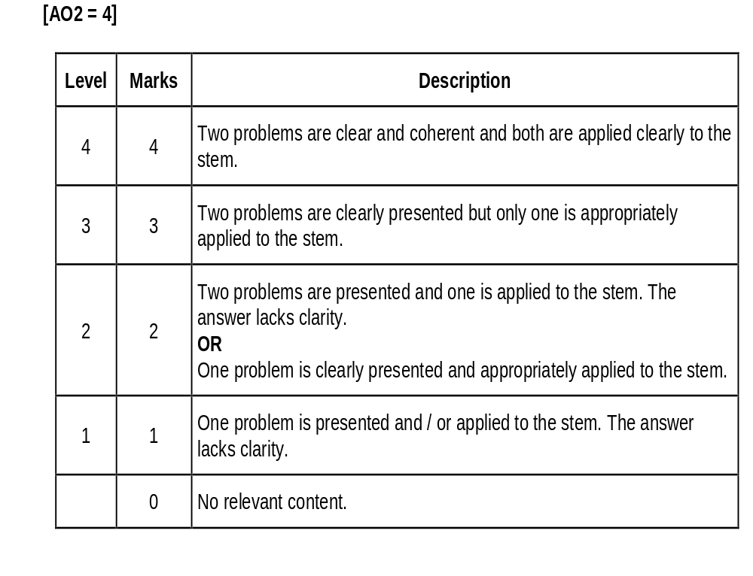
Exam Question Answer
TIME RELATIVE
because attitudes change according to historical context, over time attitudes to child rearing and child discipline have changed and so whilst smacking was common practice many years ago since 2004 it is no longer acceptable
CULTURALLY RELATIVE
because social attitudes differ between cultures, e.g. having more than one wife / husband is socially acceptable in some cultures because it is legal and common practice but illegal still in the UK .

Slide 41
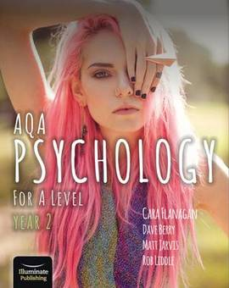
Time to read your PHG digital text book to consolidate
Complete page 2 of your crime pack whilst these ideas are still fresh in your mind ☺

