Slide 1
Recap top-down profiling

Slide 2
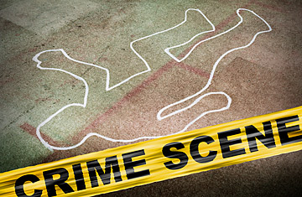
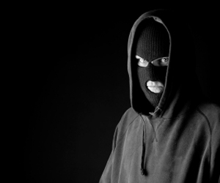
The Bottom-Up Approach to Offender Profiling
Facts about the offender
Aim: to critically investigate the bottom up approach within offender profiling.
STARTER: WHAT ARE 3 LIMITATIONS OF THE TOP DOWN APPROACH? LINK BACK TO LAST LESSON!!
Evidence and analysis of the crime scene

Slide 3


10 minute challenge!
Define what is meant by offender profiling (3marks)
Distinguish between organised and disorganised types of offender (4 marks)
Notes:
Page 354 white mask – the case of Arthur Shawcross

Slide 4
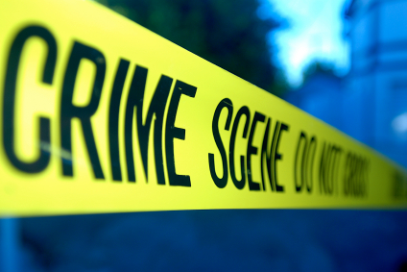
Learning Objectives
Explain bottom up approach to profiling,including investigative psychology and geographical profiling
Use research evidence to evaluate the usefulness of offender profiling

Slide 5
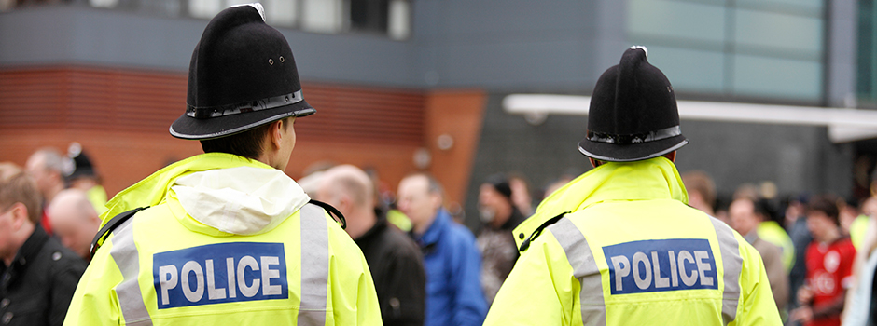
Bottom-Up Approach to Profiling
Is based on scientific theory and research
David Canter – Main researcher in this field
Two main approaches in Bottom-Up Profiling
Investigative Psychology
Geographical Profiling

Slide 6
Bottom-up approach
Unlike the FBI top down style of profiling the bottom-up approach does not use fixed typologies.
Instead it is ‘data driven’ which means the profile emerges from detailed crime scene analysis.

Slide 7

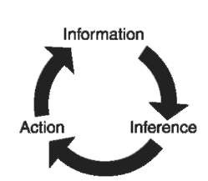
Investigative Psychology
Explores patterns that occur across crime scenes. These patterns are then used to generate data about the offender.
There are 5 key assumptions:
There will be ‘Interpersonal coherence’ The offender will behave in the same way in their everyday life as they do at the crime scene. i.e. if they are violent at the crime scene they are likely to be violent in everyday life.
The time and place of the crime is important. It may indicate where the offender is living or type of employment, shift work, night work, weekends off etc.
Notes:
There is an opportunity to recap on research methods: specifically ‘correlations’

Slide 8
3. Criminal characteristics and criminal career - it is assumed that crimes follow a pattern which enable predictions of future behaviour
4. Forensic awareness - Certain behaviours deduced from the crime scene analysis may reveal awareness of particular police techniques which would aid profiling. E.g. Davis et al (1997) found that rapists who conceal fingerprints often have a previous conviction for burglary.
5. Small space analysis - Data about crime scenes and offender characteristics can be correlated and analysed to reveal underlying themes.

Slide 9
Statistical analysis is large part of Investigative Psychology
Statistical analysis enables the profiler to detect specific patterns of behaviour.
A statistical data base has already been developed, and this is used as a baseline to compare against.
Features of an offence can be matched against the data base which will flag up statistically likely probabilities of other characteristics the offender may have, like age, occupation etc

Slide 10

Geographical Profiling
------ Criminals reveal themselves by the locations they choose.
Is a form of bottom up profiling based on the locations of a series of crimes.
It analyses the spatial relationships between different crime scenes and how they might reveal the offender’s place of residence.

Slide 11
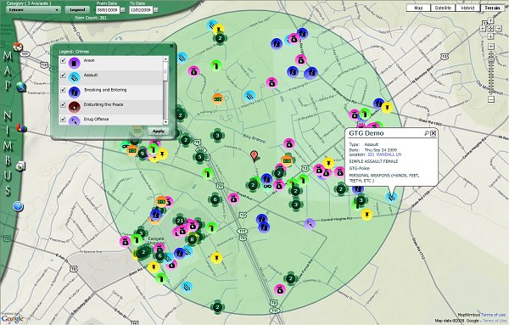
Geographical Profiling
Key terms
Locatedness
Crime location choice
Centrality
Comparative Case analysis
See tutor2U pack for further information
Rossmo (1997) believed an offender’s operational base for possible future offences are revealed by the geographical location of their previous crimes.
Notes:
Locatedness where different parts of the crime happen
Crime scenes are not random
Cluster – commuters and marauders
Crimes being done by same person

Slide 12
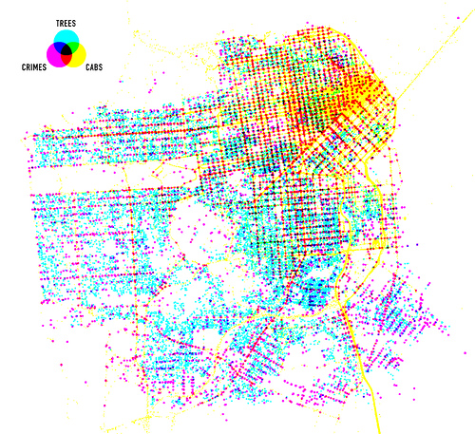
Crime Mapping
The locations of the crime are used to infer the home or operational base of the offender.
Crime mapping is used alongside investigative psychology to develop hypotheses about the offender and their habitual way of working (modus operandi).

Slide 13
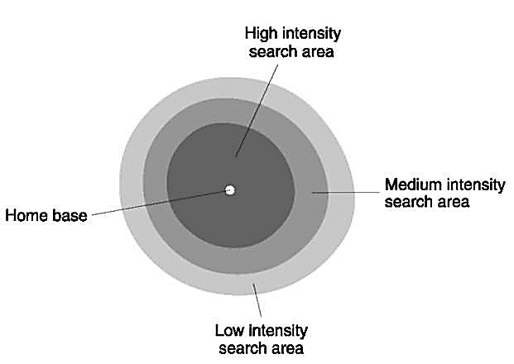
Geographical Profiling
Circle Theory: Canter & Larkin (1993)
Offenders have a spatial mind-set and they commit crimes within a geographical ‘circle’.
Criminals reveal themselves by the locations they choose.

Slide 14
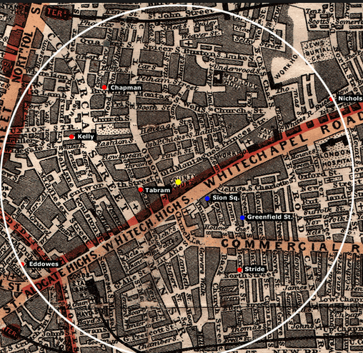
Marauders and Commuters
Circle Theory proposes two models of offender behaviour. People operate within a limited spatial mind set that creates imagined boundaries in which crimes are likely to be committed.
The Marauder: the offender operates in close proximity to their home base.
The Commuters: the offender is likely to have travelled a distance away from their usual residence.
Marauder vs Commuter

Slide 15
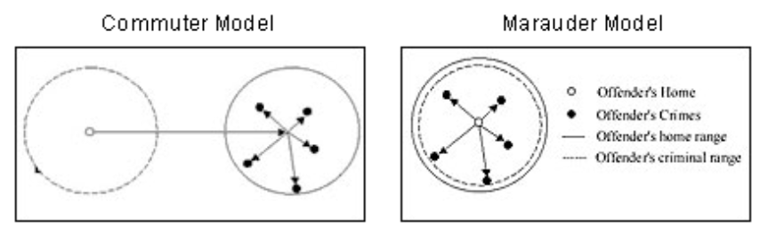
Geographical profiling
Notes:
Tends to be statistical in nature

Slide 16
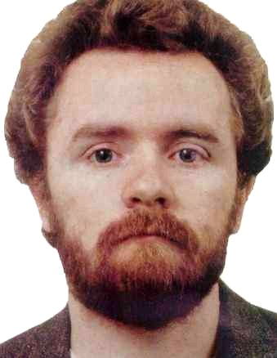
John Duffy, the “Railway Rapist”
Committed 24 sexual attacks in the 1980s and 3 murders in railway stations across North London.
David Canter analysed geographical information from similar crime scenes and details of similar attacks to draw up a surprisingly accurate profile of Duffy using bottom-up profiling techniques.
See tutor2U pack and page 356 White mask for his amazingly accurate predictions!

Slide 17
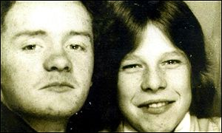
John Duffy Documentary Clip: Warning graphic
https://www.youtube.com/watch?v=P6YuBqIlcGY

Slide 18
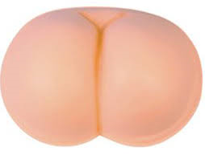
Evaluating the Bottom Up Approach
Supporting evidence comes from Canter & Heritage who showed how useful statistical analysis can be
Canter also found spatial consistency in 120 serial murder cases in the US. This supports his circle theory
It is scientific and therefore objective and more reliable.
They did content analysis of 66 sexual assault cases and identified some common features
It has wider application as spatial and interpersonal consistency can be found in other crimes like burglary and arson
48 UK Police Forces were surveyed and 83% said that the process was useful!
BUT…only 3% said that it actually helped to catch the offender.
Profiling cannot reliably identify an offender but it can help to narrow down the pool of suspects.

Slide 19

Prep
Use your text books to add detail to the evaluation issues
then
Complete p9-10 of your Forensic pack
Read GHG digital textbook, and tutor2U pack
Complete pages 1-10 in the Forensic pack
Find out more about a case of O.P: Duffy, Shawcross, Colin Stagg

Slide 20


Top down or bottom up?!
10 professional profilers in the UK (bottom up approach) and 10 USA profilers (top down approach) were given details of a murder case that they had never seen before. All were asked to write a profile on the offender based on the information they were given. The accuracy of the profiles were rated by two independent judges and the difference in accuracy between the UK/US profiles was analysed.
What was the experimental design and why? (2marks)
What is a limitation of the design above. Explain it (3marks)
Explain how the independent judges could have assessed the reliability of the ratings (3marks)
Which statistical test could be used and why? (3marks)
Notes:
1. Independent groups, 2. Independent groups may contain individual differences which act as PPs variables, which could have a been avoided via matched pairs design 3. test-retest method to test them on separate occasions to see which extent the PPs produce the same answers the second time around. 4. Mann-Whitney U test as it was independent groups and it produced ordinal data (the rankings).

Slide 21
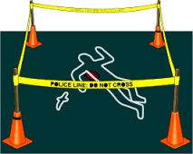
Exam Practice: 20mins
Discuss investigative psychology and/or geographical profiling. Refer to evidence in your answer. (16)

