Slide 1
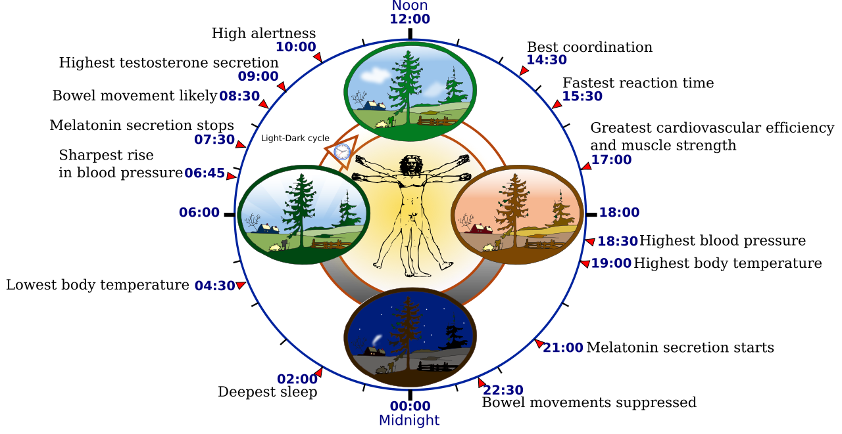
Biological Rhythms - Circadian Rhythms
Link to spec 4.2.2
A biological rhythm is a change in the body processes or behaviour in response to cyclical changes within the environment.

Slide 2
What do you need to know?
Biological rhythms
Circadian rhythms - The sleep/wake cycle
Research into the sleep/wake cycle
Practical application of research findings - shift work and drug treatments
Evaluation of research

Slide 3
Biological Rhythms - Introduction
All living organisms - plants, animals and people - are subject to biological rhythms and these exert an important influence on the ways in which the body system behaves.
All biological rhythms are regulated and governed by two things:
Endogenous pacemakers - The body’s internal body clocks that regulate biological rhythms e.g. suprachiasmatic nucleus - detects light, even when eyes are closed.
Exogenous zeitgebers - External factors in the environment which reset our biological clocks e.g. light, social cues

Slide 4

Circadian Rhythms - 24 hour cycles
Two examples of circadian rhythms:
Sleep/wake cycle
Core body temperature
The sleep/wake cycle:
Feeling drowsy at night time and alert during the day demonstrates the effect of daylight.
But what if we tried to change this? What is the biological clock was ‘left to its own devices’?
What if we were exposed to NO light and had no idea what time of day it was?

Slide 5
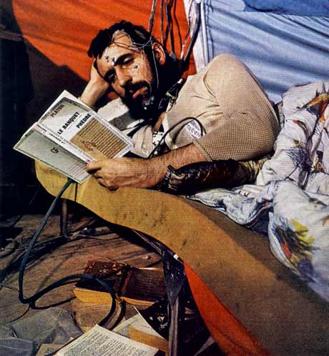
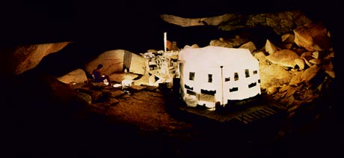
Michel Siffre - The Cave Study
In 1962, Michel Siffre spent two months living in total isolation in a subterranean cave, without access to a clock, a calendar, or sun light.
Sleeping and eating only when his body told him to, his goal was to discover how the natural rhythms of human life would be affected by living “beyond time.”

Slide 6

Michel Siffre - The Cave Study
After a 2 month cave stay, he then lived in a cave for 6 months! His findings were:
He settled into a sleep/wake cycle of 25 to 30 hours - usually just beyond the usual 24 hour cycle
“My sleep was perfect! My body chose by itself when to sleep and when to eat.”
Supports the assumption that endogenous pacemakers exert an influence on circadian rhythms
NOTE: In follow up experiments, the findings varied - Ps managed 48 HOURS CYCLES! 36 hrs active and 8-12 hours sleeping.

Slide 7
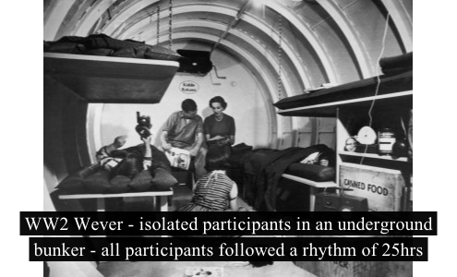
Other research….
Aschoff and Rutger (1976)
Placed participants in a bunker for 4 weeks with no natural light.
They settled into a sleep/wake cycle of between 25 and 27 hours (apart from one which extended to 29 hours).
This suggests that endogenous pacemakers control the sleep/wake cycle in the absence of light cues.
But what about the role of exogenous zeitgebers?
They still used artificial light, typical meal times….perhaps these were confounding variables?

Slide 8
Research: Circadian rhythms cannot easily be overridden by external environment
Folkard et al (1985) isolated 12 participants from natural light for 3 weeks (dark cave), manipulating the clocks so that only 22 hours passed a day.
None of the Ppts could adjust conformably to the pace of the clock, showing the strength of the circadian rhythm as a free-running cycle and questions the extent to which it can be overridden by exogenous zeitgebers.
Evaluation: It is difficult to generalise the findings from studies of the sleep/wake cycle because individual cycles can vary, in some cases from 13-65 hours!
There are also age differences in the sleep/wake cycle:
Read and answer the apply it on page 47.

Slide 9

Look at the evidence
Achoff and Weaver – cave students more than 24 hours (students)
Folkard – more than 24 hour clock
Boivin – shift work
Knutsson – heart disease
Baraldo - Real world applications – pharmacokinetics
Duffy – individual difference = larks and owls
Core Body temperature (Folkard, Gupta)
IDA: Biological approach is testable and objective thus scientific

Slide 10
Complete the Gapfill

Slide 11
Biological Rhythms - Circadian Rhythms
Link to spec 4.2.2 – Part two
A biological rhythm is a change in the body processes or behaviour in response to cyclical changes within the environment.

Slide 12
Evaluation of Circadian Rhythms
Practical application AO2 - Shift work
Desynchronisation: Disruption of circadian rhythms
Read the report from Consolidated Widgets’ shift system.
TASK: Write a report identifying the problems with Consolidated Widgets’ shift system.
NOTE: The quality of your report will determine the future of the Dudley Widget Works. If the management are convinced to implement the changes you suggest, and the changes work, then the workers can look forward to many more years of happy widget making ☺
There is a success criteria for this………..

Slide 13
Success Criteria: AQA style………
Explain the problems that night-shift workers experience and use evidence from psychological studies to back up the claims you make.
Suggest changes that the company could make to reduce their current problems and explain why the changes you suggest would work, using evidence where possible.

