Slide 1
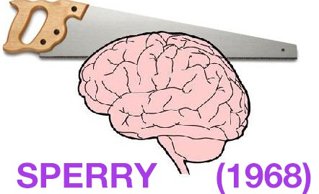
What ppts saw in their right visual field went to which hemisphere?
Left
Could they verbally describe this?
Yes
Why?
The left hemisphere is responsible for language

Slide 2
What they saw in their left visual field went to which hemisphere?
Right
Could they verbally describe this?
No
Why?
Because the language centre is not normally located in this hemisphere

Slide 3
Why?
Because the information in the right hemisphere could not reach the language centre in the left hemisphere as there was no corpus callosum
Can they report seeing anything at all?
They may be able to recognise a picture and point to it using their left hand

Slide 4
Aims and objectives
Be able to outline the Sperry study – Part two
Be able to discuss the strengths and weaknesses of Sperry

Slide 5
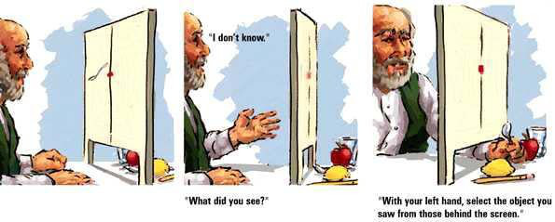
Sperry (1968) TASK TWO
Tactile task
Connected with the sense of touch
Participants placed their hands under the tachistocope so that they could reach the objects
The participants hands and the objects were covered
This was a control to ensure there was no visual stimuli going to either hemisphere and thus could not confound the results

Slide 6
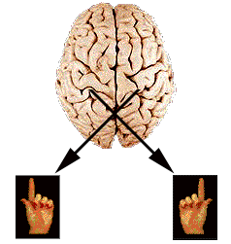
On the brain worksheet, illustrate this
Participants were introduced to objects by an experimenter, who placed them in the participants’ hands
Objects placed in the right hand of the participant are processed in the left hemisphere
Objects placed in the left hand of the participant are processed in the right hemisphere

Slide 7
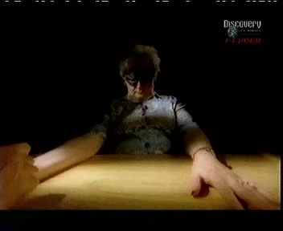
Sperry (1968) TASK TWO
Objects placed in participants right hand (__________ hemisphere?)
These objects could be described in speech or writing
Why?
The left hemisphere is responsible for language
LEFT

Slide 8
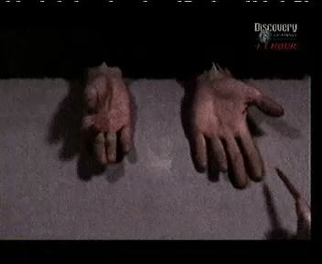
Sperry (1968) TASK TWO
If an object was placed in their left hand (__________ hemisphere?)
The participants did not know what they were holding and could only guess
Why?
Because the information in the right hemisphere could not reach the language centre in the left hemisphere as there was no corpus callosum
RIGHT

Slide 9
Sperry (1968) TASK TWO Summary
From objects placed in the right hand, information was sent to the….
Left hemisphere
This allowed the individual to describe in speech or writing OR guess?
describe in speech or writing
Why?
Language centre is in left hemisphere!

Slide 10
Sperry (1968) TASK TWO Summary
From objects placed in the left hand, information was sent to the….
right hemisphere
This allowed the individual to describe in speech or writing OR guess?
guess
Why?
In the absence of a corpus callosum, information cannot reach the language centre

Slide 11

Task
Line up in pairs
Individuals on the left, you are now the left hemisphere
Individuals on the right, you are now the right hemisphere

Slide 12

Right hemisphere…. Close your eyes!
Left hemisphere look at the screen and write on your white board what you see

Slide 13
Can the left hemisphere tell the class what they saw?
The left hemisphere was able to report what they saw… why is this?
Because the left hemisphere controls language and speech

Slide 14

Left hemisphere…. Close your eyes!
Right hemisphere look at the screen and write on your whiteboard what you see

Slide 15
If the left hemisphere is responsible for speech, how will the right hemisphere transfer that information over to allow information to be spoken??
It cant!
Not without a corpus callosum
Left hemisphere… what did the right hemisphere see?

Slide 16
While the right hemisphere saw something and was able to report it, it cannot be passed over to the language centre to be reported
This means the left hemisphere does not know what the right hemisphere has seen
This is why participants thought they had not seen anything or just guessed!

Slide 17
Combining visual and tactile…
When shown a word on the right side of the screen (RVF)
The individual is able to verbally identify what they have seen
Why?
Because information from your right visual field is sent to your left hemisphere – where language and speech are controlled

Slide 18
When shown a word on the left side of the screen (RVF)
The individual is not able to verbally identify what they have seen
They may appear to have ‘missed’ it or simply claim to not have seen anything

Slide 19
However…
Video 2.12-4.40
The interesting thing is….
When asked to draw what they saw in their left visual field (processed in the right hemisphere) with their left hand (controlled by the right hemisphere) they are able to draw the object they didn’t even know they’d seen!

Slide 20
What was Sperry’s conclusion?
Sperry highlights the different functioning of the two hemispheres. This research supports the idea of localisation of function.
The LEFT hemisphere is specialised for speech, writing and language
It can communicate about the visual experiences of right visual field and about the experiences of the right half of the body

Slide 21
What conclusion can Sperry draw?
The RIGHT hemisphere is mute and cannot speak or write
But can show non-verbal mental processes for the left visual field. It can also process emotion.

Slide 22
Decide whether the following is a strength or a weakness of Sperry… and why
The use of a quasi-experiment allowed the researchers to investigate variables which are not normally able to be investigated
For example: the use of split-brain patients
This is a strength!

Slide 23
Decide whether the following is a strength or a weakness of Sperry… and why
The study raises ethical issues as the participants may have become frustrated, embarrassed or distressed whilst completing the tasks asked of them
This is a weakness!

Slide 24
Decide whether the following is a strength or a weakness of Sperry… and why
Snapshot studies do not allow the researcher to discover whether results are due to the development of the behaviour or to individual differences
This is a weakness!

Slide 25
Decide whether the following is a strength or a weakness of Sperry… and why
Sperry used techniques which allowed the functions of the two hemispheres to be studied
This allowed for the researchers to measure each hemisphere in isolation
This is a strength!

Slide 26
Decide whether the following is a strength or a weakness of Sperry… and why
The study was conducted under strictly controlled conditions
This means it is high in reliability
This is a strength!

Slide 27
Decide whether the following is a strength or a weakness of Sperry… and why
As a quasi-experiment is naturally occurring, the researchers had less control over the IV
This means, Sperry was not able to test these participants before their operation
And so, it is possible their brain functioning may have been different to the norm before the operation
Thus, drawing conclusions about the functions of the hemispheres in non-separated brains becomes difficult
This is a weakness

Slide 28
Write in your own words, highlighting the key terms, of what we have learned

Slide 29
Make study cards
Evaluation… either
One strength and One weakness
Two strengths
Two weaknesses
Well explained PEE
Sperry (1986)
Task 2
Aim
Procedure
Results
Conclusion
Try to think of a weakness that counterbalances a strength!

