Slide 1
Aims and objectives
To be able to outline the functions of the different hemispheres in the brain
To develop an understanding of the Sperry split brain research

Slide 2
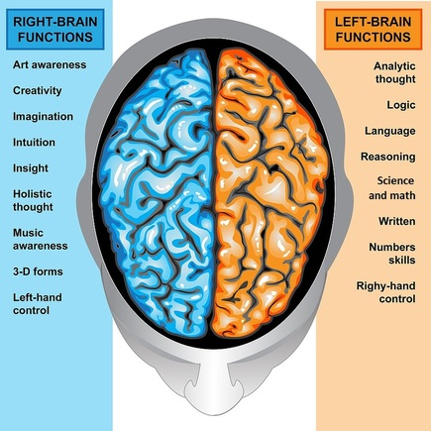
Let’s recap!
The brain has _________ hemispheres
These are called the:
__________ hemisphere and the ____________ hemisphere
TWO
RIGHT
LEFT

Slide 3
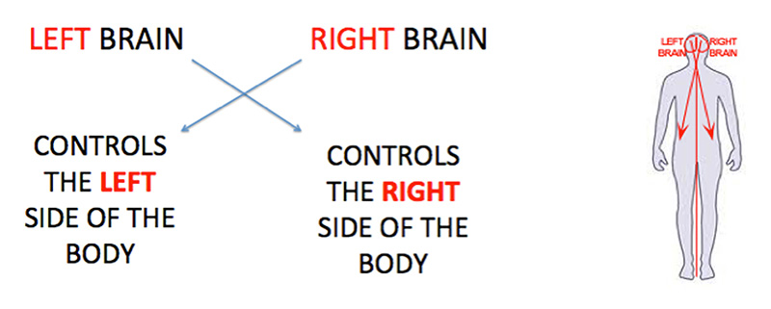
The brain hemispheres are contralateral
The left hemisphere controls the right side of the body
The right hemisphere controls the left hand side of the body
On your handout, label each hemisphere and the side of the body it controls

Slide 4
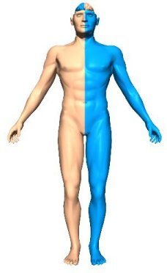
This means if a person has a stroke in the motor areas of their right hemisphere, it will be the left side of the body which is affected by the stroke
And similarly vice versa

Slide 5



If you look straight forward and cover your right eye…
Everything on the left of your noise is the left visual field
Everything on the right of your nose is the right visual field
Right
Visual
Field
Left
Visual
Field

Slide 6


L
O
O
K

Slide 7





Humans are … cross-wired
Left side
Right
side
Each eye has both a right and left visual field
Any thing seen in the right VF of either eye goes into to the left hemisphere.
and vice versa
Left
hemisphere
(Language)
Right
hemisphere
(drawing)
Left
Visual
Field
Right
Visual
Field

Slide 8
On your handout…
Draw a pair of eyes above your brain
Label the left visual field and the right visual field
Label the left hemisphere and the right hemisphere

Slide 9
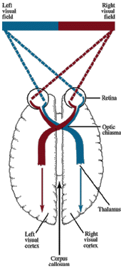
What you see in your right visual field is processed by the left of your retina, which is sent to your left hemisphere
What about things you see in your left visual field? What side of your retina is this processed by?
The right side of your retina
Before it is sent to where?
Your right hemisphere!
Outline this on your handout

Slide 10
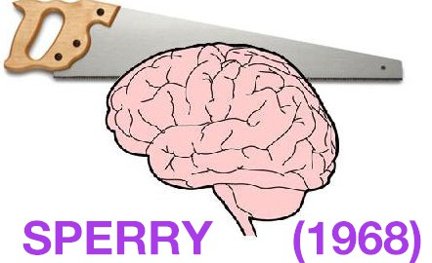
Sperry (1968)
Wanted to investigate the functions of each hemisphere
First he used cats and monkeys.
His human ppts were split-brain patients

Slide 11
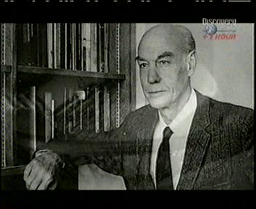

Slide 12
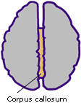
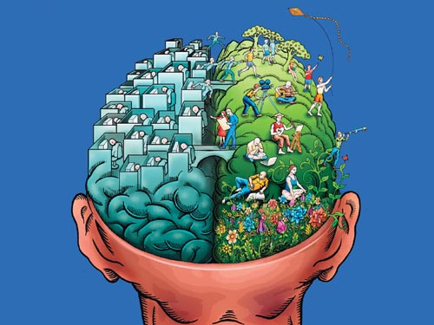
What is a split-brain?
Show the corpus callosum on your worksheet and label
As we know, the brain is made up of two hemispheres: the left and the right
The hemispheres are connected by a ‘bridge’ called the corpus callosum
The ‘bridge’ is a bundle of fibres which act as a communication pathway so that the two hemispheres can exchange information
When the corpus callosum is severed, information cannot travel from one hemisphere to the next… thus, splitting the brain into two unconnected hemispheres

Slide 13
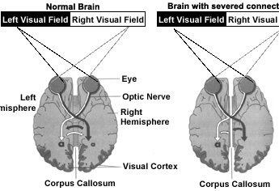
Notice THAT after the split brain operation …
Information from the left visual field is still able to reach the right hemisphere
Information from the right visual field is still able to reach the left hemisphere
Because the optic nerve was not cut
However after the operation, the right hemisphere cannot communicate with left hemisphere and vice versa

Slide 14
Why would you want to severe the corpus callosum?
To help reduce the symptoms of epilepsy that cannot be cured by drug treatment
Individuals who suffer from epilepsy often endure total seizures
During a seizure, there is an electrical storm in one hemisphere of the brain, which then travels across the corpus callosum, causing the entire brain to be affected – ‘fuse box blown’
By severing the corpus callosum this travelling of the electrical storm cannot occur and thus blackout and epileptic fits cease

Slide 15
And so…
People who suffer epilepsy and are not helped by drug treatment, brain surgery to sever the corpus callosum is considered as an option
Individuals who endure this surgery are considered ‘split-brain’ patients

Slide 16
Sperry (1968) Aim
To investigate the effects of hemisphere disconnection and to show the functions of each hemisphere

Slide 17
Sperry (1968) sample
11 participants
All participants were epileptic
All participants had previously undergone surgery, severing their corpus callosum to deal with their severe epileptic seizures

Slide 18
Sperry (1968) design
Same group of participants in all conditions
Repeated measures design

Slide 19
Sperry (1968) Method
Quasi experiment…
What is this?
When participants are not randomly assigned to experimental groups… the participants have split-brains not for the purpose of the study –this is something that these people have

Slide 20
Sperry (1968) Method
INDEPENDENT VARIABLE – whether individual has split brain or not
DEPENDENT VARIABLE – the individuals performance on task
In reality , the study did not have a control group because the effects of not having a split brain were already known

Slide 21
Sperry (1968)
A case study
The intense study of 11 patients
Investigating their behavioural symptoms resulting from hemisphere disconnection
A snapshot study
Each split-brain patient was tested at one point of time and their behaviour was monitored in relation to information presented to different visual fields and through touch alone

Slide 22
Remember
Information displayed on the left visual field
This information would then travel to which hemisphere?
The right!
Information perceived by the right hemisphere and would travel to which hemisphere?
The left!

Slide 23
Sperry (1968) procedure
Participants were provided with two tasks:
Task one: visual task
Task two: tactile task

Slide 24
Sperry (1968) TASK ONE
Participants covered one eye and were asked to stare at a focal point on a screen
The researcher then would project a stimulus on either the left or the right hand side of the fixation point for less than one-tenth of a second
Why was the time so short?
To minimise the eye movement, as this would ‘spread’ the information across both sides of the visual field and therefore across both hemispheres

Slide 25
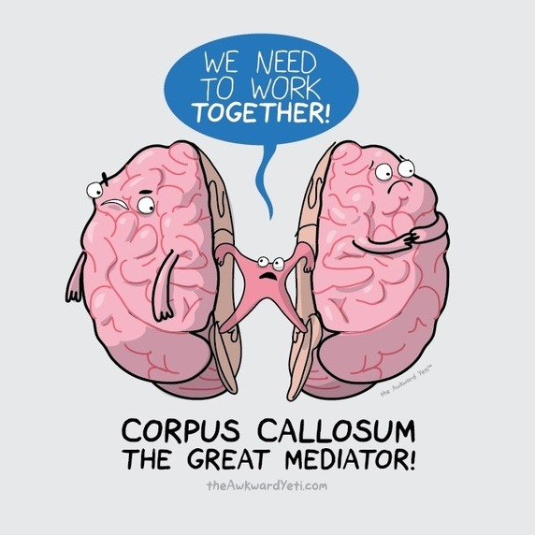
Sperry (1968) TASK ONE: Findings
When participants were shown stimuli in the right visual field, and then shown the same stimuli to the left visual field, they would claim to have not seen it before
Why?
There is no corpus callosum to bridge the information from one hemisphere to the next!

Slide 26

Image shown quickly to left VF
Focal point
Can the ppt say what the picture is?

Slide 27

Focal point
Image shown quickly to rightVF
Can the ppt say what the picture is?

Slide 28
Information presented to the right visual field (→ left hemisphere) could be described in speech, and writing with one’s right hand
Why could it be described in speech and writing?
Because the Left hemisphere is responsible for Language
Why with their right hand?
Because the left hemisphere controls the right side of the body

Slide 29
When information was presented to the left visual field (→right hemisphere) the participant insisted he either did not see anything, or that there was only a flash of light
This is because there is no bridge for the information to cross to the Left hemisphere in order to reach the Language centre
However, the individual was able to point to the picture of what they had saw (with their left hand… controlled by their right hemisphere)

Slide 30
Sperry (1968) Summary for TASK ONE
What they saw in their right visual field went to which hemisphere?
Left
Could they verbally describe this?
Yes
Why?
The left hemisphere is responsible for language and houses the language centre
Using whiteboards, answer the following…

Slide 31
Sperry (1968) Summary for TASK ONE
Using whiteboards, answer the following…
What they saw in their left visual field went to which hemisphere?
Right
Could they verbally describe this?
No

Slide 32
Sperry (1968) Summary for TASK ONE
Why?
Because the information in the right hemisphere could not reach the language centre in the left hemisphere as there was no corpus callosum
Can they report seeing anything at all?
They may be able to recognise a picture and point to it using their left hand
Using whiteboards, answer the following…

Slide 33
plenary
Try to draw what you have learned today

