Slide 1
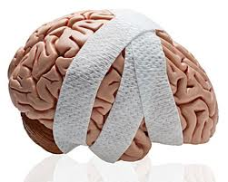
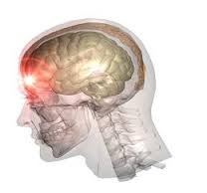
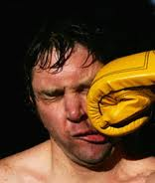
Lessons from Brain Injury and other anomalies

Slide 2
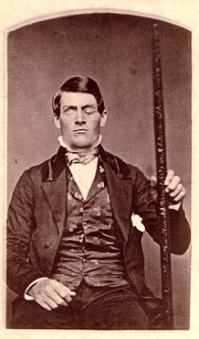
Phineas Gage
In 1848, a twenty-five-year-old construction foreman named Phineas Gage won nationwide fame by way of a hole in his head. While working on a railroad project in Vermont, he experienced a severe brain injury when a three-foot-long, fourteen pound tamping iron was violently propelled through his skull.
It entered through the bottom of his left cheekbone and exited through the top of his head, then continued to fly in an arc across the sky, landing almost 100 feet behind him.
Astonishingly, he lived to tell the tale.

Slide 3
What happened?
He lost consciousness and had convulsions on impact, but awoke quickly and was talking and walking soon afterwards
When Dr. John Martyn Harlow arrived, Phineas was conscious and had a regular heartbeat, and both of his pupils reacted to light normally. He was reported to be "in full possession of his reason, and free from pain."
He never showed any impairment of movement or speech
His memory was intact, and he was capable of learning new things
However, within months his personality had changed dramatically
  He became extravagant and anti-social, a foul mouth liar with bad manners, frequently got into fights and assaults.
  could no longer hold a job or plan his future
  According to friends “Gage was no longer Gage”

Slide 4
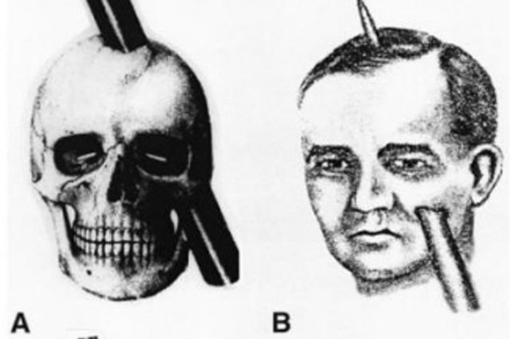
But while he was recovering, the doctor noted some changes in the man's demeanor and personality. People who had known him before the accident described him as hard-working, responsible, and popular with his workers, but after the traumatic injury, Phineas Gage was not the same man.
Within months his personality had changed dramatically
  He became extravagant and anti-social, a foul mouth liar with bad manners, frequently got into fights and assaults.
  could no longer hold a job or plan his future
  According to friends “Gage was no longer Gage”

Slide 5
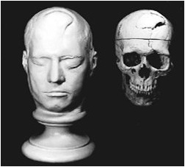
It was determined that damage occurred to Gage's skull in three places: There is a relatively small area under the cheek bone where the tamping iron first impacted, the orbital bone behind the eye socket, and very large hole where the iron rod emerged. The bone fragments over the exit wound were very skillfully put back in place by Dr. Harlow-- so much so that it was hardly visible from outside the skull-- but the original hole was about three and a half inches long by two inches wide.
The incident did much to advance the field of neurology, as it was among the first evidence suggesting that damage to the frontal lobes could alter aspects of personality and affect social skills. Before Gage's brain injury, the frontal lobes were largely thought to have little role in behavior.

Slide 6
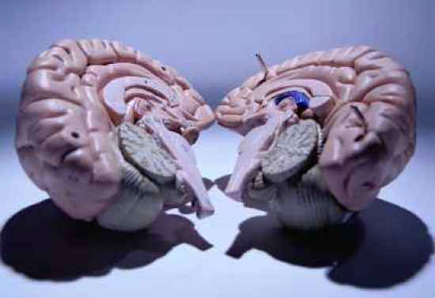
Split Brain Patients

Slide 7
Peter
Peter began to suffer from complex partial seizures at the age of 8. His seizures were severe, despite taking antiepileptic medication; so, at the age of 20, after struggling with his condition for over 12 years, he and his doctors agreed to have him undergo a commissurotomy.
The commissurotomy involved a surgical incision of Peter’s corpus callosum. The corpus callosum is the major cerebral nerve tract that connects the brain’s right and left cerebral hemispheres together; and therefore, serves as the major communication pathway for intrahemispheric signals.
Removal or damage to one’s corpus callosum would result in impaired communication between the two sides of the brain.

Slide 8
On one hand, Peter’s surgery was a success, as it did end up attenuating the magnitude of his seizures. On the other hand, however, Peter was left much different than before. For example, he was not able to respond with the left side of his body to verbal input.
If asked to “Stand like a Boxer,” his left side would sag and appear lackluster, while his right side would behave appropriately. Because his brain had, literally, been split into two separate pieces, his left and right sides were often behaving like two separate people.
He complained that his left hand would turn off television shows that he was enjoying, that his left leg would not always walk in the intended direction, and that his left arm would occasionally begin to fight with the right side of his body. It is clear from Peter’s case that the brain works best when it is capable of functioning as a single, cohesive unit, as opposed to multiple ones.

Slide 9
http://www.resourcd.com/@psychexchange/video/show/504
Gazzaniga and “Jo”

Slide 10

Prosopagnosia

Slide 11
This is exactly the life R.P. experiences everyday. R.P. suffers from prosopagnosia, which is an inability to recognize faces. In fact, prosopagnosia is only one of many visual agnosias (an agnosia is a failure of recognition). Other visual agnosias include: movement agnosia, object agnosia and color agnosia.
R.P. can usually recognize a face is a face, but generally cannot tell exactly whose face it is. R.P. does not report any other recognition problems, and like D.B. in the previous entry, has superb vision. Prosopagnosics often report seeing a jumble of individual facial parts that are not bound, or fused, into an easily recognizable whole. In some extreme cases, they cannot even recognize themselves. Prosopagnosia is associated with damage to the boundary between the brain’s occipital and temporal lobes, a region better known as the fusiform face area.

Slide 12
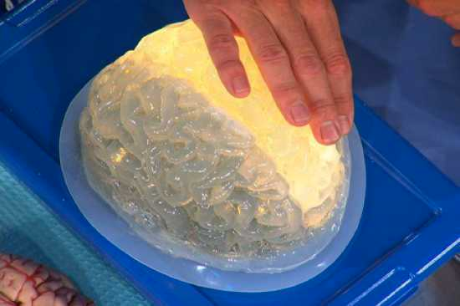
The woman who read with her right brain

Slide 13
Before contracting her illness, N.I. was a perfectly normal girl. Unfortunately, at the age of 13, she began to experience convulsions, along with deteriorated speech and motor abilities. CT scans revealed ischemic (lack of blood flow) brain damage to her left hemisphere. N.I. was still experiencing symptoms two years after the onset of her illness, and her right limbs had become paralyzed. In an attempt to relieve these symptoms, a total left hemispherectomy (removal of a hemisphere in the brain) was performed.
Post surgery, N.I. was able to recognize letters, but was totally incapable of translating them into sounds. She could read concrete familiar words (ie: fan), but could not pronounce even simple nonsense words (ie: neg). Her reading errors indicate that she reads on the basis of meaning and appearance of words rather than by translating the individual letters into sounds.
For instance, when shown the word “fruit” she would respond by saying: “juice.” Her responses are similar to people with a disorder known as ‘deep dyslexia’, which is an inability to apply rules of pronunciation while reading.
Deep dyslexics can still pronounce familiar words based on their specific memories of them, but similar to N.I., they cannot pronounce nonsensical words, or words they are unfamiliar with.

Slide 14
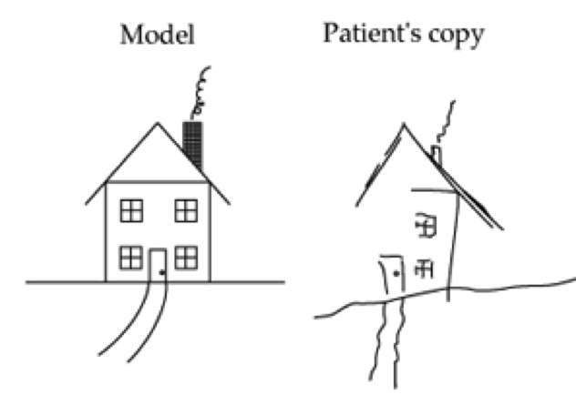
Neglect
After her stroke, Mrs. S. had been unable to recognize or respond to things on her left (this would include both external objects, and parts of her own body). For example, she often put makeup on the right side of her face but not her left. Mrs. S was suffering from contralateral neglect, which is a disturbance of one’s ability to respond to stimuli on the side of the body opposite (contralateral) to the site of brain damage. In the case of Mrs. S, her stroke had damaged her brain’s right posterior parietal lobe and, thus, she was plagued by left-side contralateral neglect.

Slide 15

This disability, as one might imagine, created many problems for her. One particularly troublesome problem was that she had difficulty getting enough to eat. When a plate full of food was placed in front of her, she could only see the food on the right side of the plate and, therefore, only ate that much, despite being very hungry.
Over time, Mrs. S. developed a clever way of getting more food if she was still hungry. While in a wheelchair, she would turn it around to the right in a full circle and stop when the remaining half of her meal would become visible. She would eat that, then turn once more until the remaining half of the previous portion came into view, and again, eat that. She would repeat this process until she was content or the plate became emptied, whichever came first.

Slide 16
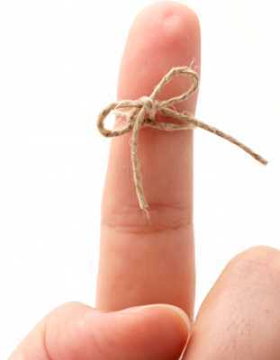
HM
The case of H.M. (Henry Molaison) is probably the most well known case on this list. Amidst all of its sadness, it has helped many scientists to advance the study of the nature of human memory.
Be that as it may, H.M. was the last patient to receive a bilateral medial temporal lobectomy for epilepsy; this was because the procedure had been responsible for producing profound amnesic effects. After his surgery, H.M. developed severe anterograde amnesia.

Slide 17
Anterograde amnesia is a form of amnesia that impairs one’s memory for any event after the onset of brain damage (in contrast to retrograde amnesia, which impairs one’s memory for any event before the occurrence of brain damage).
It turns out that H.M.’s general intelligence was not affected by the surgery (he scored above average on standardized intelligence tests). Much like his intellect, his memory for events predating the surgery was largely intact. In addition, H.M.’s short-term anterograde memory had also remained normal (ie: if given a list of 6 digits and asked to repeat them, he would do so without difficulty).
Sadly, however, H.M. had an almost total inability to form new long-term memories. Once he stopped thinking about an experience, it would be lost forever. H.M. could not recognize those who he had met after his surgery, and would require a reintroduction as though he had never seen them before. He spent most of his day doing crossword puzzles in the nursing home he was a resident of. His progress on a crossword puzzle was never lost because it was written down. H.M. was a prisoner in his own mind, suspended in time, for the rest of his life.

Slide 18
The Pinocchio experiment with body image
Find 2 willing (and good) friends
Sit on a chair blind-folded, and ask your friend (let’s call her Sam) to sit on a chair in front of you, with her back to you.
Ask your other friend to take your right hand and put it on Sam’s nose
Tap and stroke her nose in a gentle random manner, making exactly identical movements with your other hand, on your own nose.
Continue this for 60 seconds.
About 50% of people will have the extremely odd sensation that their nose is 3 feet long, or somehow their nose is elsewhere!

Slide 19
Phantom Limbs
Following amputation or paralysis of an arm or leg, most people still have a perception of their missing limb, and receive sensations from it.
For some people the phantom limb cannot move, for others it gesticulates when they talk and moves as before - even though the person knows the limb is missing or paralysed.

Slide 20
Phantom Limbs
About 80% of people with phantom limbs, feel excruciating pain from their missing limb, describing it as burning, aching, or 'as if my missing hand is being crushed in a vice’.
There is nothing phantom or imagined about the pain coming from a limb that is no longer there. The sensation is generated by the brain and as such is no different from pain elsewhere in the body.

Slide 21

Using mirrors to relieve phantom pain
Ramachandran wanted to test the idea that visual feedback could change the way the cortex operated, and reduce pain from phantom limbs.
He propped a mirror on a table and asked a man with a painful paralysed arm to arrange himself so that when he looked in the mirror he saw the reflection of his good arm in the position of his paralysed arm.
The idea was to trick his visual system into believing his paralysed arm was moving.
When the man watched the reflection of his good arm moving, he began to have the sensation that his paralysed arm was moving. That it had begun to obey his brains commands to move.
The man was able to take his arm out of its painful clenched position and reported a huge reduction in pain.

Slide 22
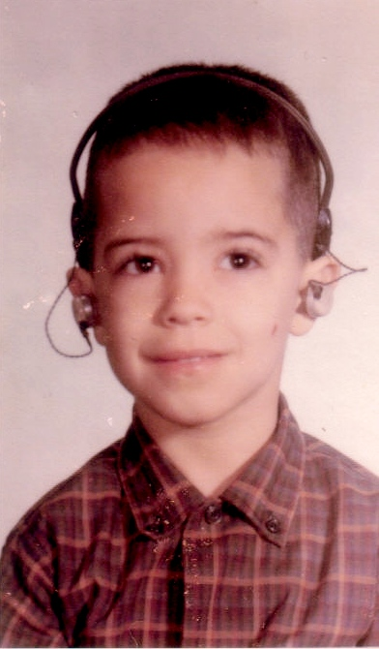
Savant Abilities
For the first five years of his life, doctors thought that Lidell Simpson was mentally retarded. Luckily, Lidell’s parents didn’t trust them. They didn’t send him to the nuthouse. Instead they had him fitted for a hearing aid that would blast sounds into Lidell’s tiny ears.
Together with lip reading and years of speech therapy the faint sounds Lidell could hear from the sound blaster made it possible for him to learn to speak. As it turned out, Lidell was not a "retard," he was super smart.

Slide 23
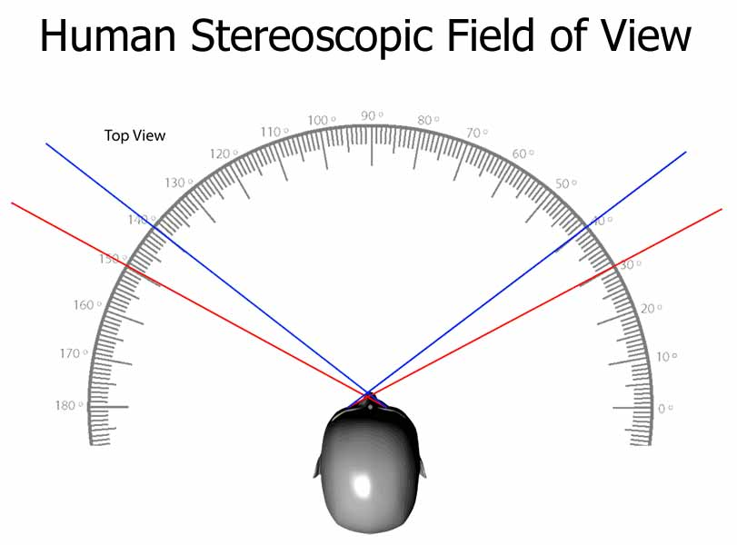
Lidell has other extraordinary abilities. He reports hearing a unique "ping sound" corresponding to every face he recognizes.
However, Lidell suffers from face blindness, also known as prosopagnosia. He cannot recognize faces using sight as the main source of recognition. Lidell’s “pings” counteract his face blindness. When people he knows enter the periphery of his visual field, he hears it internally as a “ping.” He tells us that one time when he was in the lobby of the Museum of Natural History in London, he suddenly heard a “ping.” It came from the other side of the room. As he walked across the room, he realized it came from a friend sitting with his head pointed downward reading the museum guide.
Early-deaf individuals sometimes undergo brain rewiring. Some early-deaf individuals, like Lidell, apparently develop extraordinary abilities to locate objects in space and to detect motion.
This phenomenon is also known as “neuroplasticity.” If the brain loses capacities, it can adjust itself to the loss by rewiring other brain regions.

Slide 24
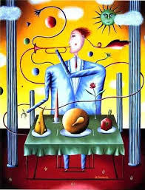
Synaethesia
Synaesthesia is a curious condition where there is a mingling of the senses due to cross-wiring in the brain.
People may taste spoken words, for example, on hearing the word 'table' they might taste apricots, whereas ‘book’ tastes like tomato soup and ‘telephone’ tastes like earwax.
What’s happening in the brain?
Colour information is analysed in the fusiform gyrus in the brain’s temporal lobe (area V4).
This is very close to the area of the brain that deals with the physical form of numbers (also in the fusiform gyrus).
It’s thought that a genetic abnormality causes these two areas to cross- wire.

Slide 25
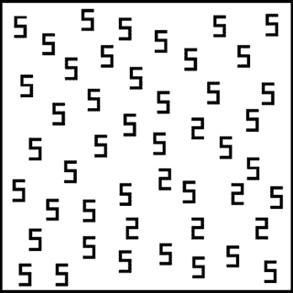

Slide 26
What did you see?
Most people see lots of 5’s. If they look for longer, they will see that some of the 5’s have been reversed and are 2’s.
Someone with number – colour synaesthesia will immediately see a triangle of 2’s – it would stand out because the 2 and the 5 are seen in two different colours.

Slide 27
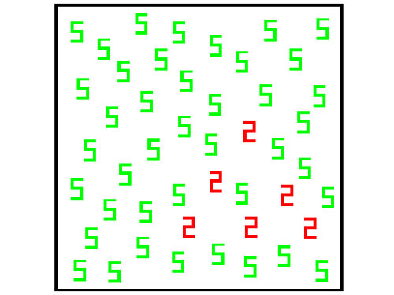

Slide 28
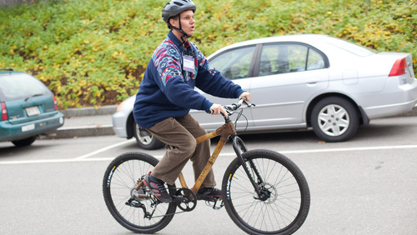
Echolocation
Daniel Kish was born with bilateral retinoblastomas, tiny tumors sitting on the retina. As this type of cancer spreads rapidly, aggressive treatment is necessary to prevent metastasis. Some patients have the retina surgically removed. Others receive laser treatments followed by chemotherapy. This latter treatment destroys the retina along with the cancer. Daniel lost his first eye at seven months and the other at thirteen months. He has no memory of having eyesight.
Daniel nonetheless navigates through crowded streets on his bicycle, camps out far in the wilderness, swims along beaches, dances all night long in crowded nightclubs and engages in many other activities that seem impossible for a person who can’t see.

Slide 29
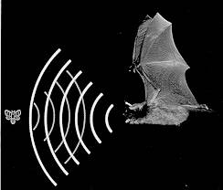
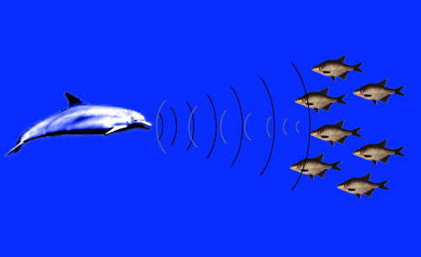
Using a technique similar to bats and dolphins, human echolocators navigate on the basis of audio cues from reflective surfaces in the environment. Seemingly impossible, echolocation comes quite naturally to people, like Daniel, who are deprived of visual information. Daniel makes clicking noises with his tongue to explore the environment.
American psychologist Winthrop Kellogg, best known for a controversial experiment in which he raised a baby chimpanzee alongside his own infant son, began a human-echolocation research program .Kellogg showed that with some training, both blind and sighted individuals are capable of determining properties, such as distance, size, shape, substance, and relative motion, using echolocation.
Oh! I’m so clever!

Slide 30
Visual Agnosia
Visual object agnosia (or semantic agnosia) is the most commonly encountered form of agnosia. The clinical "definition" of the disorder is when an affected person is able to copy/draw things that they cannot recognize. Individuals afflicted with the associative type often cannot identify, describe or mimic functions of items, though perception is intact, since images of objects can be copied or drawn.

Slide 31

Visual Agnosia
Integrative Agnosia
A form of visual agnosia in which one retains the ability to recognize elements of objects but is unable to integrate these elements together into comprehensible percept. People with integrative agnosia would be able to see the fruit and vegetables in this image; however, they would not be able to see that these foods create a face.
Category Specific Agnosia
Differential impairments in subject knowledge or recognition abilities pertaining to specific classes of stimuli, such as living things vs. non-living things, animate vs. inaminate things, food, metals, musical instruments, etc.

