Slide 1
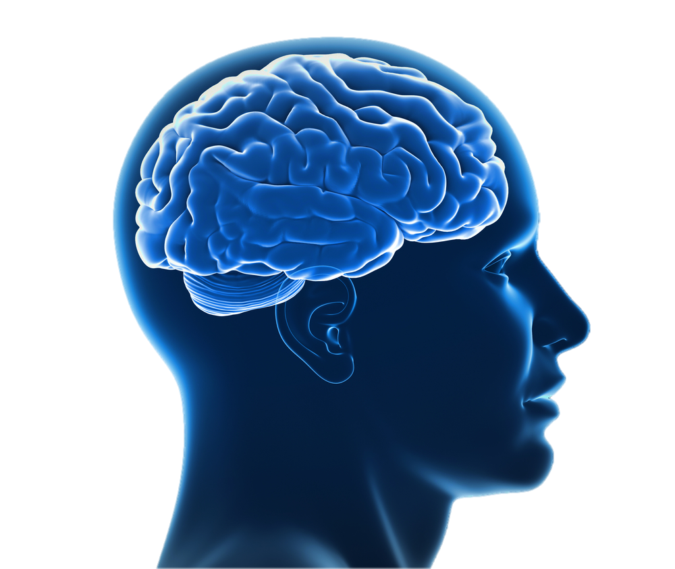
Localization of function

Slide 2
Localisation and lateralisation
Spec check: 4.2.2 Biopsychology
Localisation of function in the brain and hemispheric lateralisation: motor, somatosensory, visual, auditory and language centres; Broca’s and Wernicke’s areas, split brain research. Plasticity and functional recovery of the brain after trauma.

Slide 3

Pages 38-40 lots to click and discover

Slide 4
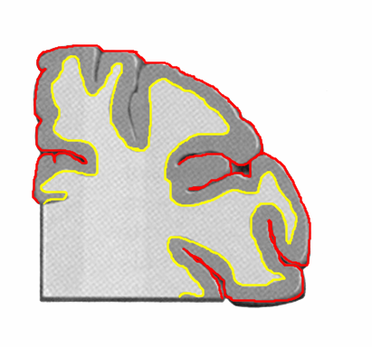
The cerebral cortex
The outer layer of the brain
3mm thick
Looks grey – ‘grey matter’
Known as ‘the thinking cap’
High developed

Slide 5
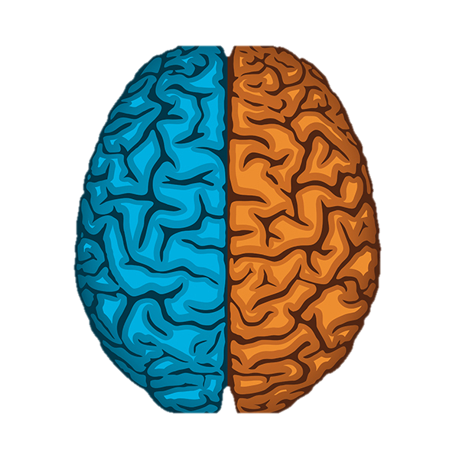
Lateralisation means the brain is divided into 2 hemispheres
Left Brain
Right Brain

Slide 6
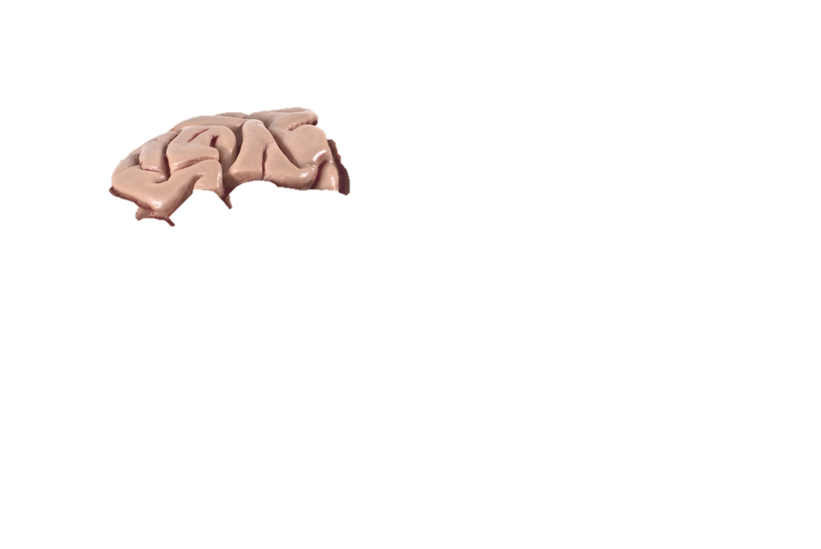
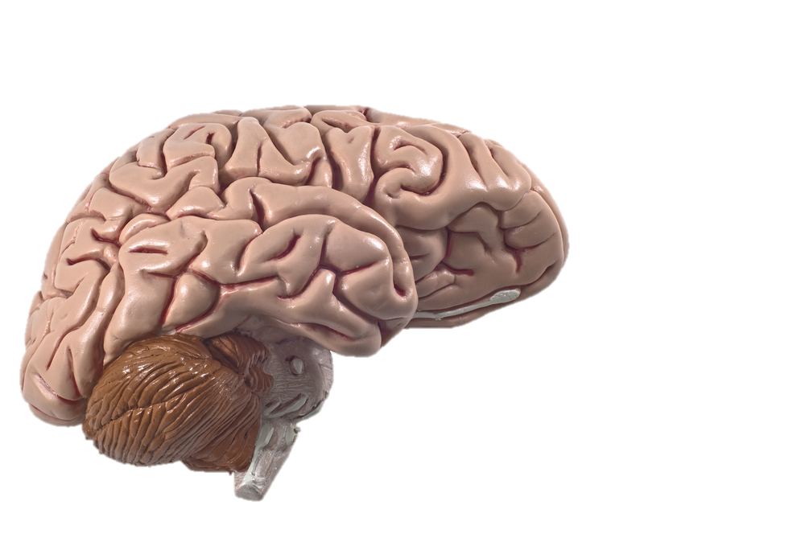
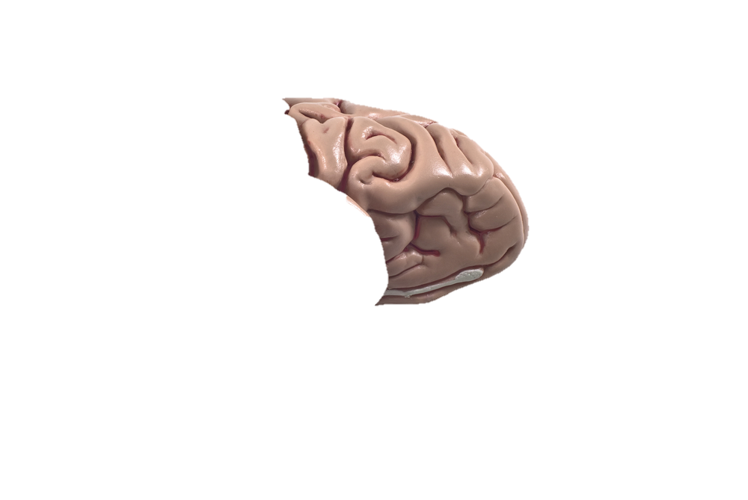
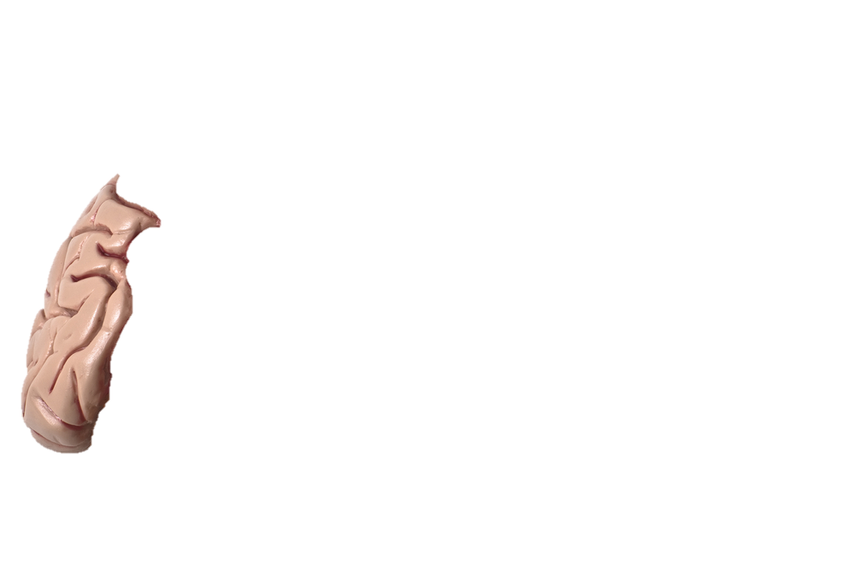
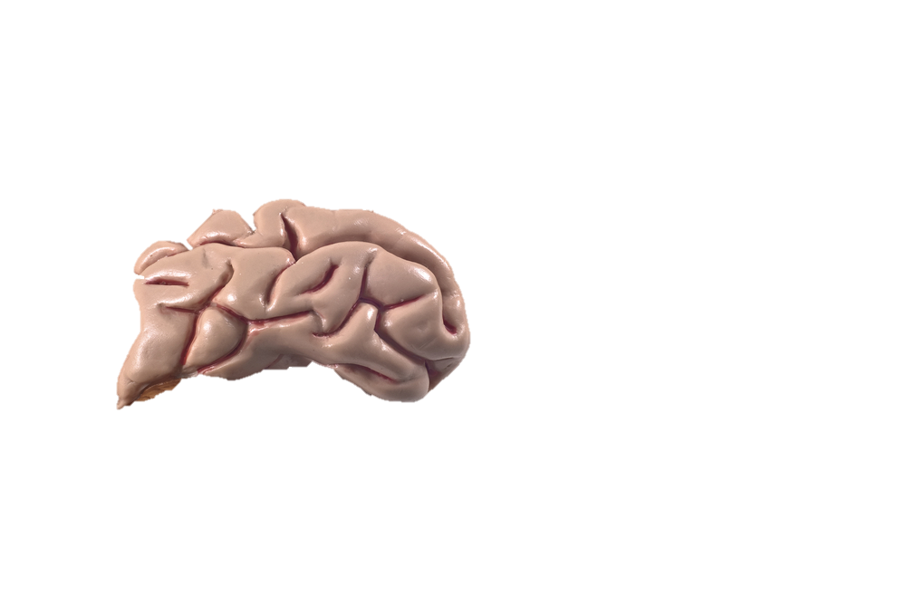

Parietal Lobe
Frontal Lobe
Occipital Lobe
TemporalLobe
Cerebellum
Brain Stem
Spinal Cord

Slide 7

The occipital lobe has the visual cortex.
This is where the signals from the eyes
go to so that you can see.

Slide 8
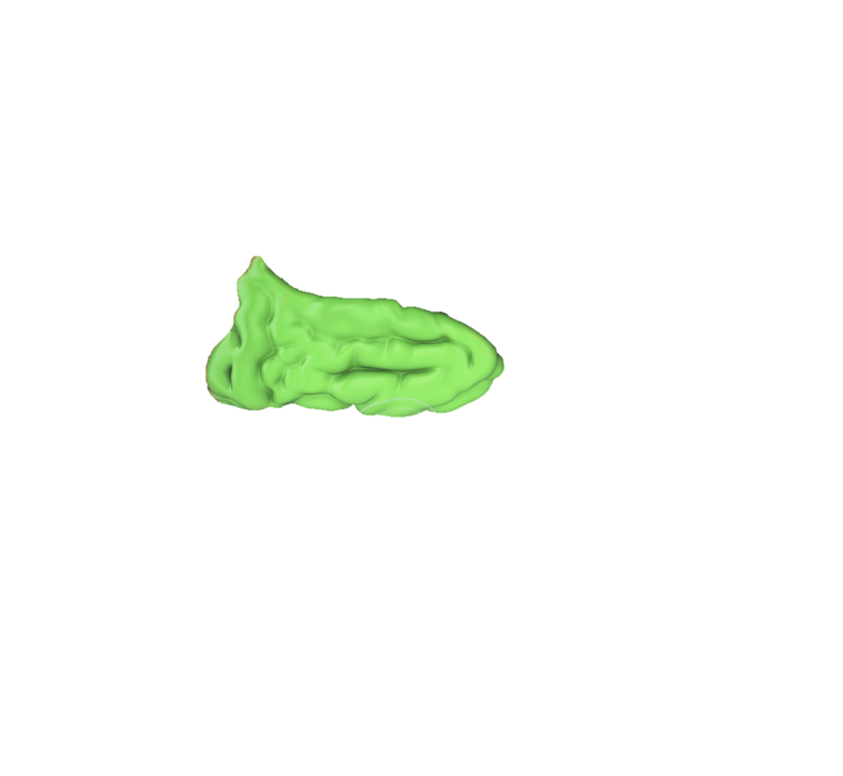
The temporal lobe is mainly responsible for auditory information.
Further into the brain from the temporal lobe is the limbic system, with the hippocampus which facilitates memory formation

Slide 9
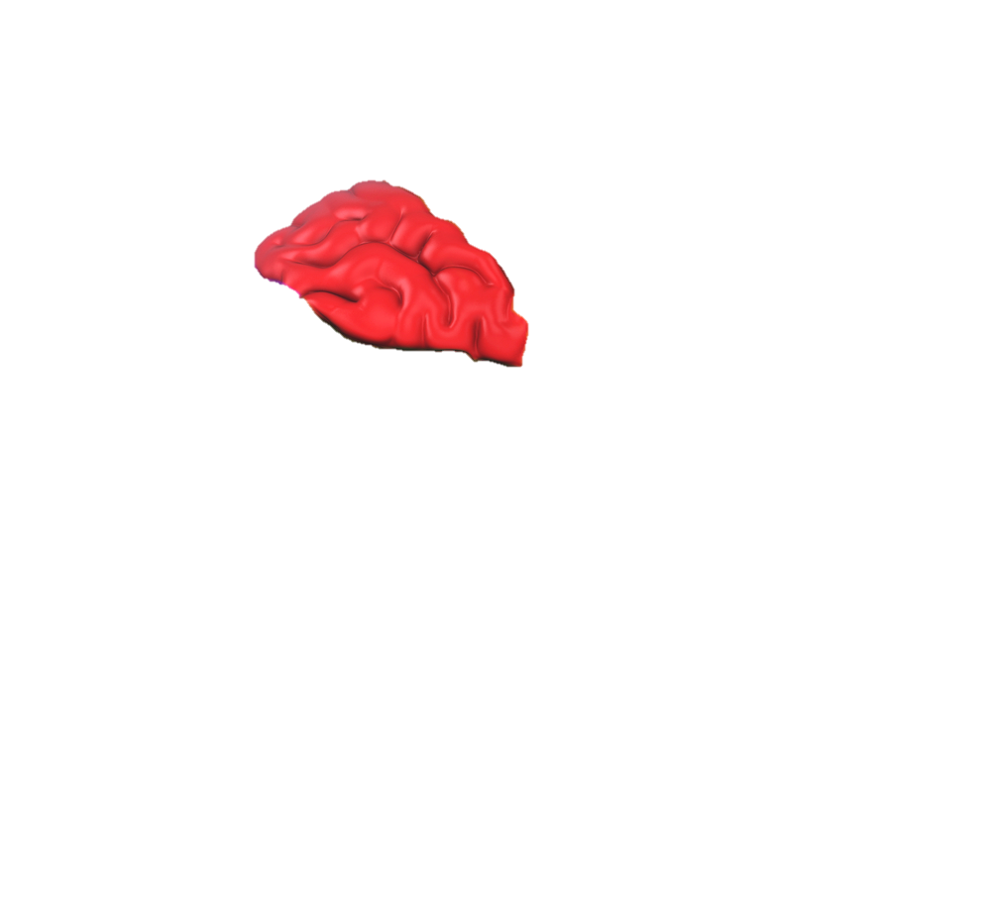
The parietal lobe is involved with sensation and perception.
There is the motor cortex (movement) and the somasensory cortex
(perception of touch)

Slide 10
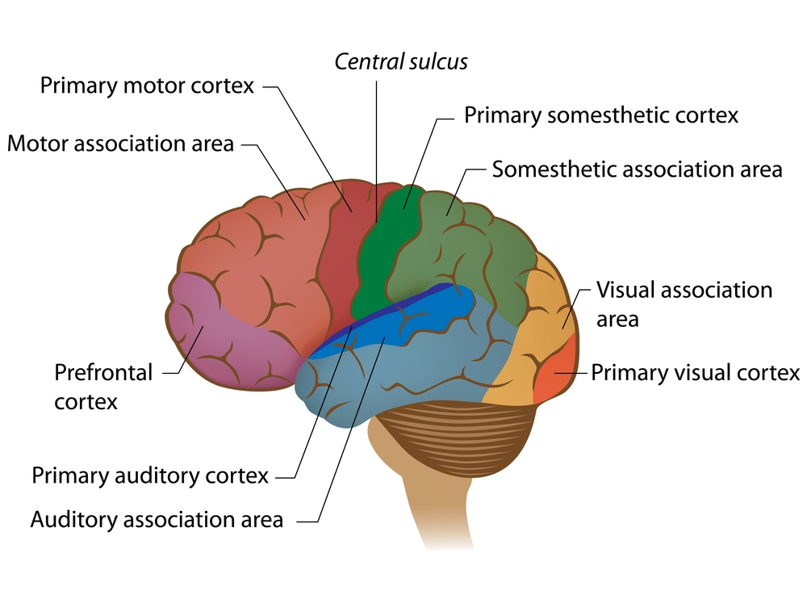
The motor cortex deals with movement
The somatosensory cortex deals with information on touch

Slide 11
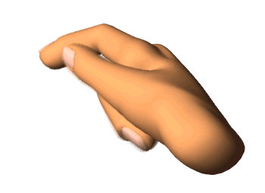

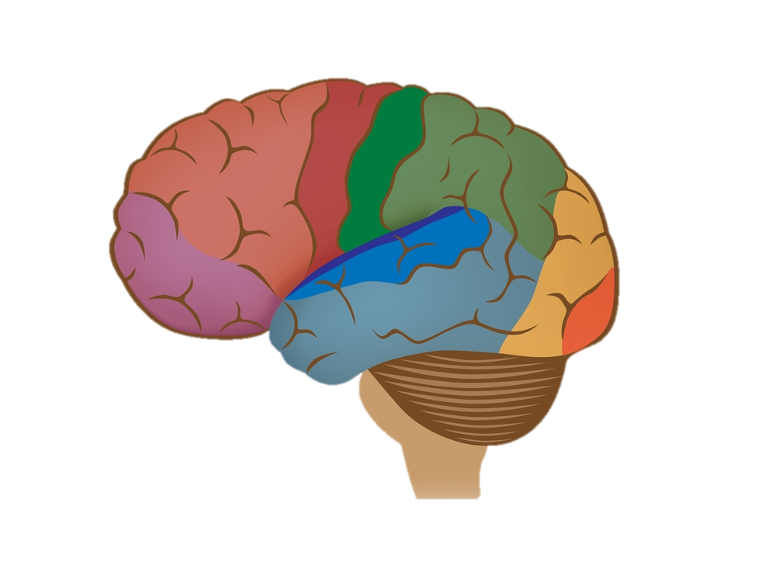



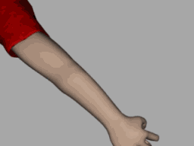
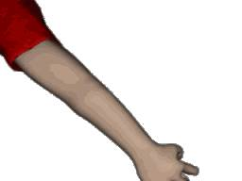
Primary Motor Cortex
Some areas such as the face and fingers have large areas of the motor cortex dedicated to them, others such as the limbs have less. Why?

Slide 12
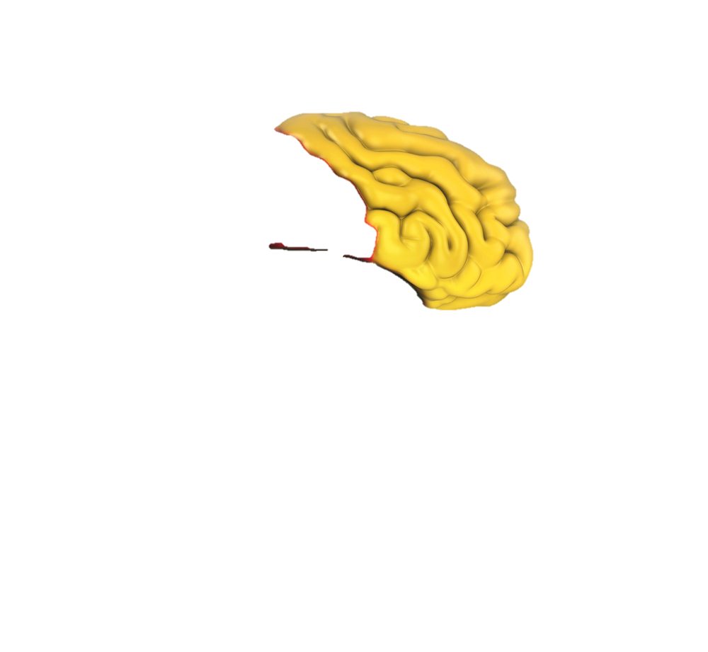
This area is about control (as with the case study of Phineas Gage)
Some also argue it is the home of consciousness.
This area formulates our thoughts from brain activity in all parts of the brain. Schizophrenics are thought to have problems in their frontal lobes.

Slide 13
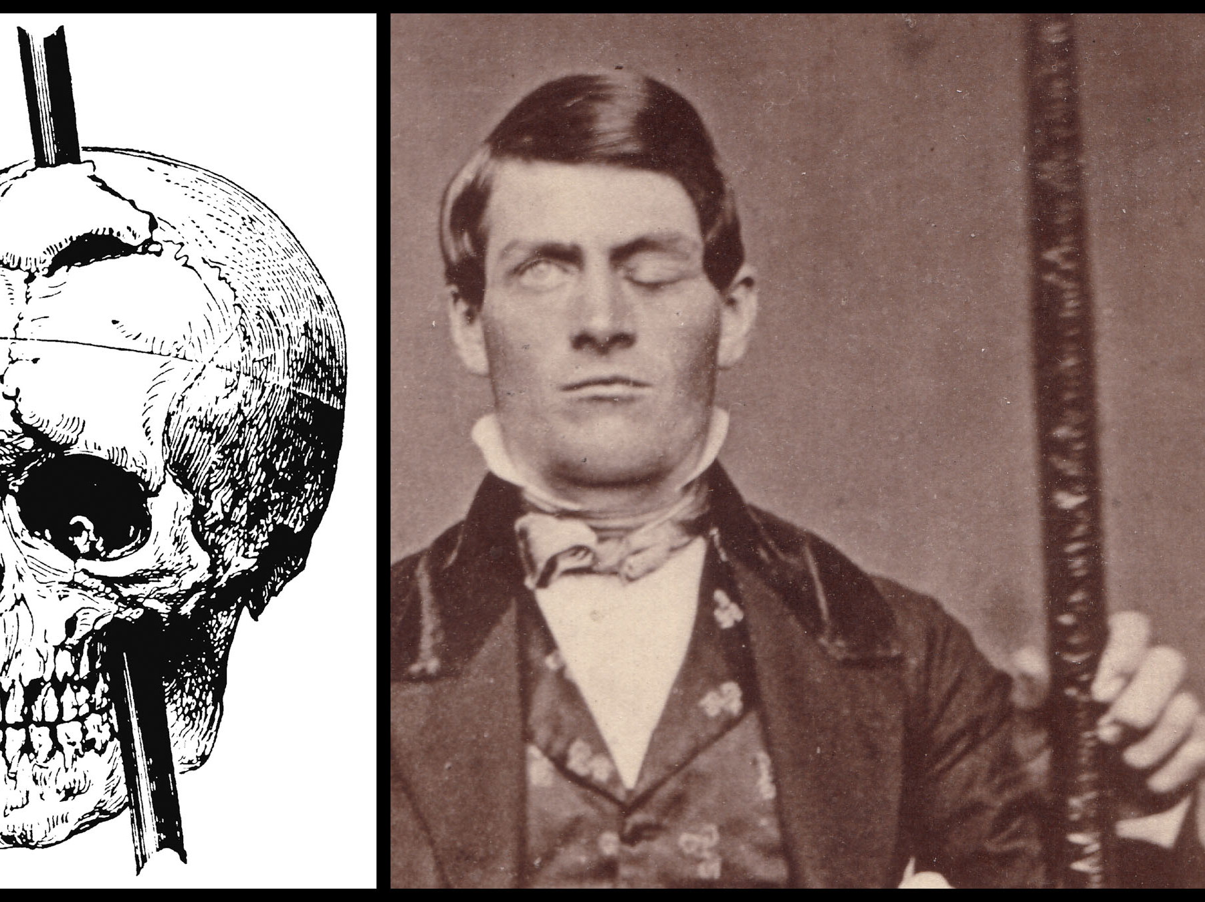
Phineas Gage

Slide 14
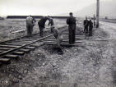
Phineas Gage
September 13th, 1848
Phineas 25 years old
Rutland & Burlington Railroad, Cavendish, VT
Paving the way for new RR tracks
“Tamping Iron”
  1.25in x 3ft

Slide 15


Slide 16


Phineas Gage
Accident
  Quick Recovery
Months later: “No longer Gage”
  Before: capable, efficient, best foreman, well-balanced mind
  After: extravagant, anti-social, liar, grossly profane
Stint with P.T Barnum
Died 12 years later

Slide 17
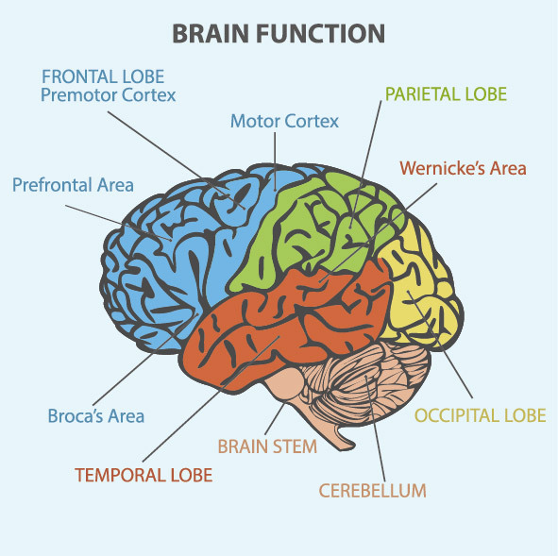
Understanding
Speech production
Most people have language on the left hand side of their brains. Broca’s area deals with producing speech and Wernicke’s area with understanding language

Slide 18
Which areas would be activated if you were
Reading a book out loud to someone?
Listening to Barack Obama's speech on the radio?
Scratching your right arm with your left hand?

Slide 19

Using information from your PHG text book and or revision guide add details to your labelled brain about the different areas of the cortex.
Find out more information about Broca and Wernicke, in particular find out about their patients - write a couple of sentences
Complete the knowledge check questions on page 31 of your PHG revision guide

