Slide 1

Introduction to
Assessment and Command words

Slide 2
What will the exams look like?
What are the examiners looking for?
All of the three ‘A’ Level exams are 2 hours long and contain multiple choice short answer and extended writing questions up to 16 marks. Each paper is worth 96 Marks.
But in order to fully understand the requirements of the exam we need to know how you are being assessed. These are called Assessment Objectives (AO’s) which assess the skills that you need to demonstrate in Psychology.
We will have a look at these now…

Slide 3

Skills, skills, skills….
Create
These are the learning skills we are going to develop and practice in all our lessons.
The more skills you demonstrate on the ladder, the more likely you are to achieve the top grades.
But what do these mean and how do they fit in with Psychology?
Evaluate
Analyse
Apply
Understand
Remember

Slide 4
Remember
Exam Skills + Hard work = Success
There is no short cut to an A* grade

Slide 5
From the specification
Our assessment in A-level Psychology includes questions that allow students to demonstrate their ability to draw together their skills, knowledge and understanding from across the full course of study and provide extended responses.
An ‘extended response’ is evidence of sufficient length generated to allow students to demonstrate their ability to construct and develop a sustained line of reasoning which is coherent, relevant, substantiated and logically structured.

Slide 6
AO’s
Assessment objectives (AOs) are set by Ofqual and are the same across all A-level Psychology specifications and all exam boards.
The exams will measure how students have achieved the following assessment objectives.
• AO1: Demonstrate knowledge and understanding of scientific ideas, processes, techniques and procedures.
• AO2: Apply knowledge and understanding of scientific ideas, processes, techniques and procedures in a theoretical context and in a practical context, also when handling qualitative data and when handling quantitative data.
• AO3: Analyse, interpret and evaluate scientific information, ideas and evidence, including in relation to issues, to be able to make judgements and reach conclusions and to be able to develop and refine practical design and procedures.

Slide 7
Test your understanding…..draw this diagram and place the command word in the appropriate column as we go
AO1 – Understand | AO2 – Apply | AO3 – Analyse & Evaluate

Slide 8
Exam terminology
Recognising key terms is essential

Slide 9

Complete
Finish a task by adding to given information.

Slide 10

Identify
Name or otherwise characterise.

Slide 11

Choose
Select from a range of alternatives.

Slide 12

Select
Choose or pick out from alternatives.

Slide 13

State
Express in clear terms.

Slide 14

Label
Provide appropriate names on a diagram.

Slide 15

Comment
Present an informed opinion.

Slide 16

Name
Identify using a recognised technical term.

Slide 17

Which is
Select from alternatives.

Slide 18

Write
Provide information in verbatim form.

Slide 19

Discuss
Present key points about different ideas or strengths and weaknesses of an idea.

Slide 20

Outline
Set out main characteristics.

Slide 21

Describe
Give an account of.

Slide 22

Compare
Identify similarities and/or differences.

Slide 23

What is meant by
Give a definition.

Slide 24

Explain why
Give a detailed account of reasons in relation to a particular situation.

Slide 25

Consider
Review and respond to given information.

Slide 26

Justify
Provide reasons, reasoned argument to support, possibly provide evidence.

Slide 27

Calculate
Work out the value of something.

Slide 28

Analyse
Separate information into components and identify their characteristics.

Slide 29

Suggest
Present a possible case/solution.

Slide 30

Give
Produce an answer from recall or from given information.

Slide 31

Evaluate
Judge from the available evidence.
Weigh up different points of view

Slide 32

Distinguish
Explain ways in which two things differ. Provide detail of characteristic that enable a person to know the difference between …

Slide 33

Explain
Set out purposes or reasons.

Slide 34

Explain how
Give a detailed account of a process or way of doing something.

Slide 35

Draw
Produce a diagram or a graph

Slide 36

Design
Set out how something will be done. Design a piece of research – give the stages

Slide 37

Understanding the exam question is essential to exam success

Slide 38

Candyman
Define (what is it?)
Describe
Compare/contrast to another
Evaluate – strengths and weaknesses
This Photo by Unknown Author is licensed under CC BY-SA

Slide 39

Definition
lol·li·pop
Noun
A confection consisting of a
piece of hard candy attached to the end of a small stick.
This Photo by Unknown Author is licensed under CC BY-ND

Slide 40
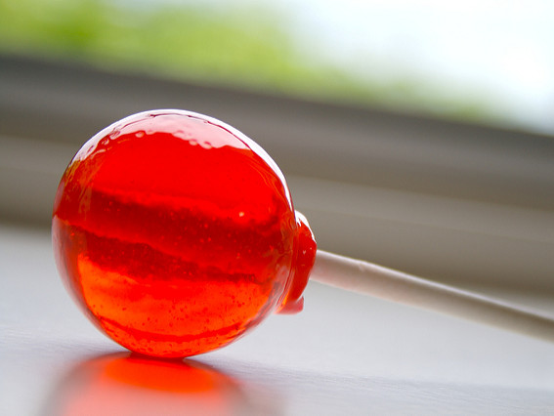
Describe
This lollipop is made of hard boiled sugar. It is red and shiny. It tastes of sweet strawberries and is sticky to touch. It is a spherical shape and the size of a large marble.
Make at least 6 points
This Photo by Unknown Author is licensed under CC BY-SA

Slide 41

Compare and contrast
Both lollipops are of similar size however one is spherical whereas the other is an oblong shape. They are similar in as much as they are both on plastic sticks which are white in colour. However the rectangular lollipop is covered in a brightly coloured plastic wrapper whereas the spherical one is wrapped in a clear covering. Both taste very sweet and both are sticky. The lollipops are different in that one is chewy however whilst the other is hard and can be crunched not chewed.
Use connectives and the language of comparison

Slide 42
Evaluate
A strength of having a lollipop is that they are an inexpensive treat that anyone can afford.
For example, you can buy a whole multi pack of lollipops for 99p.
In fact the lollipops teachers buy for their students are often even cheaper as most teachers buy in bulk.
Being so inexpensive means everyone can enjoy lollipops and give them to their friends as gifts without feeling guilty which means joy is added to the world.
Point Example Extra detail Which means

Slide 43
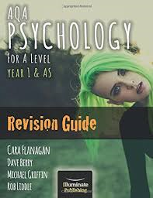

Pages 4-9 GHG
Read the section on exams advise
Pages 4-9 PHG

